Slide 1


Freud Sanitary Pump Station
09/17/25

Slide 2
Agenda
System Background
Freud Improvements
  Why is GLWA proposing a Sanitary Pump Station?
  Why was the location chosen?
  Why will Freud St be rerouted?
Design Review
  Design Alternatives
  Exterior Design
Project Progress
  Where are we at?
  What’s next?
Conner Creek Improvements
  System Background
  Storm Station Improvements
  Why is GLWA proposing a new Sanitary Pump Station?
  Where will the new Sanitary Pump Station be located?
  What’s next?
Questions

Slide 3


System Background

Slide 4
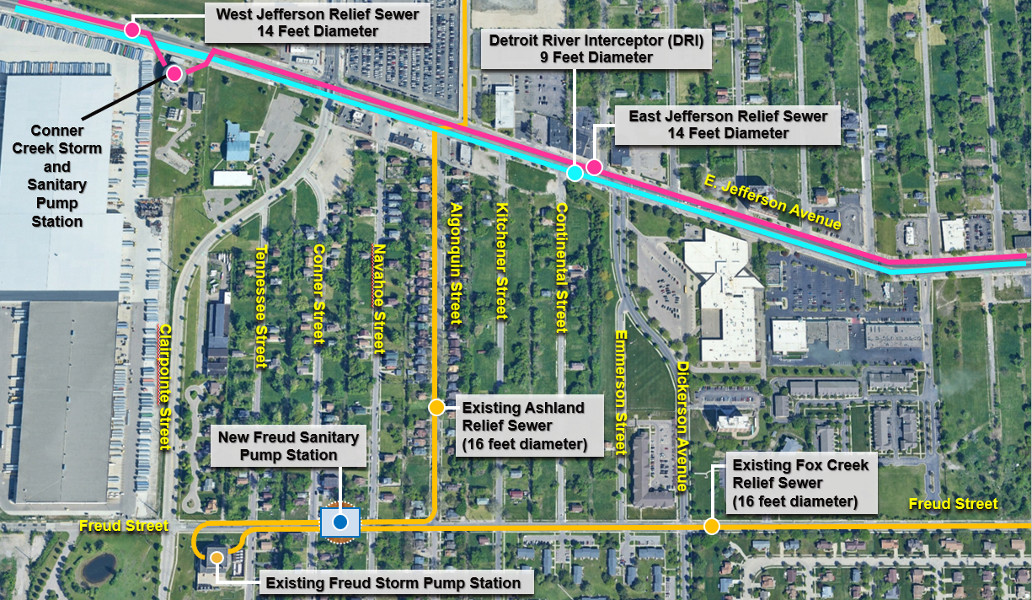
System Background
Notes:
Conner Creek Pump Station – 1929
Storm - 8 Pumps - Total 2,584 MGD
Sanitary - 4 Pumps - Total 215 MGD
Freud Pump Station – 1955
Storm – 8 Pumps – Total 2,325 MGD
Dewatering – 2 Pumps – Total 36 MGD

Slide 5
Freud Improvements

Slide 6
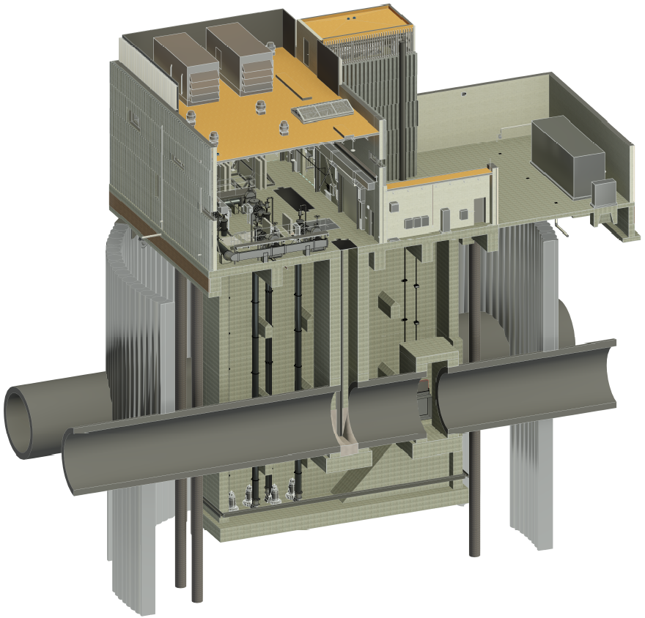
Why is GLWA Proposing a Sanitary Pump Station?
Improve the Reliability of Freud Storm Pump Station
  Cleaning
  Inspection
  Maintenance
  Rehabilitation
Maximize GLWA’s ability to keep sewer water levels low during rain events
Help prevent basement backups
Notes:
The new Sanitary Station will allow for the isolation of the existing Storm Station to allow for cleaning, inspection, and maintenance that isn’t currently feasible.
- Safety standards are much different than in 1955.
- Bypass pumping would be continuously invasive and disruptive to the neighborhood.
Keeping the existing Storm Station in top running condition allows GLWA to better manage the sewer water levels and respond to rain events.

Slide 7
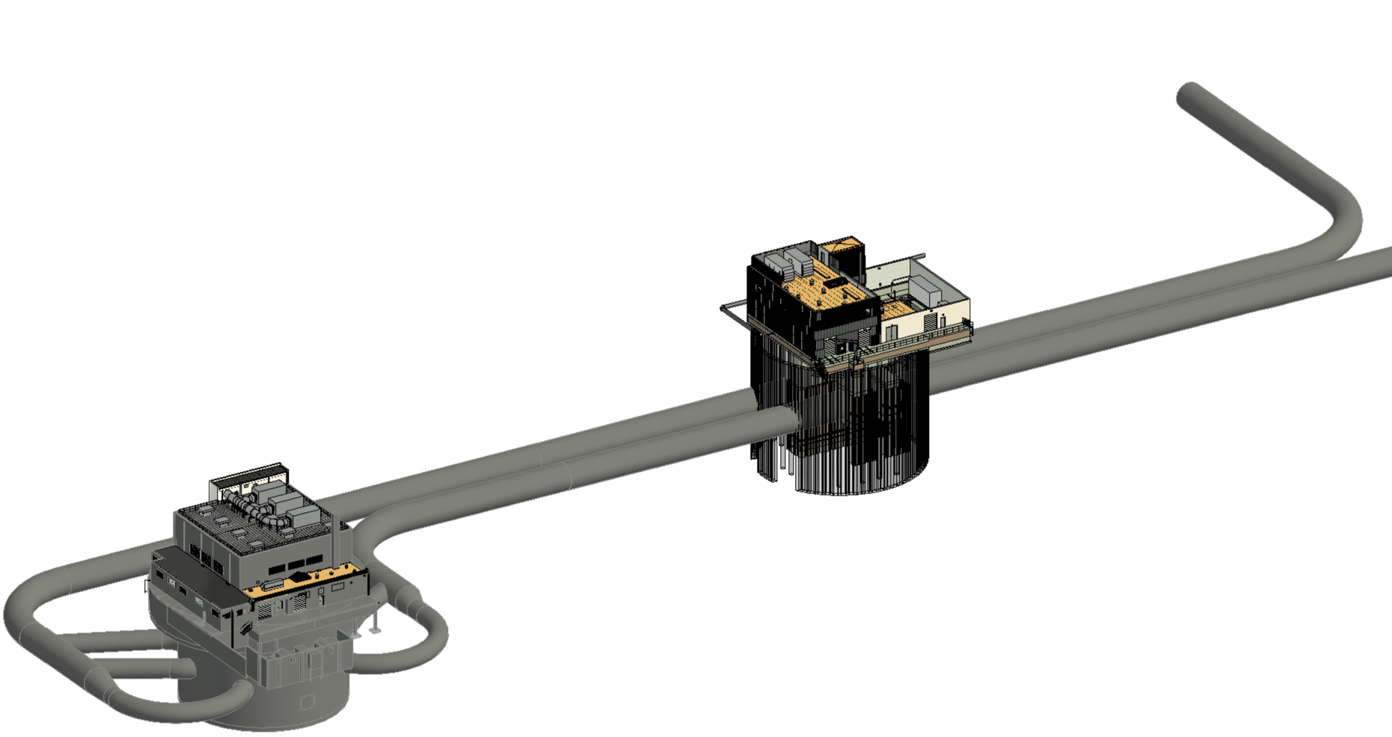

Why is GLWA Proposing a Sanitary Pump Station?
Ashland Relief Sewer
To DRI
Fox Creek Relief Sewer
Freud Sanitary Pump Station
Freud Storm Pump Station
Notes:
Wet Weather Flow will pass through the station.
Dry Weather Flow will enter the station and be pumped to the DRI.

Slide 8
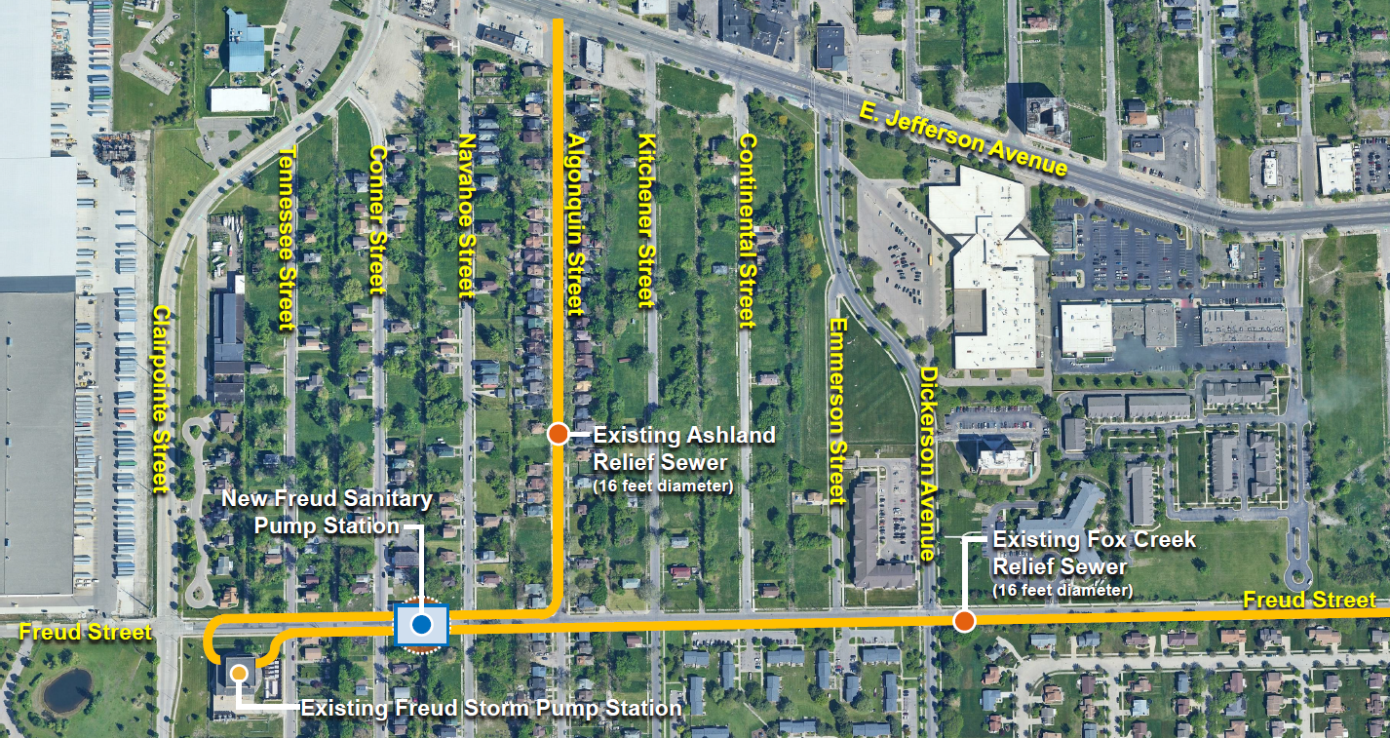
Why Was The Location Chosen?
Notes:
There is a small window between Tennessee & Algonquin where the Ashland & Fox Creek Relief Sewers run in parallel and allow for the construction of one station instead of 2 separate stations.
Construction of the Sanitary Station in between Conner & Navahoe means that no residents need to be displaced.

Slide 9
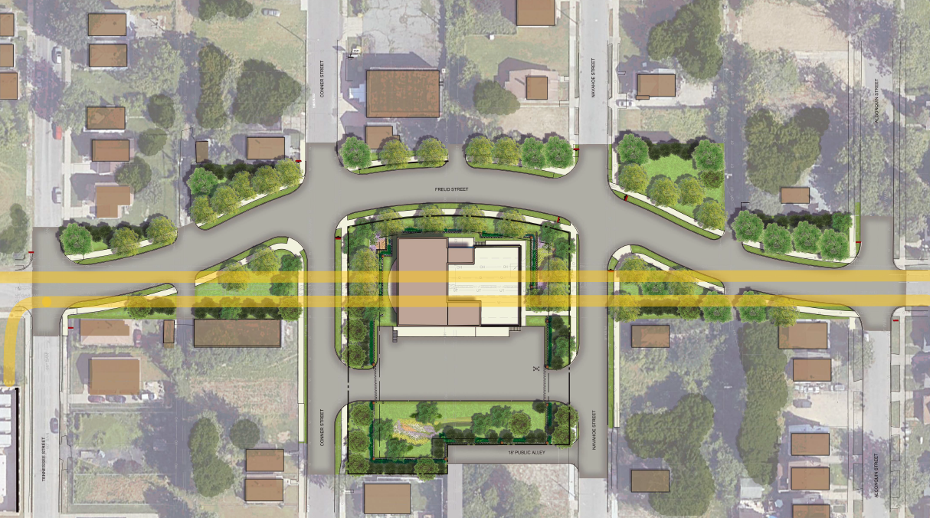
Why Will Freud St Be Rerouted?
Notes:
Freud St will need to be rerouted as both the Ashland & Fox Creek Relief Sewer are located directly below Freud St and the Sanitary Station needs to be located directly above both sewers.
Freud will be rerouted around the new Sanitary Station instead of creating a dead end.
Additional questions may revolve around road closures.
- Freud, Conner, & Navahoe are currently scheduled to be closed for the full duration of the project (i.e. 4 years).
- We’re currently working with Kokosing to reduce the Freud closer to a shorter duration (i.e. 2 years).
- Kokosing is planning to install a walking path to maintain safe foot traffic between the south side of Freud, Conner, & Navahoe.

Slide 10
Design Review

Slide 11
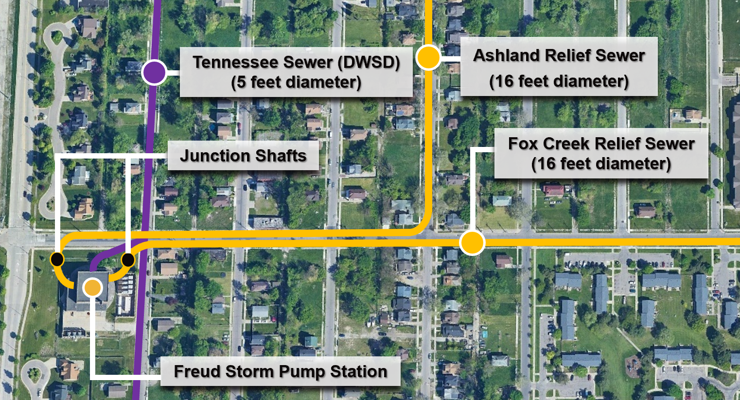
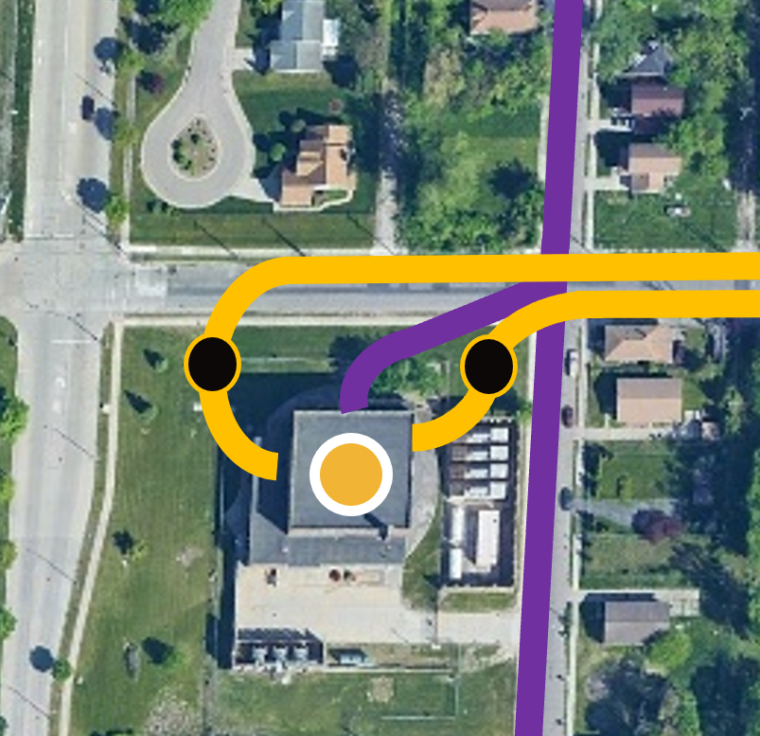
Design Alternative #1
DWSD – Detroit Water and Sewerage Department
Notes:
Install Isolation Structures on the existing station property.
Doesn’t allow for handling of dry weather flows when station is isolated.

Slide 12
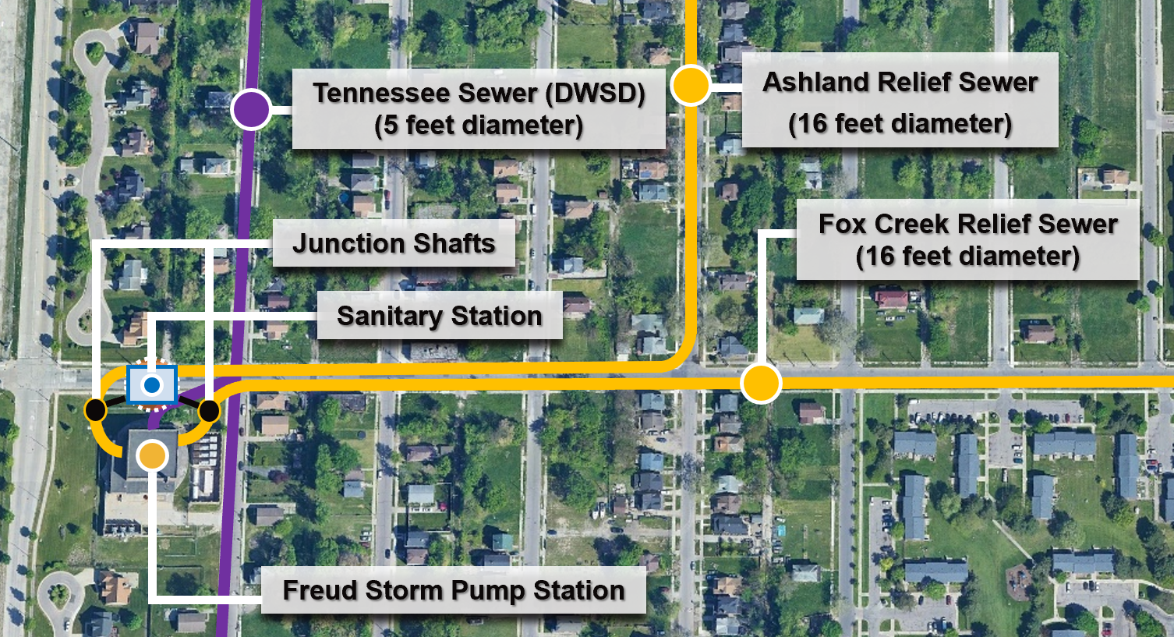
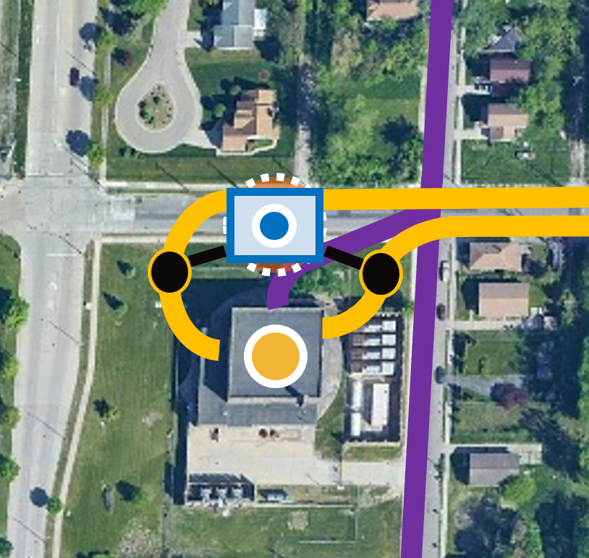
Design Alternative #2
DWSD – Detroit Water and Sewerage Department
Notes:
Install Isolation Structures on the existing station property & a Sanitary Station immediately adjacent to the property.
Would result in Freud St being closed permanently between Clairpointe & Tennessee.

Slide 13
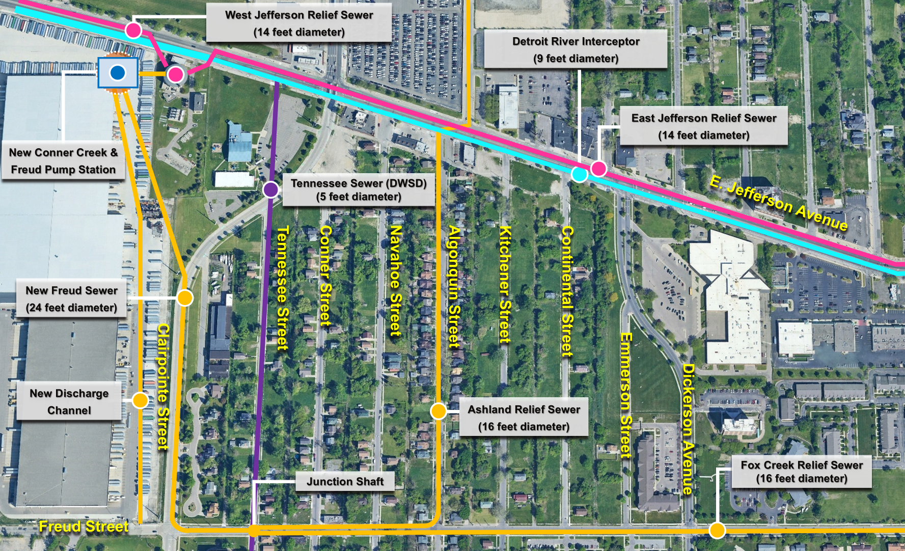
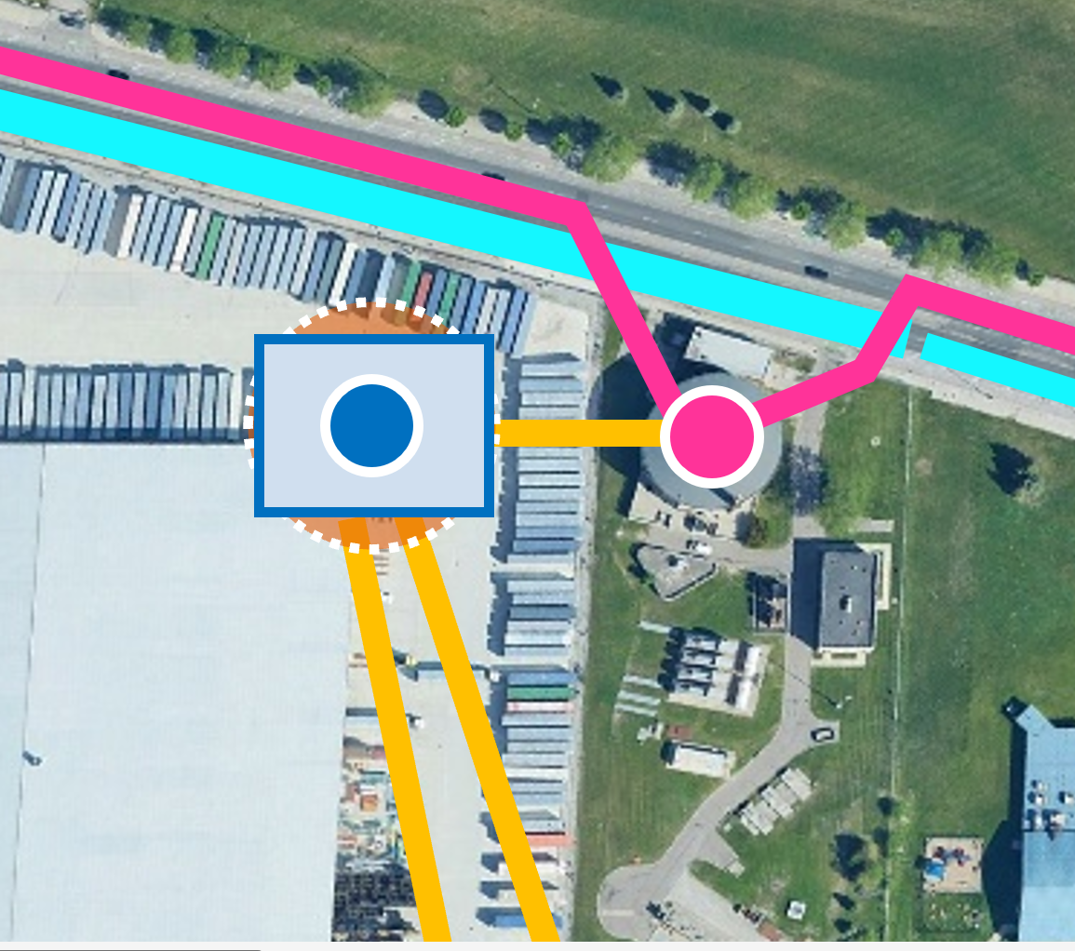
Design Alternative #3
DWSD – Detroit Water and Sewerage Department
Notes:
Install a Junction Shaft for the Ashland & Fox Creek Relief Sewers that would combine the two into a single large diameter tunnel feeding a new combined Conner Creek & Freud Pump Station w/new Discharge Channel.
Option was found to be excessively costly >$1B.

Slide 14
Why was a Variation of
Alternative 2 Selected?

Slide 15
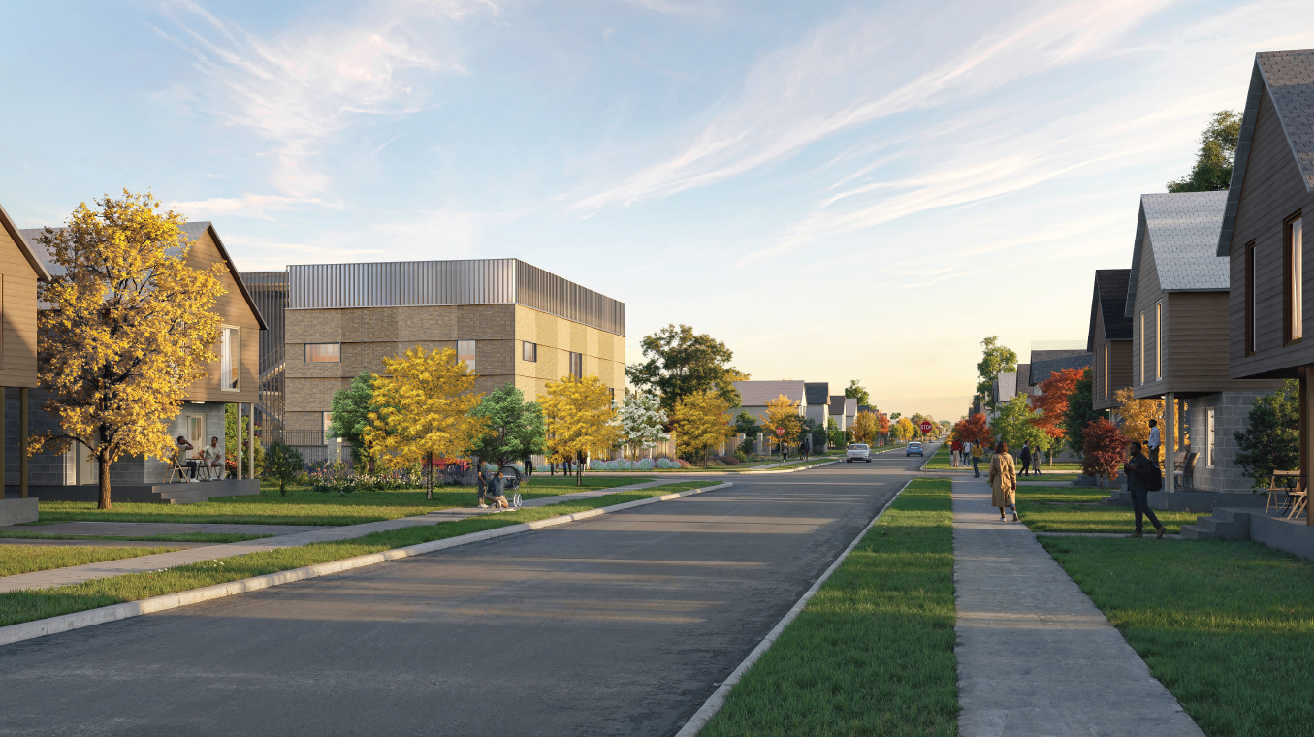
Exterior Design – Conner Street View

Slide 16
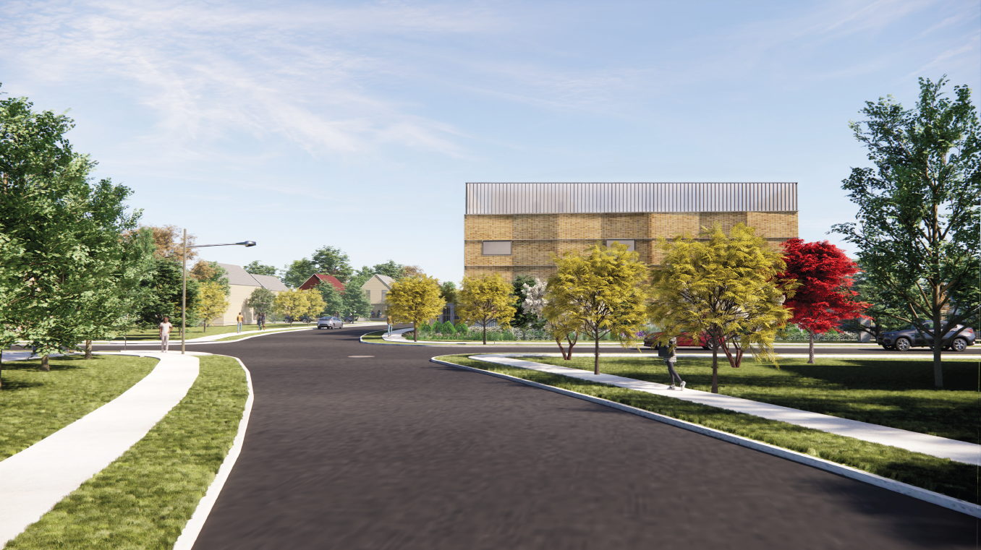
Exterior Design – Freud Street View

Slide 17
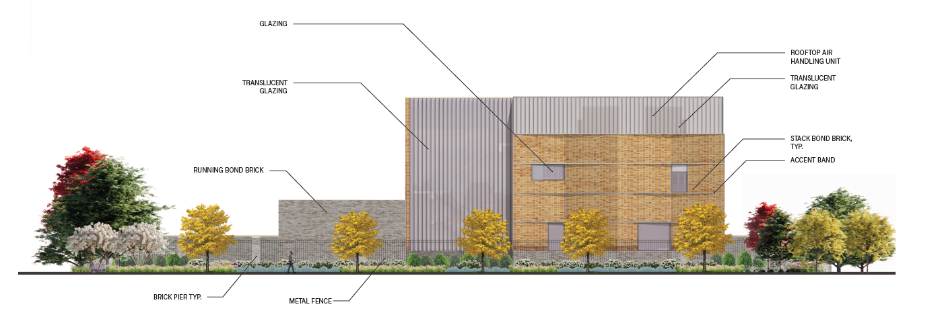
Exterior Design – North Elevation

Slide 18
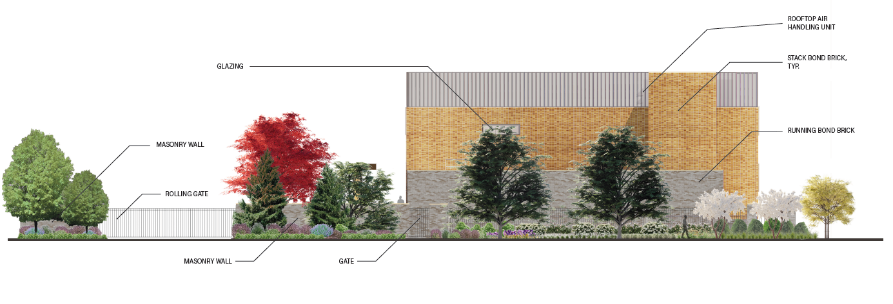
Exterior Design – East Elevation

Slide 19
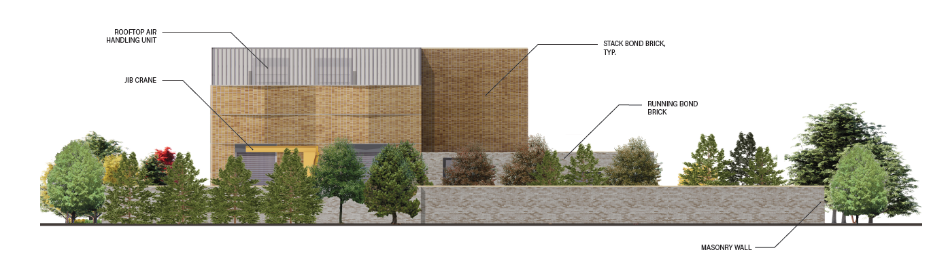
Exterior Design – South Elevation

Slide 20
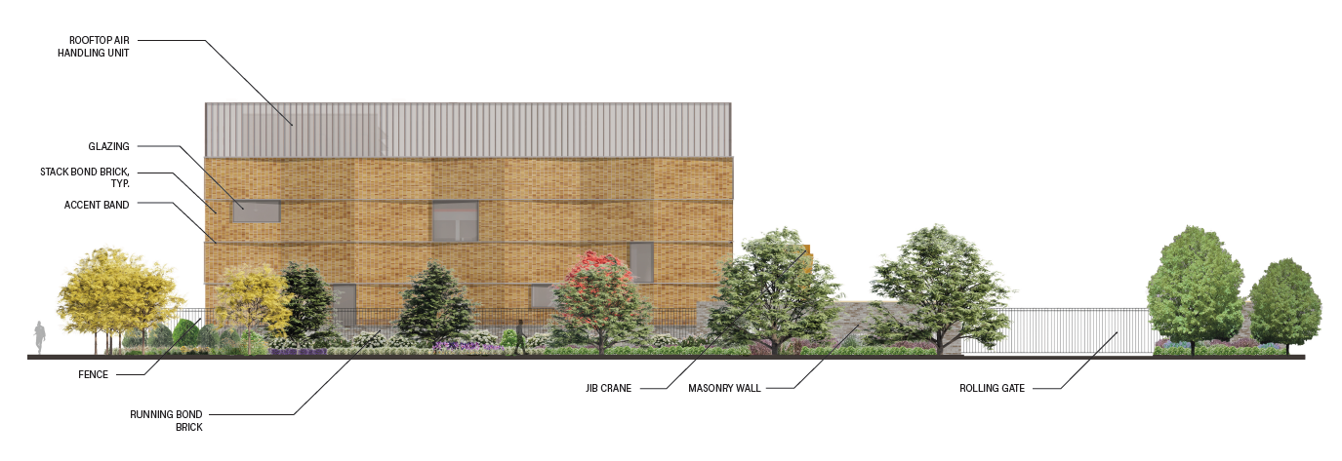
Exterior Design – West Elevation

Slide 21
Project Progress

Slide 22
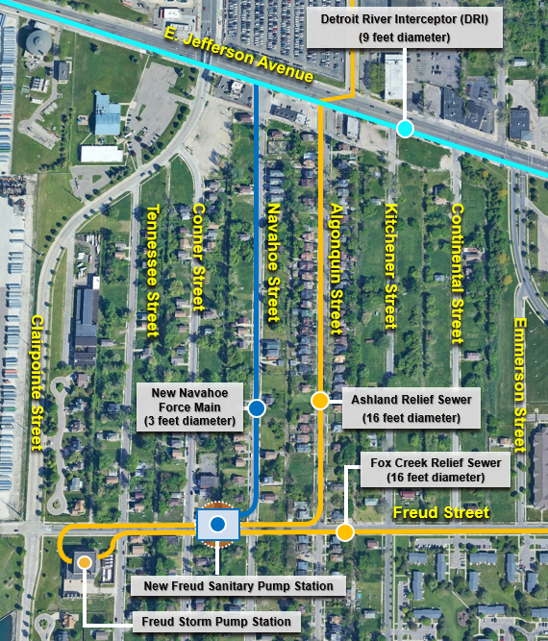
Where are we at? – Construction
Utility Relocations Complete
DRI Structure Installation
  Traffic Shift
  May-December
36” Force Main Installation
  Navahoe St
  August-December
Rezoning
Notes:
Utility Relocation
Gas – Complete in February
Electric – Complete in March
Communication (6) – Complete in March
Rezoning
11/21/24 – CPC Public Hearing
01/16/25 – CPC Public Hearing
06/05/25 – CPC Meeting
Additional CPC Meetings?/City Council Meeting?
Bypass Pumping system in place for Sewers during relocation.
Water supplied by Essex Line during relocation.
Utility Relocation - New utilities in place before removal of existing utilities.
Sewer – February
Water - March
Communication – February/March
Freud Street Closure
Dependent on Traffic Study\MOT Approval – January
GLWA to send out notice & social media at least one week ahead of time.
Freud Sanitary Station
Site Setup
Force Main – March
Locate 16’ Sewers - April
Freud Storm Station
Construction activities mostly internal ongoing.

Slide 23
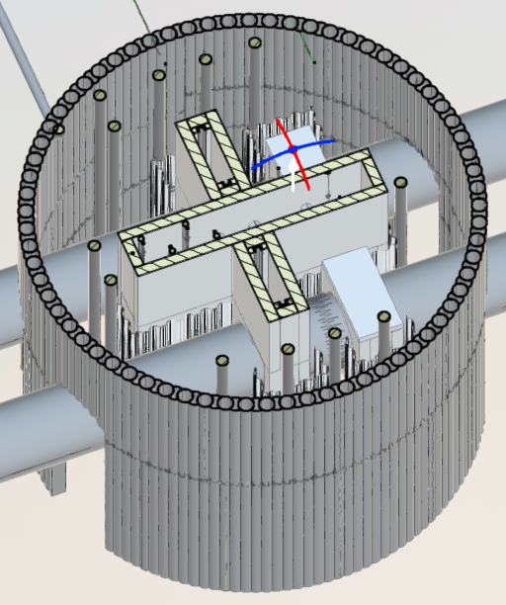
What’s next? – Construction
Rezoning
  City Planning Commission
  Planning & Economic Development Committee
  City Council
Secant Pile Installation
Shaft Excavation

Slide 24
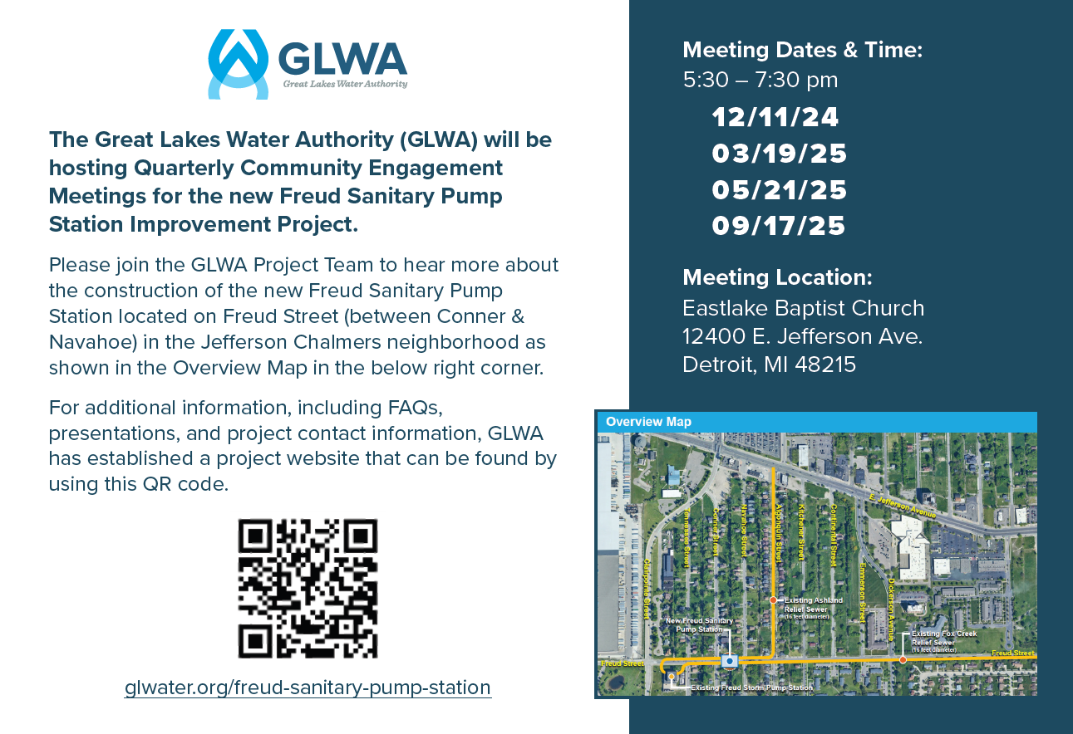

What’s next? – Quarterly Meetings

Slide 25

What’s next? – Communication
Website - www.glwater.org/freud-sanitary-pump-station
QR Code -
Email - freudsanitarypumpstation@glwater.org
Phone
  GLWA - (313) 822-7007
  Kokosing - (313) 960-7687
Mailers
Social Media
Notes:
Website
FAQ’s, Map, Meeting Schedule, Presentations, & Contact Info
Email & Phone
Messages returned in a timely manner
Mailers
Yearly – Schedule of Community Update Meetings
Traffic Impacts\Abnormal Project Activities – Minimum of one week
Social Media
Traffic Impact– Minimum of one week

Slide 26
Conner Creek Improvements

Slide 27
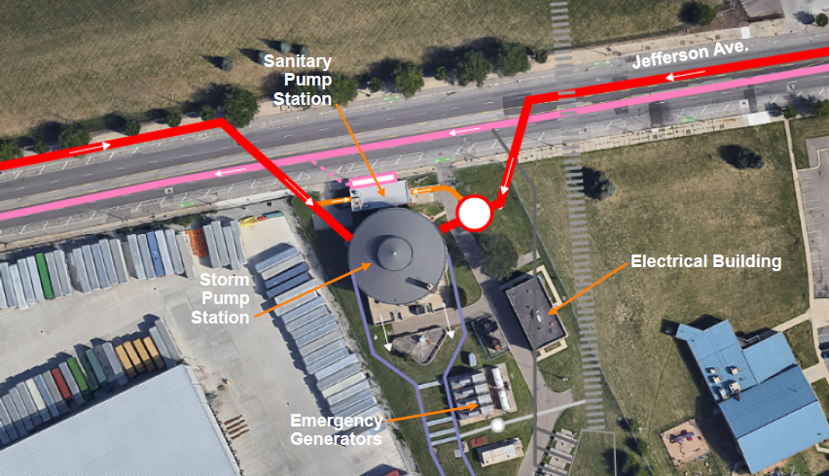
System Background

Slide 28
Improvements to the Storm Station
New Isolation Gates
Isolation Gate Installation
  East Jefferson Relief Sewer
  West Jefferson Relief Sewer
Storm Pump Replacements

Slide 29
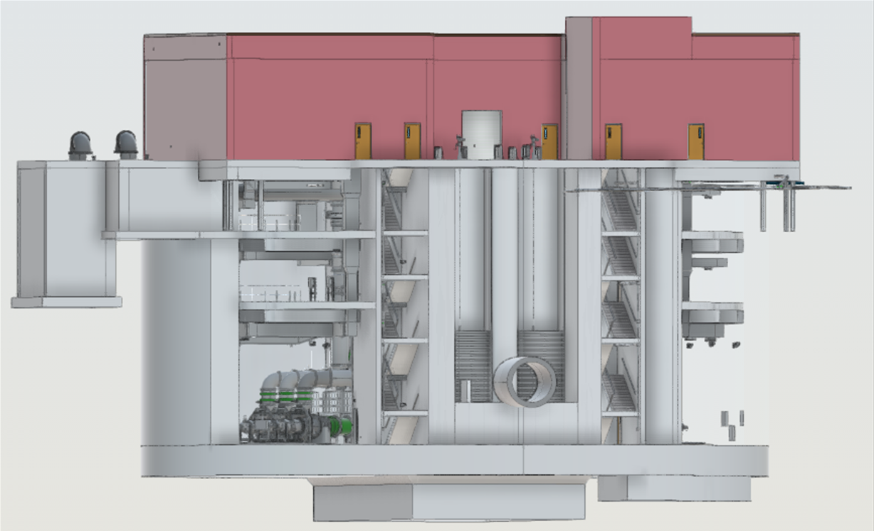
Why is GLWA proposing a new Sanitary Pump Station?
Improve Reliability
  Cleaning
  Inspection
  Maintenance
Existing Limitations
160 MGD Firm Capacity
    53 MGD Average Flow
    148 MGD Peak Flow
N+2 Configuration
Notes:
Existing Station Limitations
4 Pumps - 145 MGD Firm/215 MGD Total Capacity
Small Wet Well
Pump Isolation/Maintenance Issues

Slide 30
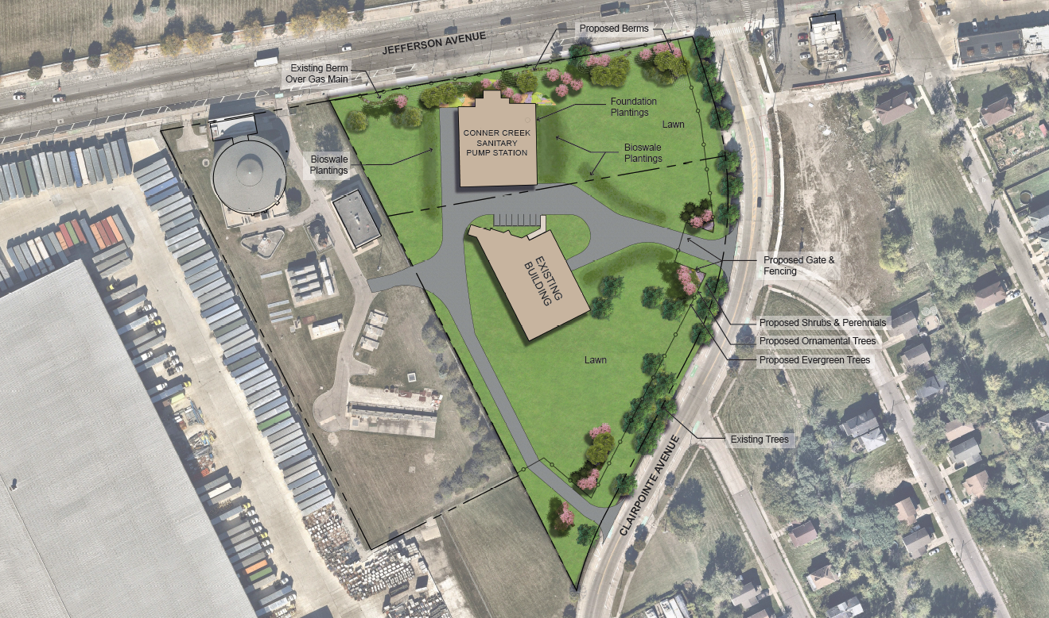
Where will the new Sanitary Pump Station be located?
Notes:
Existing Station Limitations
4 Pumps - 145 MGD Firm/215 MGD Total Capacity
Small Wet Well
Pump Isolation/Maintenance Issues

Slide 31
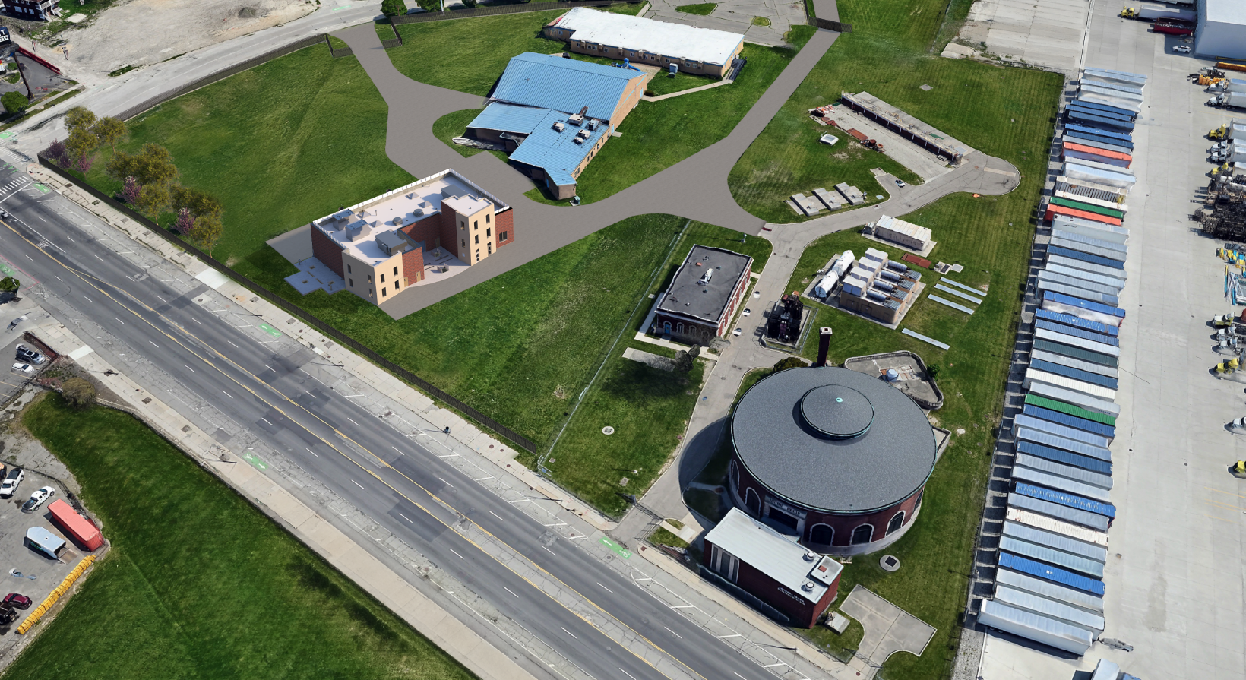
Where will the new Sanitary Pump Station be located?
Notes:
Existing Station Limitations
4 Pumps - 145 MGD Firm/215 MGD Total Capacity
Small Wet Well
Pump Isolation/Maintenance Issues

Slide 32
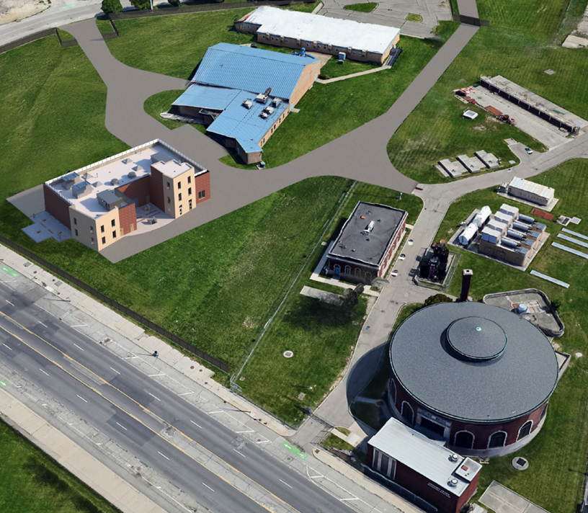
What’s next?
Quarterly Meetings
Additional Meetings
  District 4
    Councilmember Johnson
    Community Advisory Council
    Department of Neighborhoods
Preliminary Plan Review
Exterior Design
Notes:
07/31/25 - Preliminary Plan Review Meeting
2026-2029 – Construction
03/18/25 – 90% Design Workshop
12/11/24 – Quarterly Community Engagement Event
12/05/24 – Introductory Meeting
10/02/24 – 60% Design Workshop

Slide 33
Questions

Slide 34
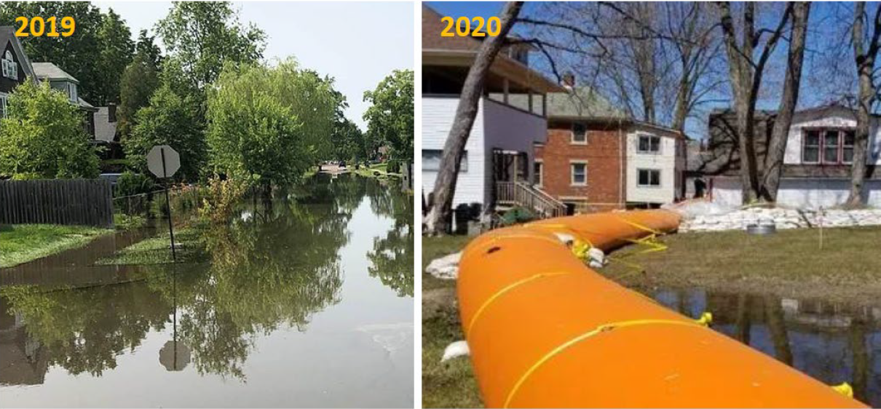
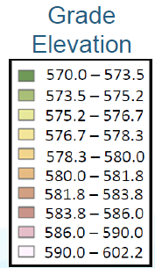
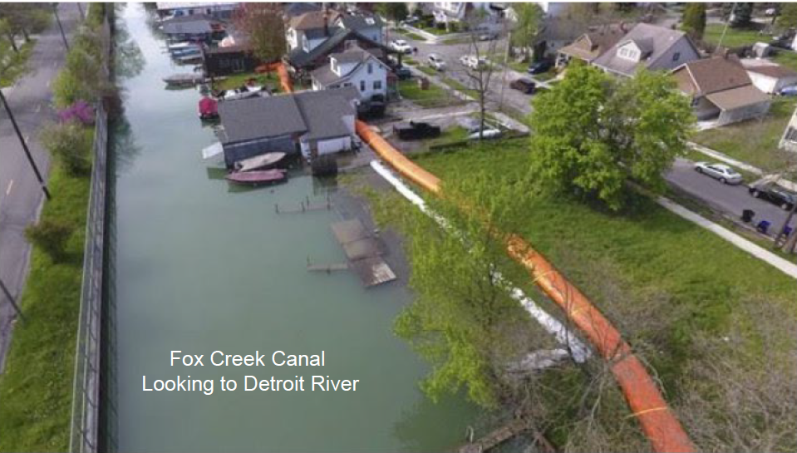
Jefferson Chalmers Topography Relative to Detroit River Levels
5 to 7 ft below Max River Level of 578

Slide 35
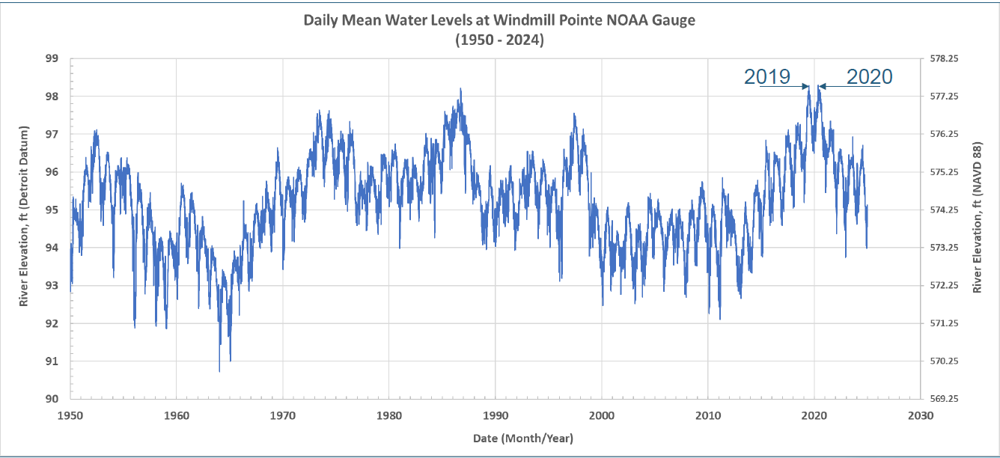
Jefferson Chalmers Topography Relative to Detroit River Levels
2019 & 2020 River Levels reached 577.50
GLWA system protected Jefferson Chalmers Community by removing over 1 Billion Gallons of water from River Inflow
The Freud Pumpstation operated 50% more in run hours in 2019/2020 compared to the average of 2017-2024

Slide 36
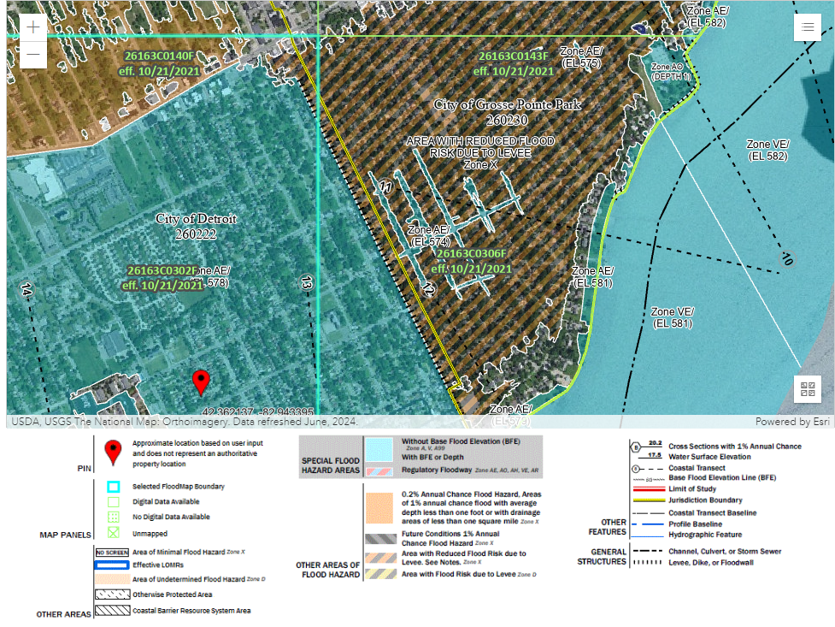
East Side System FIRMs
Special Flood Hazard Areas
Area with reduced
flood risk due to levees
Flood Plain Designation Jefferson Chalmers in 2021
FEMA : Federal Emergency Management Agency
FIRMs: Flood Insurance Rate Maps
FEMA Flood Map Service Center | Search By Address
Notes:
Flood plain designation is related surface water flooding and coastal flooding not pluvial flooding. Using the map as an example for the 2021 rain event both locations on the map were significantly overwhelmed by the rain precipitation however, the designation for gross point remains protected based on Levee. In May of 2022 CITY of Detroit in partnership with US Army Corp attempted to present alternatives to achieve similar designation as Gross Point Park shown on the image however the alternativities were not successful.
Both communities experienced similar flooding and precipitation from the 2021.
Here are screenshots from the 2012 FEMA maps (the previous version before 2021). As I mentioned the remapping process for Wayne County started maybe around 2014 or 2015 and the new maps came out in 2021. The remapping had absolutely nothing to do with the high lake levels in 2019-2022. It also has nothing to do with stormwater. The FEMA maps do not consider stormwater flooding at all.

Slide 37
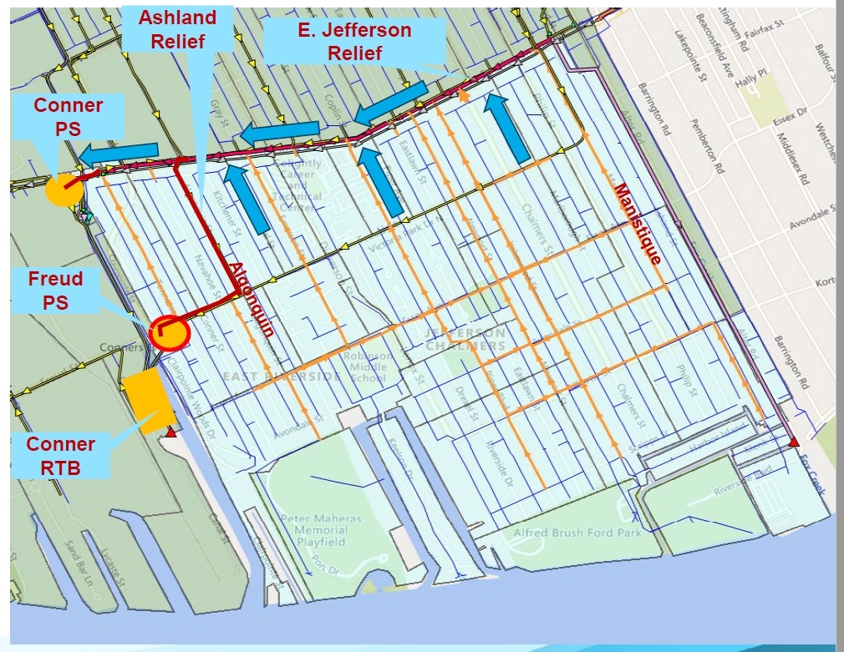
Dry Weather Flow
Notes:
E. Jefferson Relief Sewer receives dry weather flow from Jefferson Chalmers and conveys it to Conner PS
Dry weather flow is pumped to the DRI via Conner PS

Slide 38
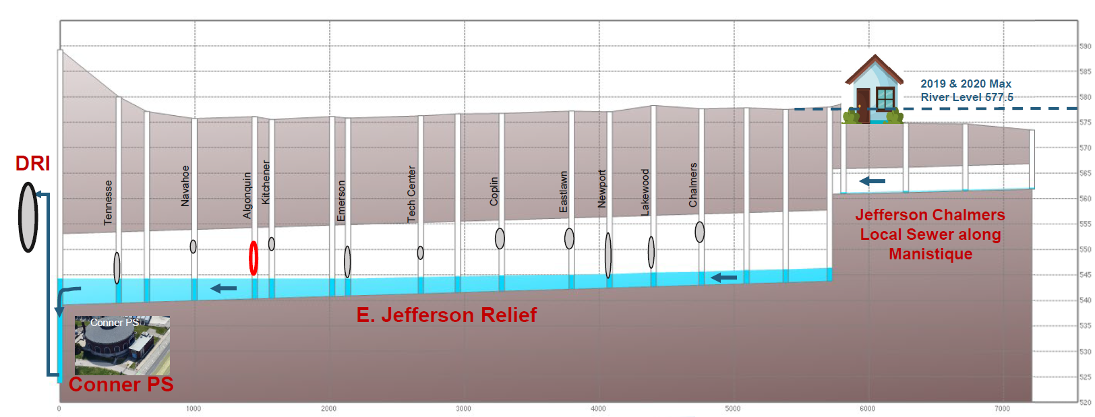

Dry Weather Flow
Jefferson Chalmers Sewer Connection
Notes:
Dry Weather Flow
Daily Average – 2.5 MGD
Annual – 910 MG

Slide 39
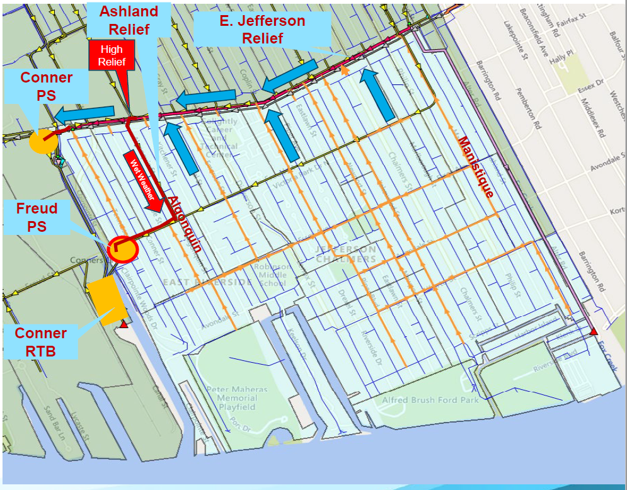
Wet Weather Flow
Notes:
E. Jefferson Relief and Ashland Relief Sewers receive combined (dry and storm) flows from Jefferson Chalmers
Combined flow is delivered to DRI and Conner RTB via Conner and Freud PSs

Slide 40
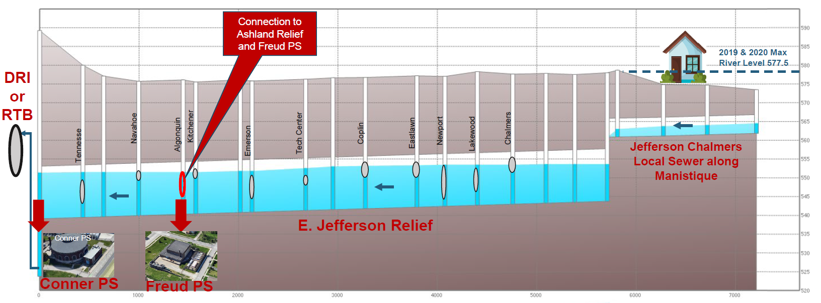
Wet Weather Flow
Recent Strom Water Reached 554 elev. (74.7 Detroit Datum)
Flow Divert to Freud @ 545 elev. (65.7 ft Detroit Datum)
Jefferson Chalmers Sewer Connection
Notes:
Wet Weather Flow
Daily Average – N/A MGD
Annual – ~400 MG (rain dependent)
River Inflow (2019/2020)
Daily Average (72 Days) – 13 MGD
Total (72 Days) – 930 MG

Slide 41
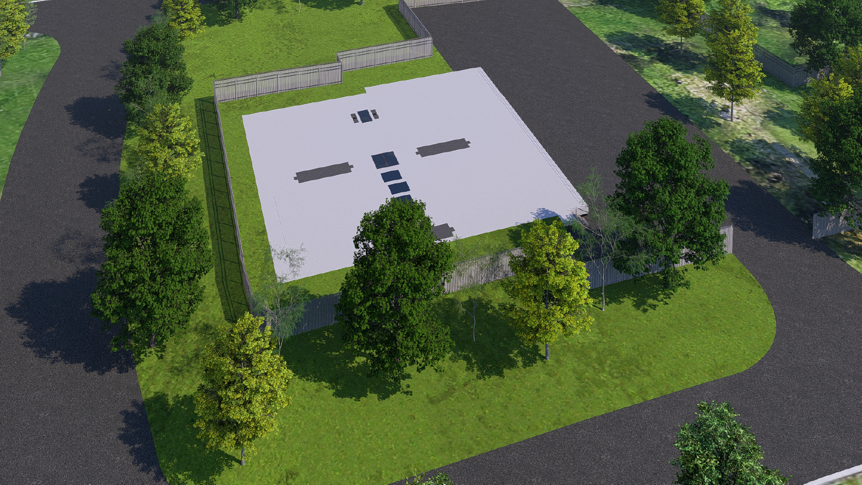
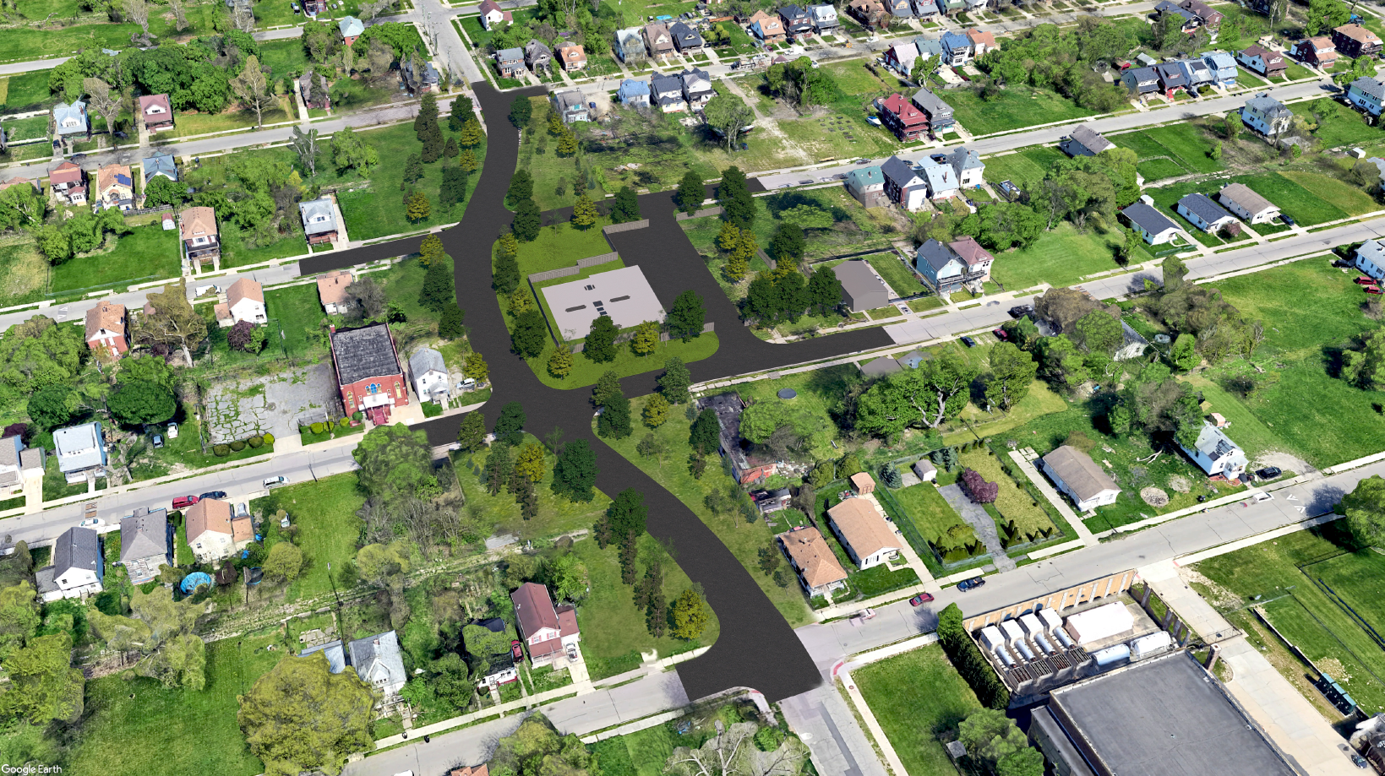
No Station Option – Overhead View

Slide 42
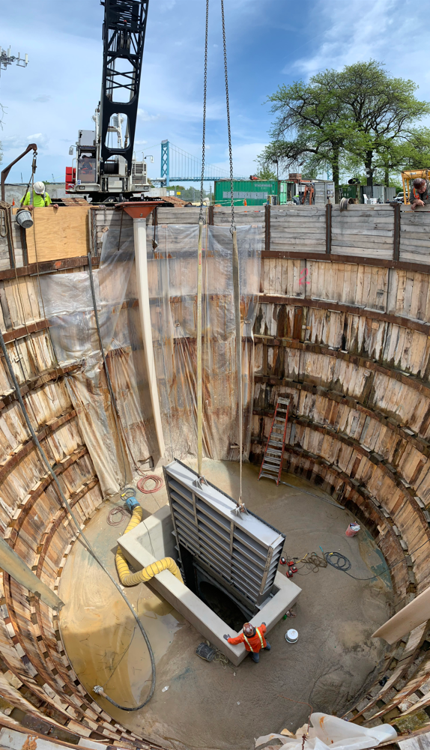
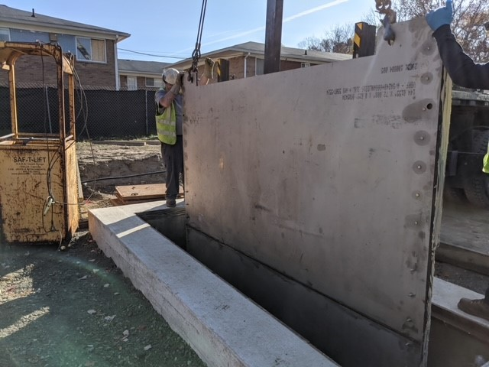
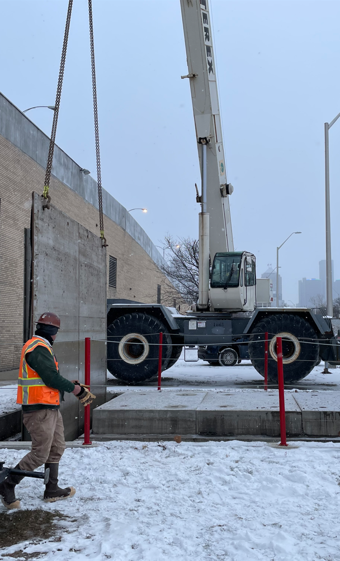
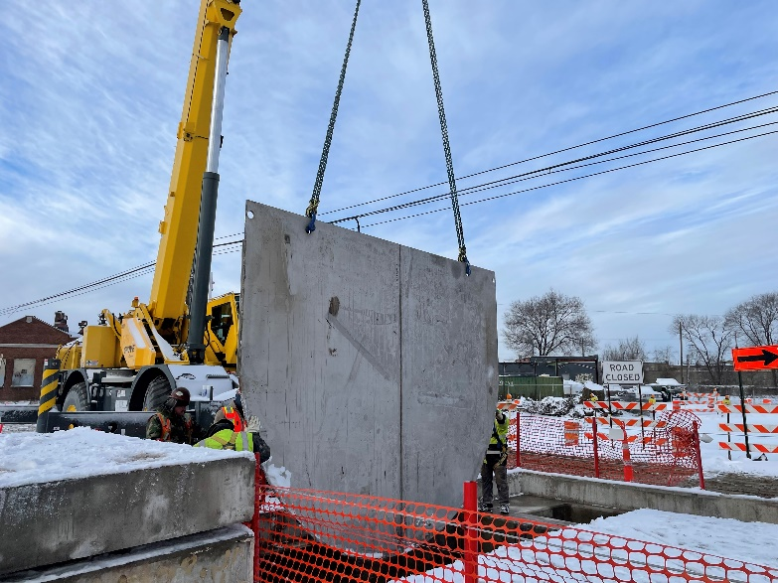
No Station Option - Heavy Equipment

Slide 43
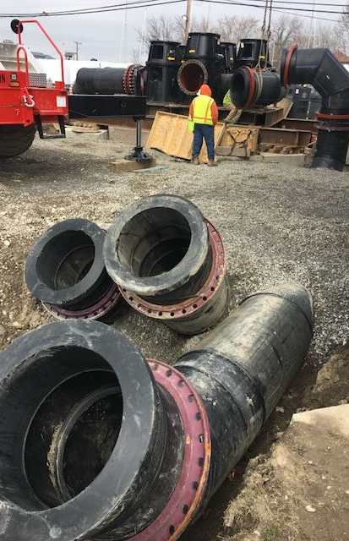
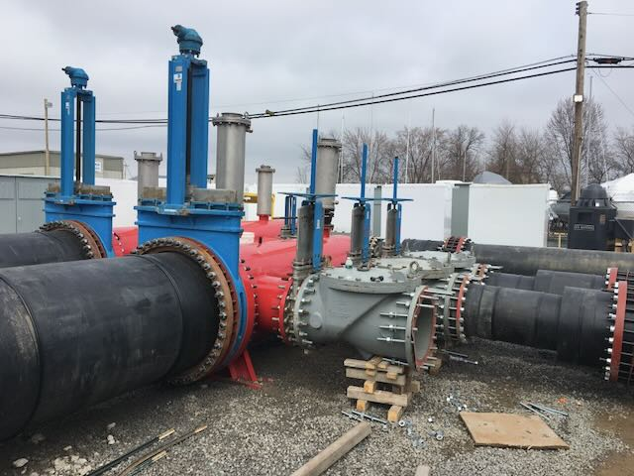
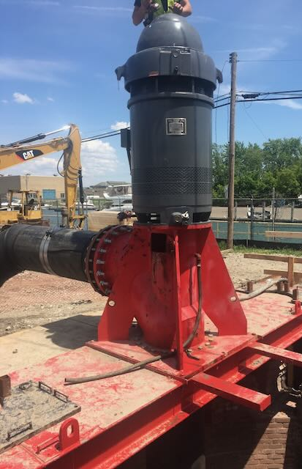
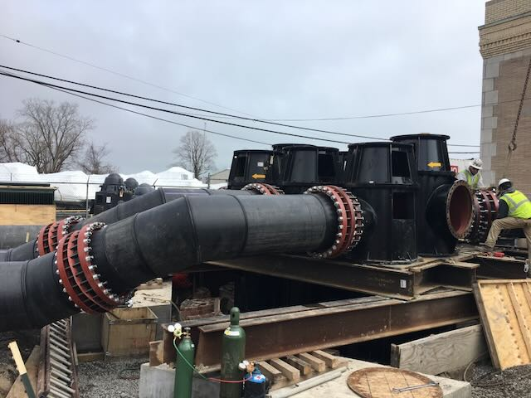
No Station Option - Bypass Piping

Slide 44
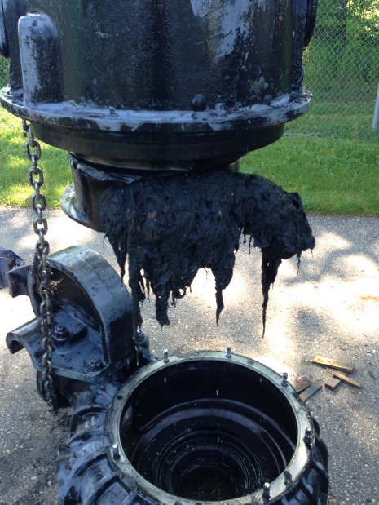
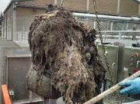
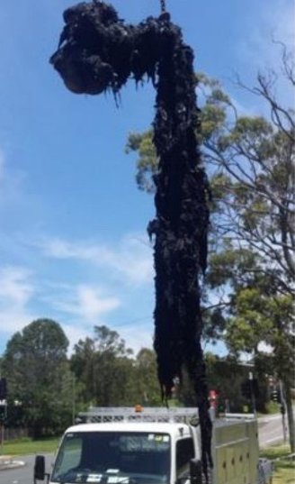
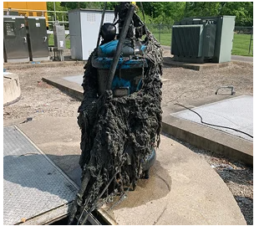
No Station Option - Wastewater Pumps

Slide 45
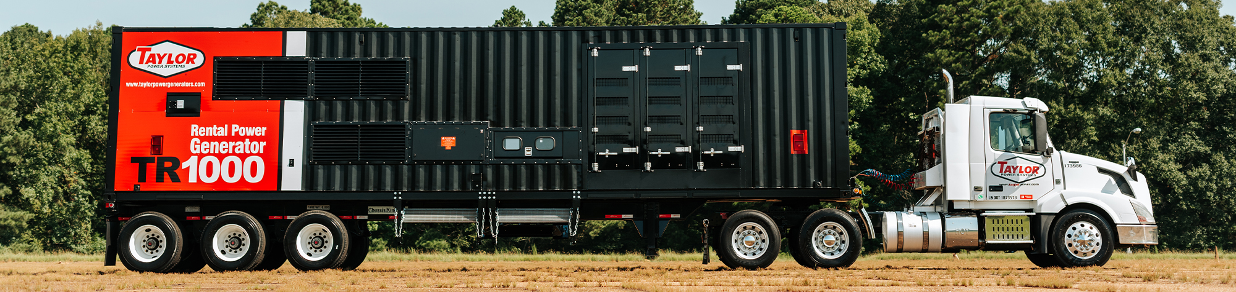
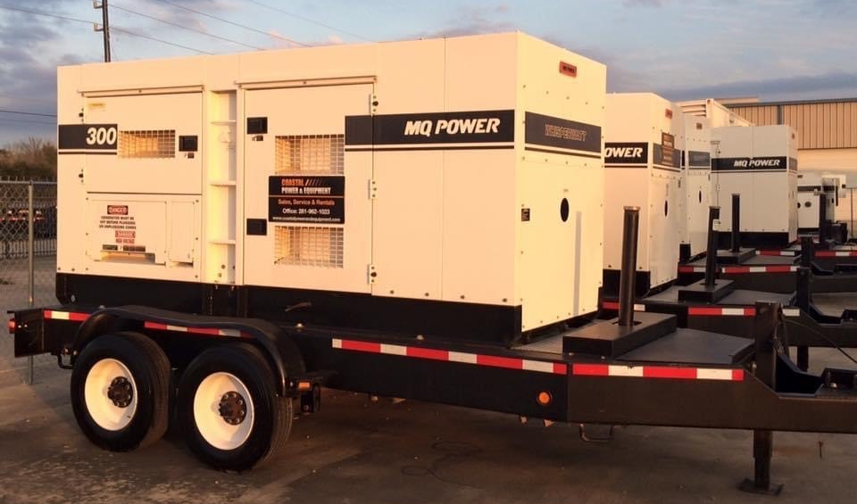

No Station Option - Generator Power

Slide 46

Where are we at?
Utility Relocation
  Gas
  Electric
  Communication
Rezoning
Freud Street Closure
  Detour
  Fencing
  Path
Notes:
Utility Relocation
Gas – Complete in February
Electric – Complete in March
Communication (6) – Complete in March
Rezoning
11/21/24 – CPC Public Hearing
01/16/25 – CPC Public Hearing
04/17/25 – CPC Meeting
Additional CPC Meetings?/City Council Meeting?
Freud Street Closure
Working with consultants on enhancing road closure signage to limit neighborhood traffic.
New sidewalk around the construction area will be installed before the EOM.
Traffic Study results have determined the Freud St reroute should be Freud to Clairpointe/Conner to Jefferson to Dickerson and back to Freud.
Utility Relocation
DTE-Gas – 01/31/25
DTE-Electric – 02/10/25
Rezoning is in front of CPC. Attend 11/21/24 and going to January meeting
City Council approved the Vacation & Dedication of Freud St on 07/02/24.
EGLE has approved SRF Funding.
Kokosing was issued Contract# 2204605 with an NTP of 07/15/24 and Final Completion Date of 11/12/28.

Slide 47


Exterior Design – Scale

Slide 48

Exterior Design – Conner Street View

Slide 49

Exterior Design – Freud Street View

Slide 50

Exterior Design – Navahoe & Freud View

Slide 51

Dry Weather Flow

Slide 52

Wet Weather Flow

Slide 53

Temporary Access – Conner Street View

Slide 54




Exterior Design – Elevations

Slide 55

System Background
Notes:
Conner Creek Pump Station – 1929
Storm - 8 Pumps - Total 2,584 MGD
Sanitary - 4 Pumps - Total 215 MGD
Freud Pump Station – 1955
Storm – 8 Pumps – Total 2,325 MGD
Dewatering – 2 Pumps – Total 36 MGD
Freud Sanitary Station
- Allow for the isolation of the existing Storm Station for cleaning, inspection, and maintenance that isn’t currently feasible.
- Safety standards are much different than in 1955.
- Bypass pumping would be continuously invasive and disruptive to the neighborhood.
Keeping the existing Storm Station in top running condition allows GLWA to better manage the sewer water levels and respond to rain events.

Slide 56






Project Background
Resiliency
  Power Monitoring and Reliability
  System Access for Routine Maintenance
  Mechanical Upgrades

Slide 57


Why is the building this size?
Contain Operations
  Crane
  Noise
  Odor
Notes:
The building is large enough to fully contain the operations that occur within it.
- Crane for pumps & stop logs.
- Contain noise
- Contain odors

