Slide 1


New Freud Sanitary Station
03/18/24
Notes:
TITLE SLIDE
Click in text boxes to edit the presentation title.

Slide 2

Agenda
Project Goals & Design
Project Advantages
Project Renderings
  Overhead View
  Northwest Street View
  Northeast Street View
Project Schedule
Traffic Control
Questions

Slide 3
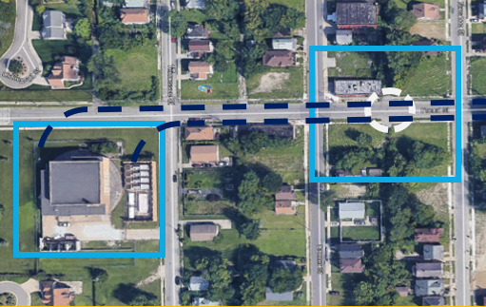
Project Goals & Design
Protect the Health, Safety, & Welfare of Residents
Improve the Reliability of Freud Storm Pump Station
  Rehabilitation
  Isolation
    Cleaning
    Inspection
    Maintenance
Utilize one Sanitary Pump Station for both Ashland & Fox Creek Sewers
Improve Sanitary Flow
Design for City Master Plan

Slide 4
Project Advantages
Improved Reliability of Storm & Sanitary Systems
Traffic Calming
Enhanced Landscaping Plan
Bioswales & Rain Gardens
Doubling of Mature Trees
Abandoned Structure Removal
Improved Drainage at Freud Storm Pump Station

Slide 5
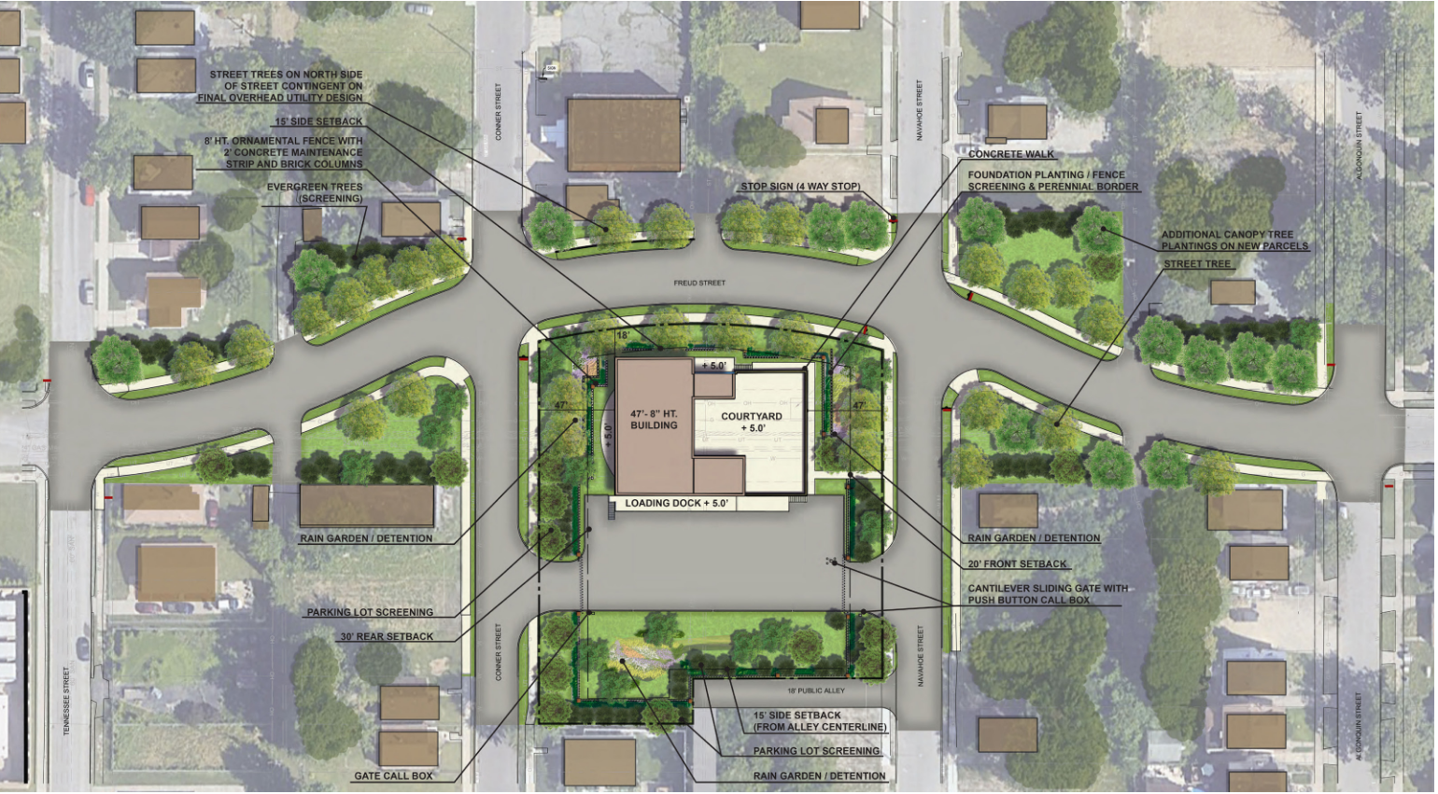
Rendering - Overview

Slide 6
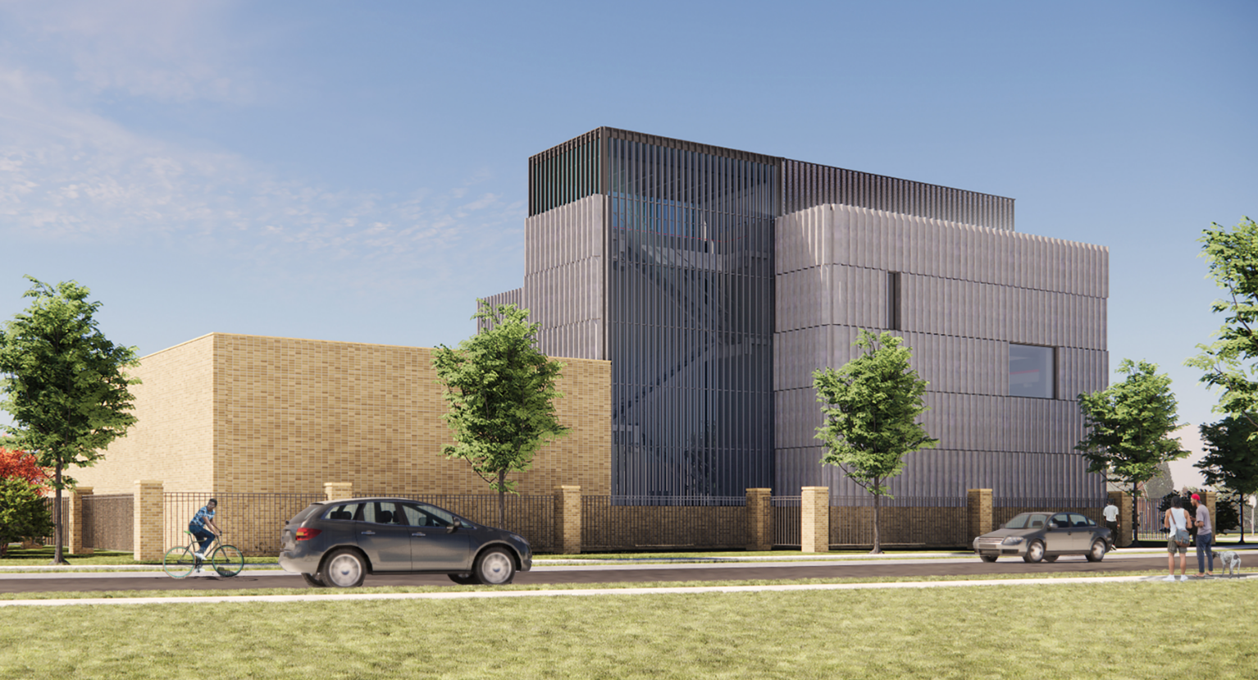
Rendering – Northwest Street View

Slide 7
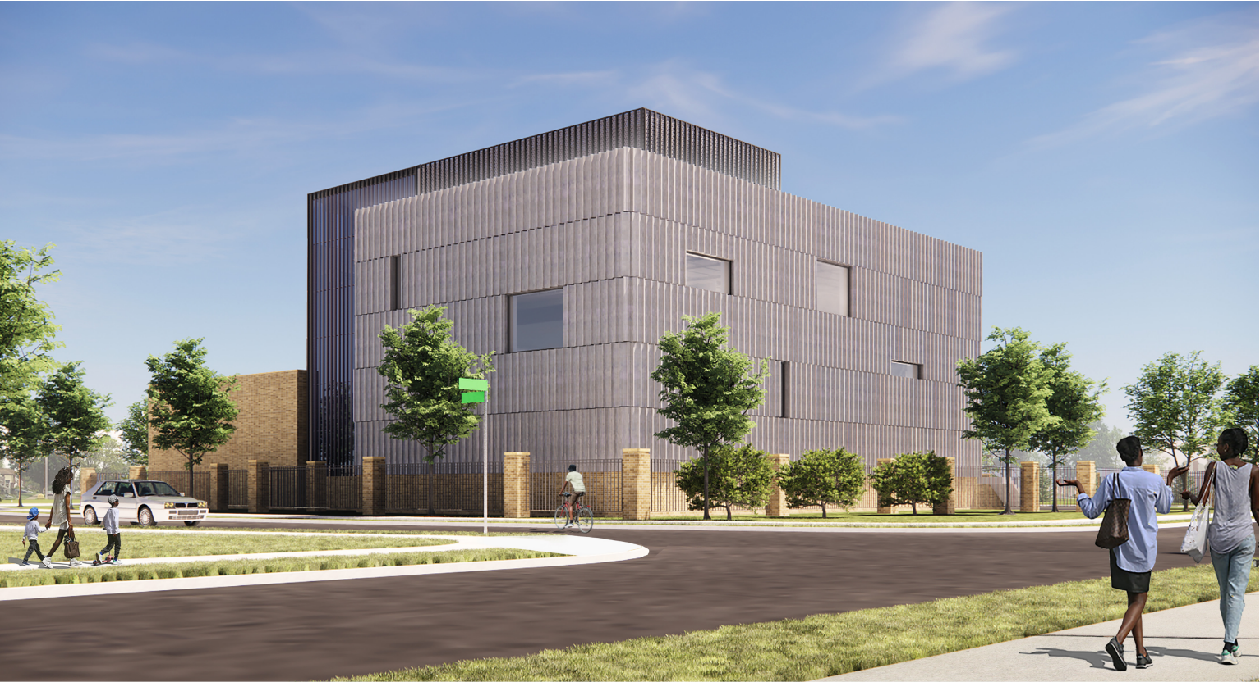
Rendering – Northeast Street View

Slide 8
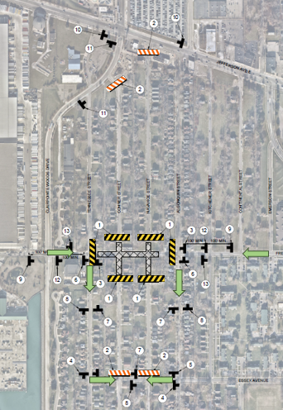

Traffic Control
Freud Street Road Closure
Traffic will be routed along:
  Essex Ave
  East Jefferson Ave
Traffic Flow
Road Closure
Through Traffic Closure

Slide 9
Project Schedule
Contractor Notice to Proceed Q2 2024
Abandoned Structure Removal Q2 2024
Contractor Site Mobilization Q4 2024
Project Completion Q2 2028
*Project Schedule is in development more details to follow.

Slide 10


Questions
Notes:
SECTION TITLE SLIDE
Click in text boxes to edit the section name.
Background image can be updated. 1. right-click and select “reorder objects” 2. drag photo ahead one layer and click ”ok” 3. right-click on the photo and select “change picture” 4. right-click image and select “send to back.”

