Slide 1
Great Lakes Water Authority Resiliency Efforts

Slide 2
GLWA and DWSD Partners in Delivering Wastewater Services
GLWA
Operates Regional System: Serves 79 communities in Wayne, Oakland and Macomb Counties
Leases large pipes, treatment plants, and pumping facilities from the city of Detroit
Focuses on regional operations and the level of service for the region
GLWA’s six-member Board of Directors is comprised of one representative from each of Oakland, Macomb, and Wayne counties, two representatives from the City of Detroit, and one representative appointed by Michigan’s Governor
DWSD
Operates Local System: Serves more than 230,000 residential, commercial, and industrial accounts within the city of Detroit
Retains ownership of the city of Detroit’s local system and leases regional infrastructure to GLWA for $50M per year
Focuses on Detroit local operations and level of service for the city of Detroit
DWSD’s seven-member Board of Water Commissioners is comprised of seven Detroit residents who are appointed by the Mayor of the city of Detroit

Slide 3
Partnered with the US Army Corps of Engineers Southeast Michigan Flood Mitigation Study
One of five new start projects for the US Army Corps in President Biden’s budget
Regional in nature including Detroit and Wayne, Oakland, and Macomb Counties
Funded 50% US Army Corps and 50% GLWA
Expected to start this year with the federal funding approval
Focus on both overland flooding and basement back-ups
Will engage federal agencies such as NOAA to understand projections for the climate, rain intensity, and the levels of the Great Lakes
It is likely that the recommended solutions will be very costly and require federal and state assistance to implement

Slide 4
$533M East Side Projects Underway or Planned
$350M Upgrades and new construction at the Freud and Conner Pump Stations (PS)
$113M Rehabilitation of the Detroit River Interceptor (large sewer along Jefferson Ave)
$ 50M Rehabilitation of the Fairview Pump Station
$ 8M Gate, electrical and control systems upgrades at the Conner Creek CSO Facility
$ 5M Full condition assessment of all combined sewer overflow facilities
$ 5M New electrical, controls, and equipment/pumps upgrades at the Freud PS
$ 2M Pump rehabilitation/vacuum priming system upgrades at the Conners Creek PS
$533M Total

Slide 5
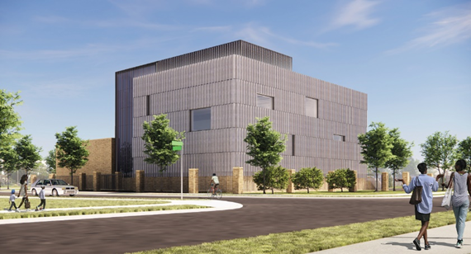
GLWA System Resiliency Efforts
Freud Pumping Station
Construction of New Sanitary Wastewater Pump Station
Design is complete
Properties acquired along Freud Street between Tennessee
and Algonquin
Construction to start this year
Large-scale Rehabilitation of Existing Freud Pump Station
Design is complete
Rehabilitation to start this year
Resiliency Improvements Already Completed
Installed three new transformers with three new independent power feeds
Converted the external power supply to DTE and installed power monitoring to detect power issues

Slide 6
GLWA System Resiliency Efforts
Blue Hill Pump Station
Installed two independent power feeds
Installed power monitoring to detect power issues
Conners Creek Pump Station
Installed power monitoring to detect power issues
Upgrade of vacuum priming system in progress
Studied and in process of installing a different type of pumps to allow for use earlier in rain events

Slide 7
GLWA System Resiliency Efforts
Installed power monitoring to detect power issues at all wet weather facilities
Invested more than $3.5 million in sewer system instrumentation improvements
Reinspected more than 20 miles of the regional system, which is about 13 percent of the total GLWA regional sewer system, in the last two years
Initiated a comprehensive “Electrically Reliability Study” of all the pump stations GLWA operates with an anticipated completion this summer
Hosts emergency operations meetings with all tributary communities when forecast of 2 inches or more are predicted

Slide 8
GLWA System Resiliency Efforts
Independent Investigation of 2021 Flooding
Status of 25 Recommendations
7 have been completed
14 are currently in progress
1 will start when a pilot at Conners Creek Pump Station is complete
3 will be completed in the Regional Flood Mitigation Study

Slide 9
Thank You

