Slide 1
Flood Mitigation Efforts
Gary Brown, Director
Detroit Water & Sewerage Department
August 2023

Slide 2
How the Sewer System Functions

Slide 3
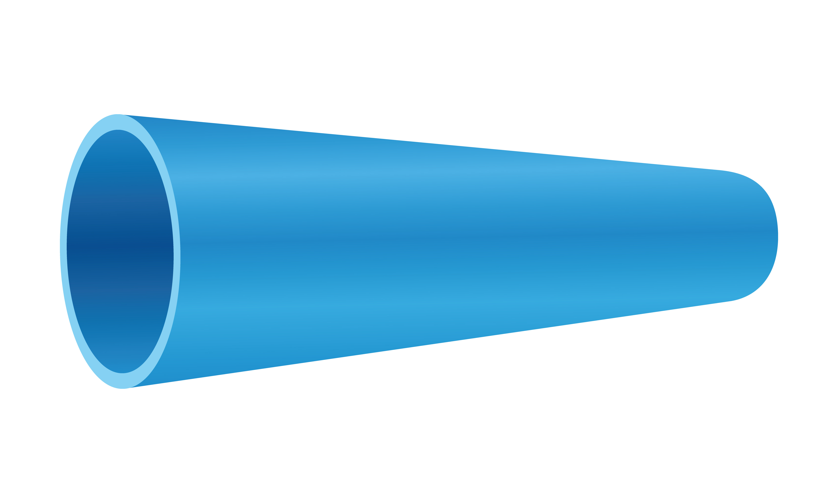
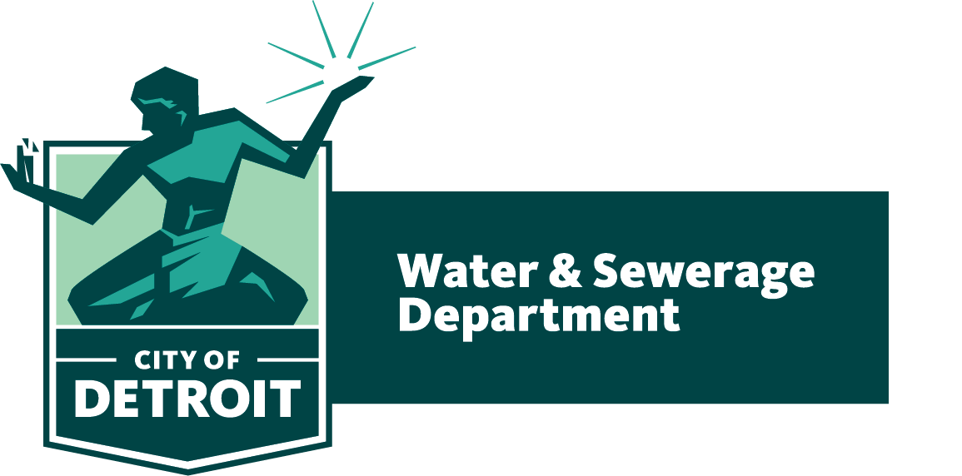
Three Parts to the Sewer System
GLWA*
collects & treats combined sewage from Detroit & other cities – large collection pipes, nine pumping stations, eight wet weather facilities & a treatment plant
DWSD
maintains the public sewers in the alleys and under streets, collecting the combined
sewage
Sewage collection starts with private sewer lateral service lines
*GLWA is the Great Lakes Water Authority

Slide 4
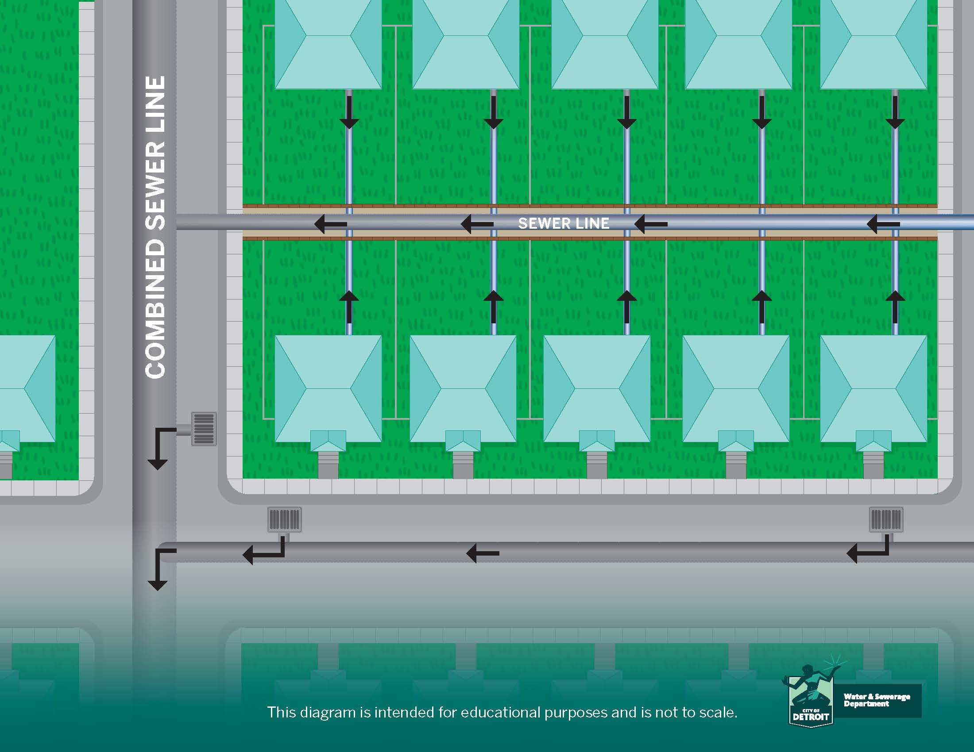
Detroit Sewer System:
Local Collection System Operated by DWSD
COMBINED SEWER LINE
SANITARY SEWER LINE
STORM LINE

Slide 5
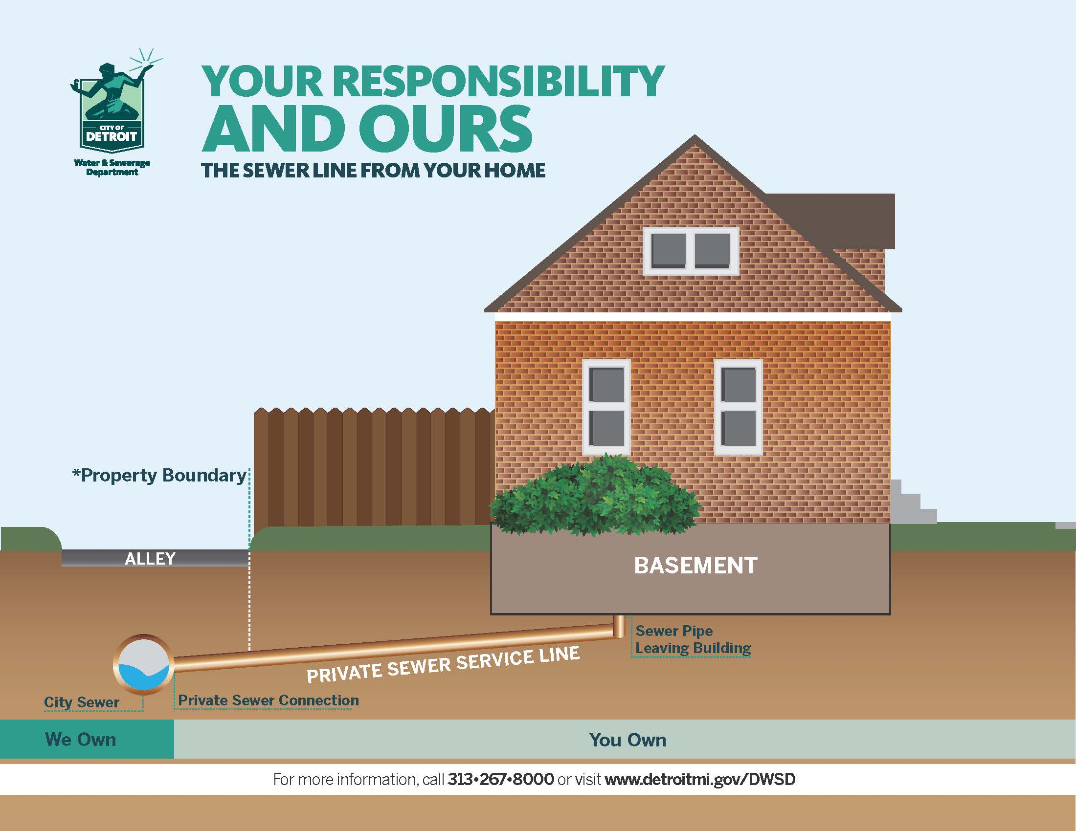
Detroit Sewer System:
Private Portion
Less than 20% of homes in Detroit have the sewer service line in front of the house, including some parts of Jefferson Chalmers and in several westside neighborhoods.

Slide 6
Sewer System Improvements

Slide 7
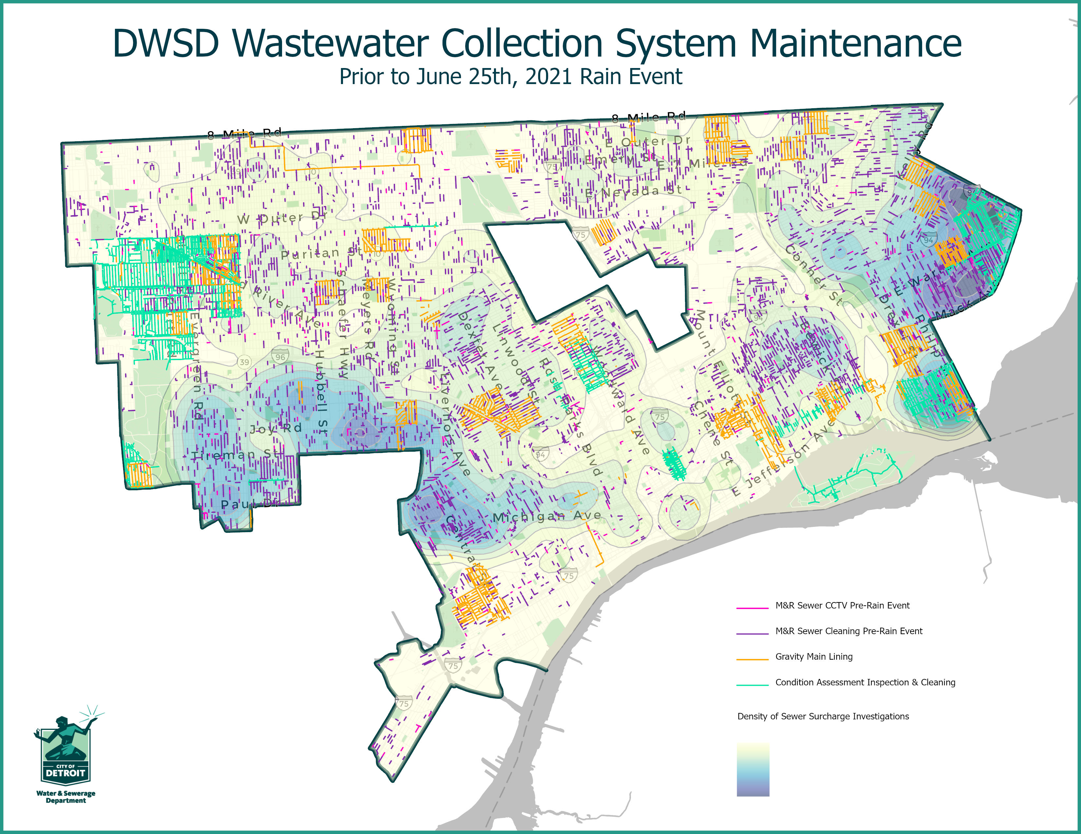
What We’ve Done:
Sewer Cleaning and Rehab to Build Capacity
DWSD has cleaned 886 miles of city sewer pipes since the rain event in June 2021.
300.75 miles of city sewer have been condition assessed since 2018.
18.29 miles of sewer have been lined or repaired since 2018 to extend the useful life.

Slide 8
Stormwater Ordinance and GSI Projects

Slide 9
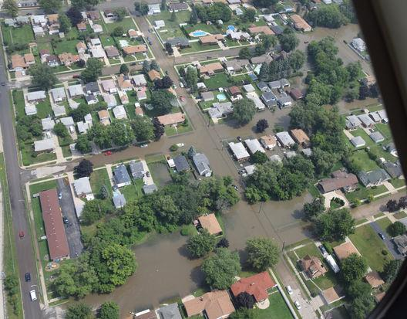
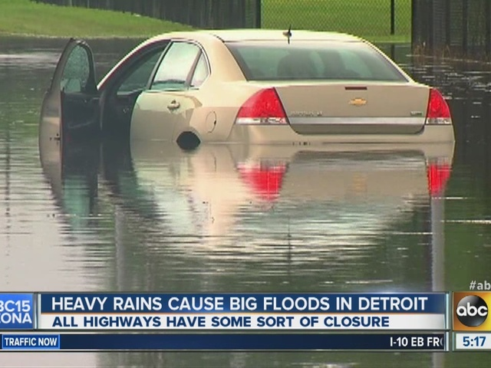
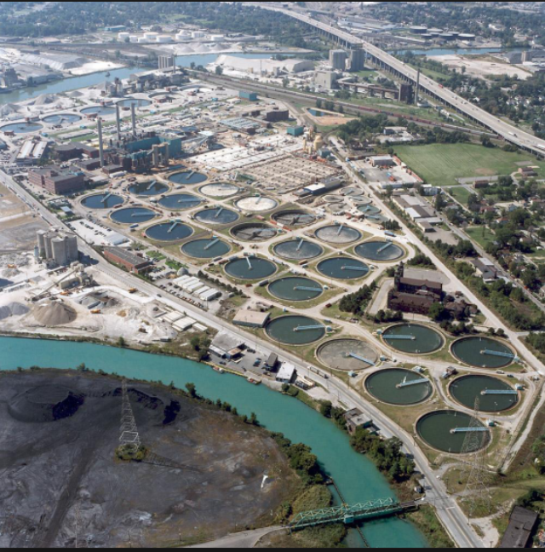
Stormwater Management Ordinance – Enacted Citywide
Permit requirement for ordinance was for the Rouge Sewer and Central Sewer districts only.
Prior to 2018, no formal stormwater management requirements in the City.
Excess stormwater caused flooding, backups and sewer overflows in receiving waters (Detroit and Rouge Rivers).
Stormwater management ordinance was enacted in November 2018 and is a regulation within City Code.

Slide 10
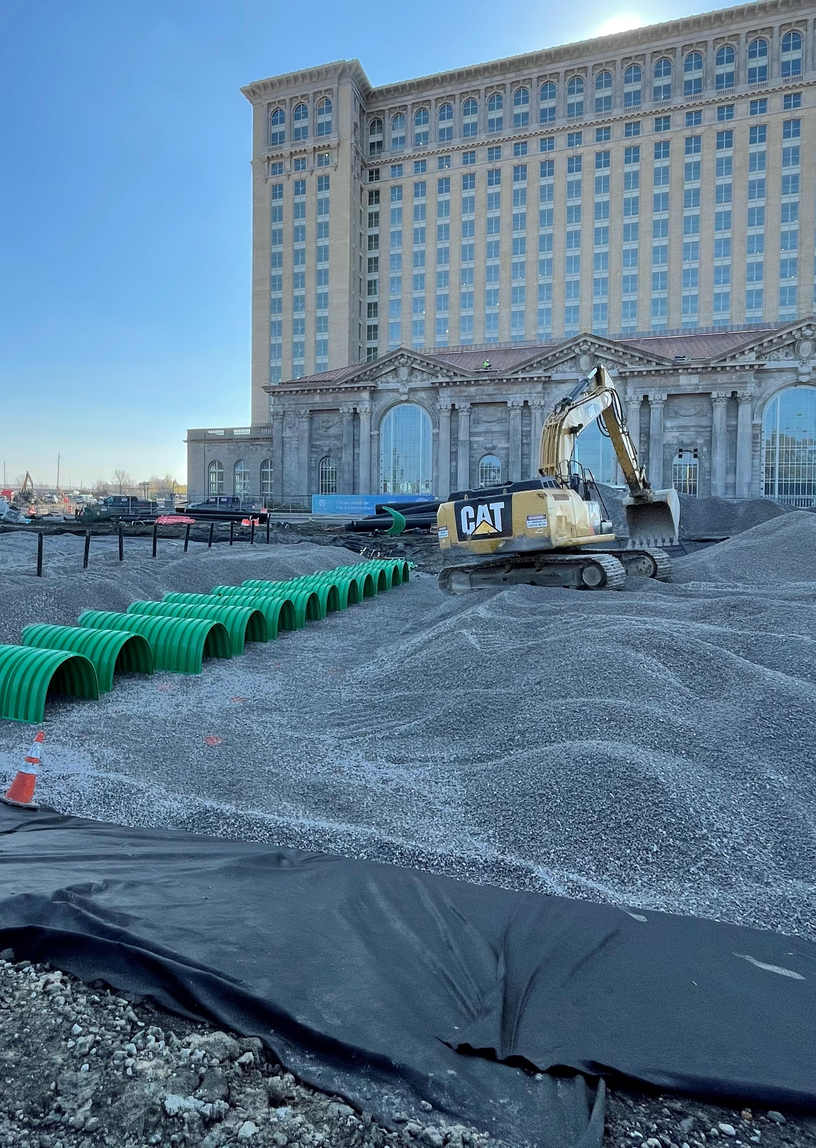
Reporting Metrics
Stormwater Management Ordinance
Total Number of Projects | 74
Project Cost (estimated) | Not Available (Private Work)
Peak Flow Reduction Volume Provided 10 and 100 year peak flow detention volume | 33 Million Gallons
Volume Reduction Provided Retention Volume | 2.8 Million Gallons

Slide 11
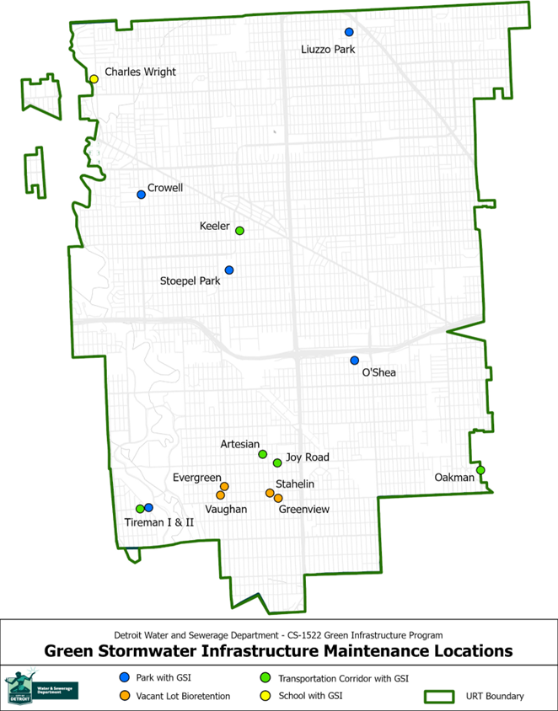
DWSD GSI Program Completed Projects

Slide 12
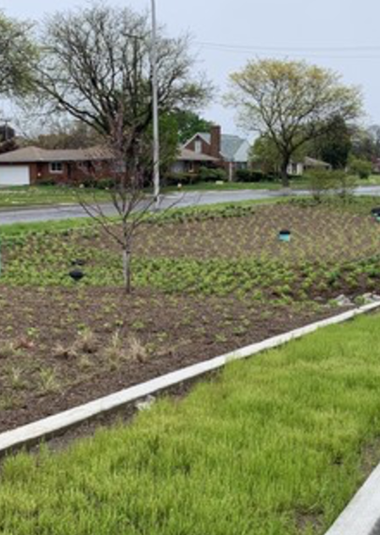
Reporting Metrics
DWSD GSI Program - Completed Projects
Number of Projects | 19*
Project Construction Cost (estimated) | $13.9M
Volume provided for peak flow reduction Design Target 2 yr-24 hr Event | 2.2 Million Gallons
Annual Volume Reduction Provided Retention Volume and Direct Discharge | 53 Million Gallons
*Includes Joy Road (GSI funding only)

Slide 13
GLWA Pumping Station Power Improvements

Slide 14
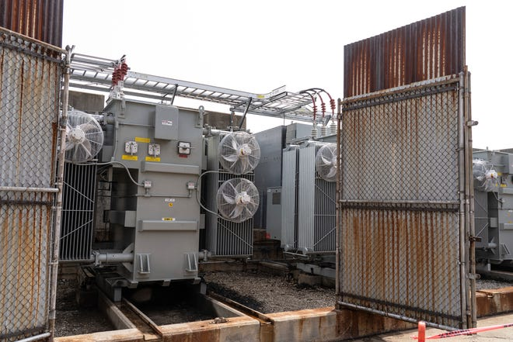
What We’ve Done:
GLWA Electrical Improvements
GLWA installed three new transformers at the Freud Pump Station.
It successfully converted the external power supply feeding the transformers to DTE
power via three independent power feeds at Freud and two feeds at Blue Hill Pump Station increasing power reliability and redundancy.

Slide 15
Flood Mitigation Projects
In-Progress and Coming Soon

Slide 16
Detroit Stormwater Resiliency
Before the 2021 floods, DWSD has been striving to manage stormwater to REDUCE FLOODING:
More than 30 million gallons through compliance with New Ordinance
75 million gallons through completed Green Stormwater Infrastructure Projects
More than 100 million gallons to be managed by Far West Detroit GSI (under construction)
110 million gallons to be managed by Brightmoor/Minock Park (planning stage)
100s of millions of gallons through MDOT Coordination (I-94, GHIB, I-375, M39)

Slide 17




Detroit Stormwater Resiliency
PEAK FLOW CONTROL
Reducing the intensity of runoff to the DWSD and GLWA system.
SOURCE REMOVAL
Removing unnecessary impervious area from the sewer system.
LAND USE PLANNING
Activating underutilized open space and promoting density.
COLLABORATION
Bigger projects result in impactful benefits with higher return on investment.
Creating Capacity. Reducing Flooding.
Keeping Basements Dry.

Slide 18
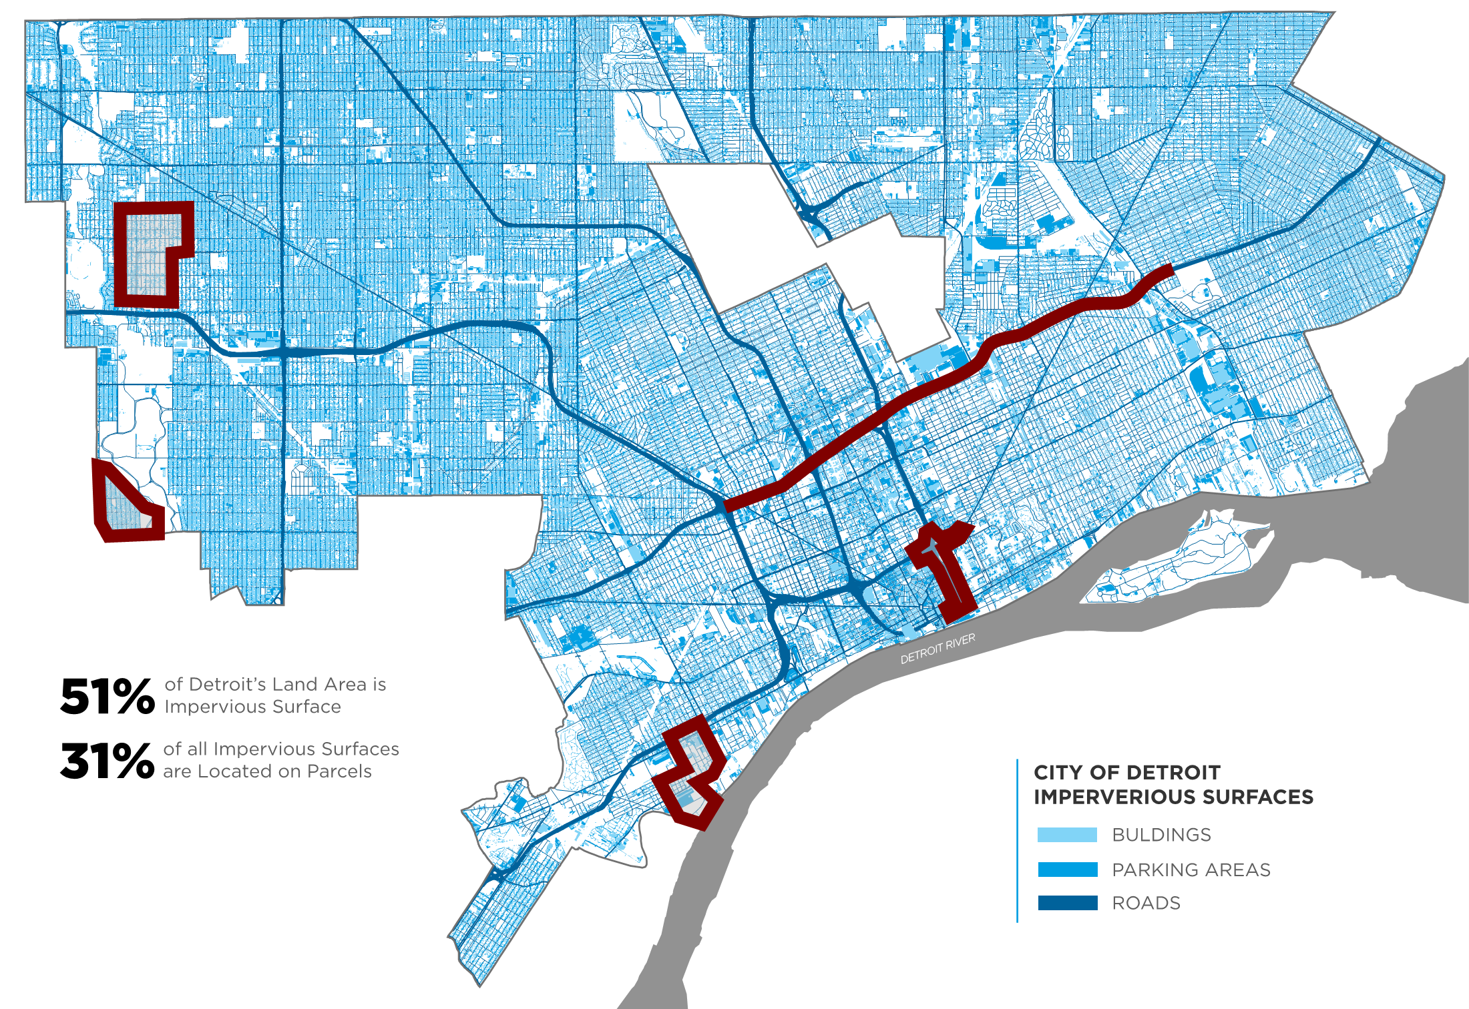
Upcoming Stormwater Projects
Brightmoor / Minock Park
$30M
I-94 Reconstruction
$430M
M-39 Reconstruction
TBD
Far West Detroit
$32M
I-375 Removal
TBD
Gordie Howe Bridge
$30M

Slide 19
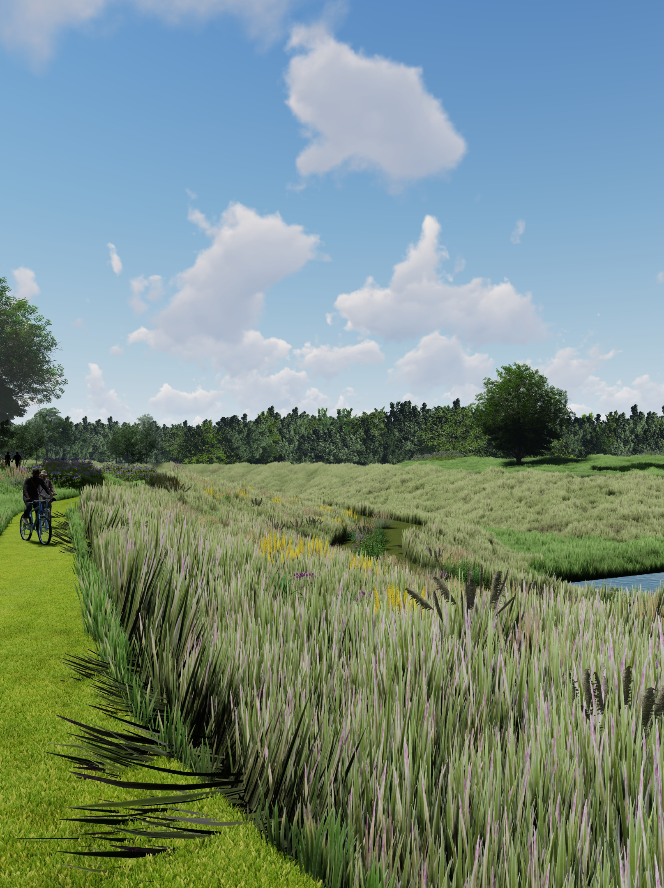

Far West Detroit Stormwater Improvement Project
$32M stormwater improvements
funded by Evergreen/Farmington
2.5 MG of peak flow reduction
100+ MG removed annually
Use of city-owned Rouge Park creates highly visible amenity

Slide 20
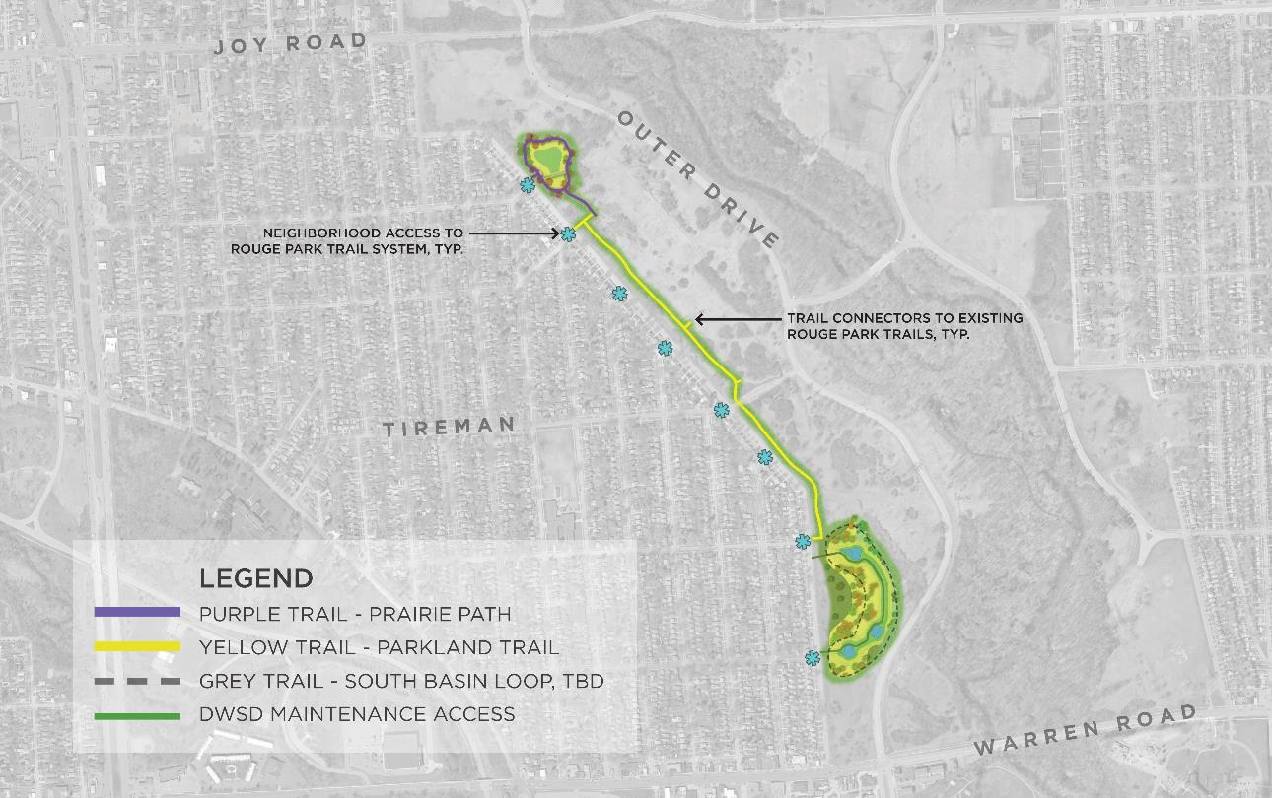

NORTH BASIN
SOUTH BASIN

Slide 21
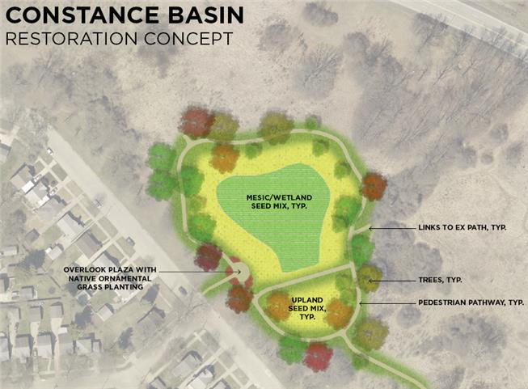
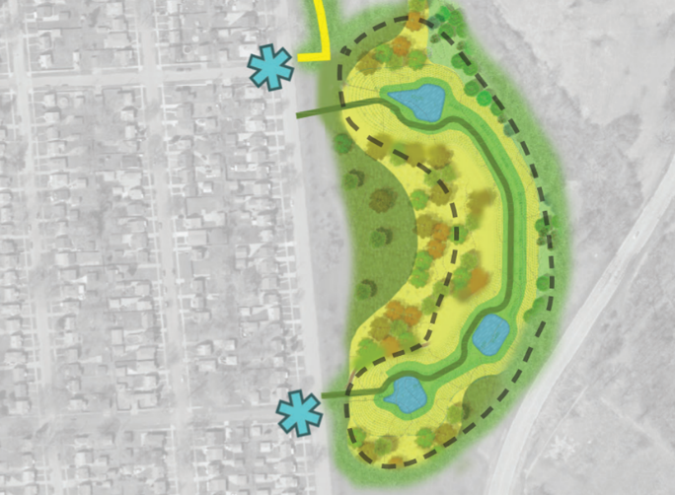
Far West North Basin (Constance) & South Basin Overview

Slide 22
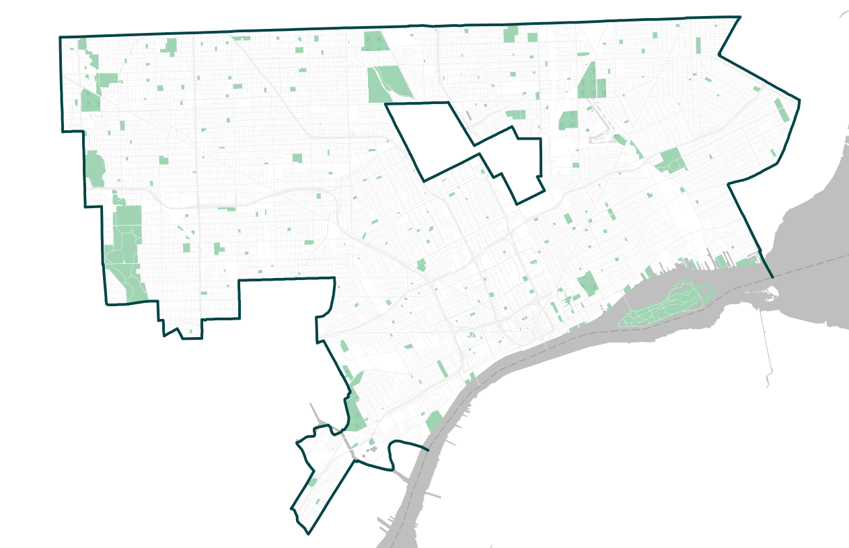
Westside Stormwater Improvements
More than $100M of planned stormwater Improvements for the West Chicago and Schoolcraft Areas.
Targeted investment to remove stormwater from combined sewer systems and improve water quality of the Rouge River by reducing combined sewer overflows.
Combination of gray and green infrastructure designed to maximize performance, create native landscapes.
Funding sought through State of Michigan Clean Water Revolving Fund.
Schoolcraft
West Chicago

Slide 23
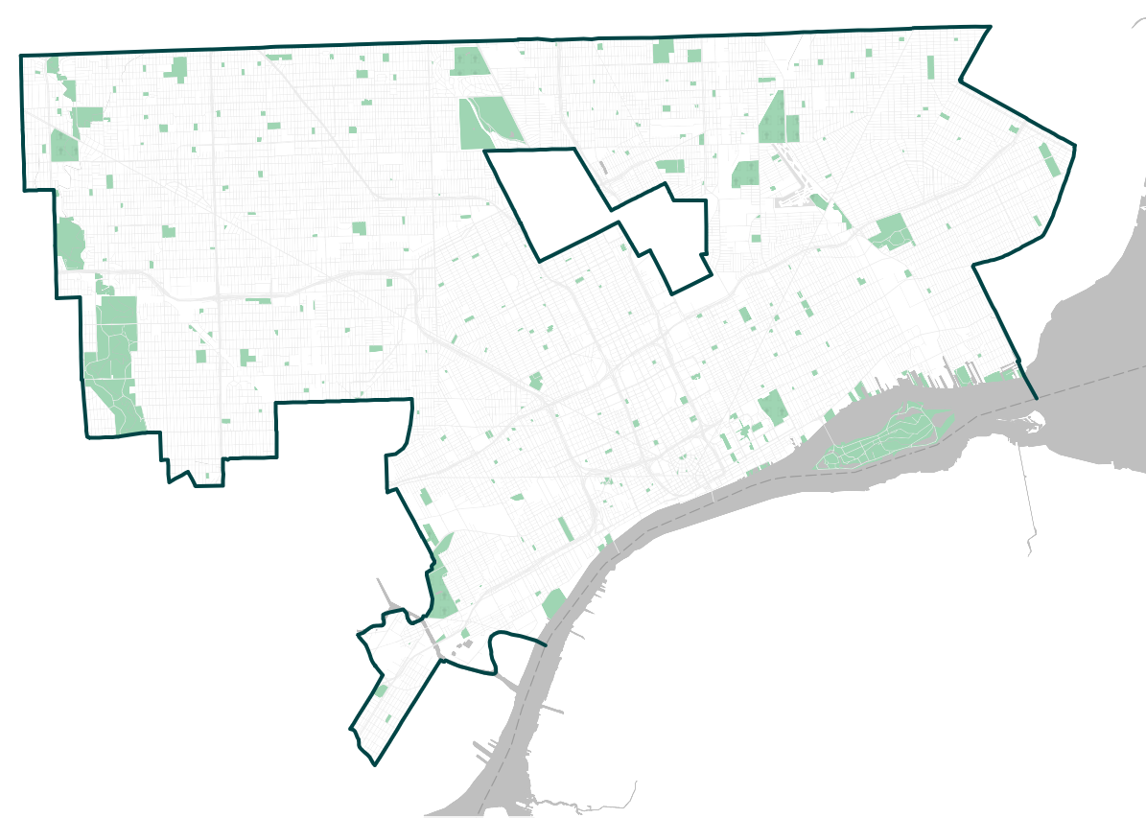
McNichols West and McNichols East Grant Application
McNichols West
McNichols East
DWSD seeking $975K in grants to study the
viability of direct discharge to the Rouge
River along McNichols Road between the
Rouge River and the Southfield Freeway.
The study will compliment ongoing work by
GLWA to create in-line storage within the
combined sewer system and eventually
convert the McNichols Relief Sewer to
manage stormwater only.
Study to help advance preliminary engineering required for future construction projects for NPDES permit compliance.
The projects will also reduce the risk of localized flooding of streets and buildings.

Slide 24
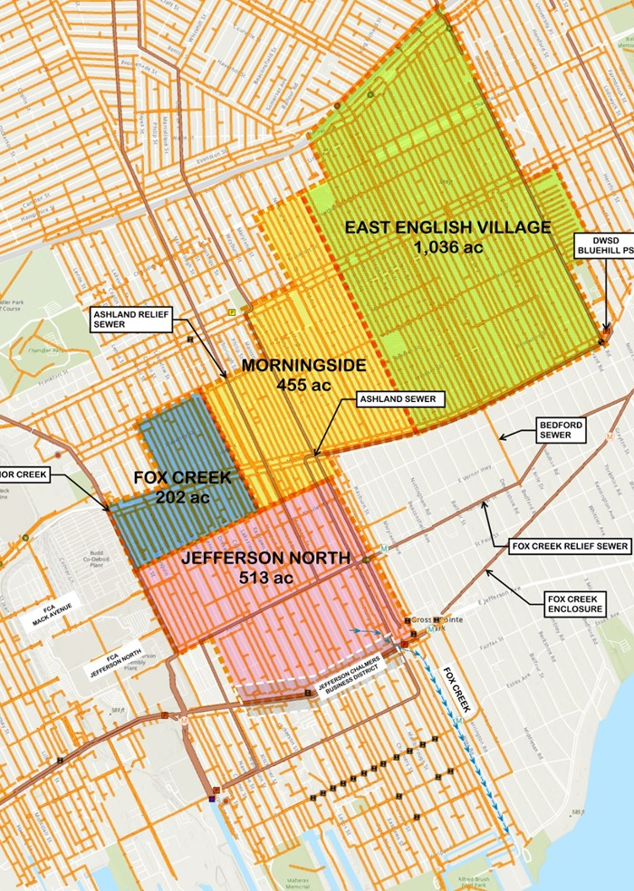
Eastside Stormwater Relief Project
Project Study Area
Project will study sewer relief for
four eastside neighborhoods:
Drainage Area | Area (Acres)
East English Village | 1036
Fox Creek | 202
Jefferson North | 515
Morningside | 455
TOTAL | 2,208

Slide 25
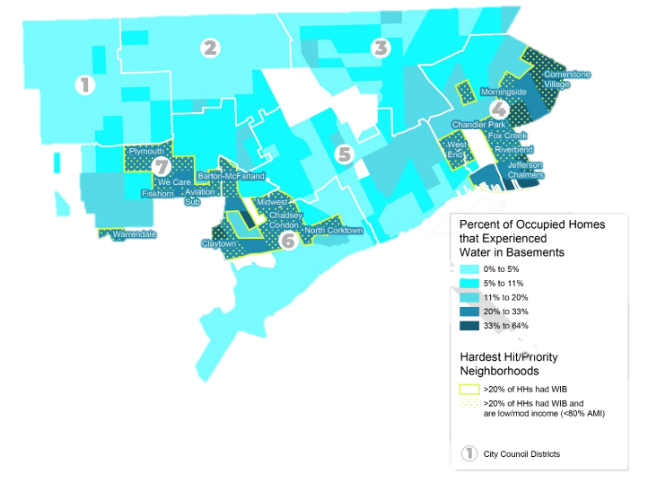
Eastside Stormwater Relief Project – Water in Basement Reports
STUDY AREA

Slide 26
Basement Backup Protection Program
324 Homes Completed: Phase 1
Spring 2022-Summer 2023: 324 homes received a backwater valve and/or sump pump in following neighborhoods:
Aviation Sub
Vitoria Park
Jefferson Chalmers (internal only)
East English Village (internal only)
Warrendale (internal only)
What’s Next: Phase 2
Set to start Summer 2023 in following (9) neighborhoods:
East English Village
Jefferson Chalmers
Moross-Morang
Morningside
The City of Detroit’s Basement Backup Protection Program provides flood prevention services to 11 flood prone neighborhoods. Home eligibility is based on need and includes assessments by a City inspector and a licensed plumber. The following services are offered to participating homeowners/landlords:
    Camera inspection of sewer lateral service line
    Disconnect downspouts and install extensions
    Install backwater valve (external installations will be included in phase 2)
    Install sump pump with overflow
    Sewer lateral repair (will be included in phase 2)
    ONLY BACKWATER VALVEPROGRAM IN NORTH AMERICA THAT SECURES THE CONTRACTORS AND PAYS FOR THE ENTIRE COST!
Barton-McFarland
Cornerstone Village
Chadsey Condon
Garden View
Warrendale

Slide 27
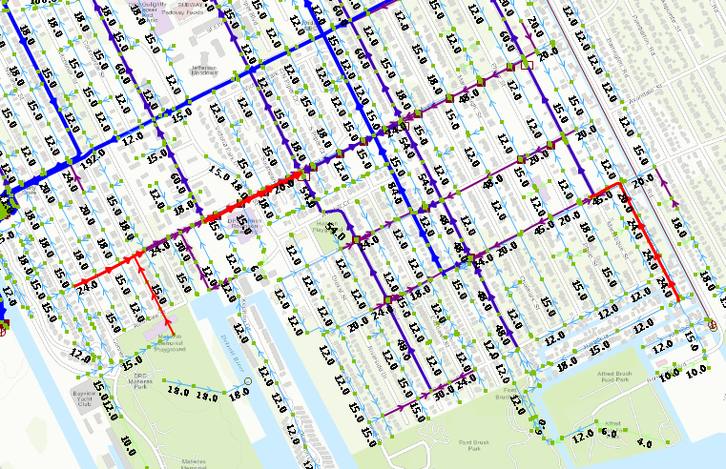
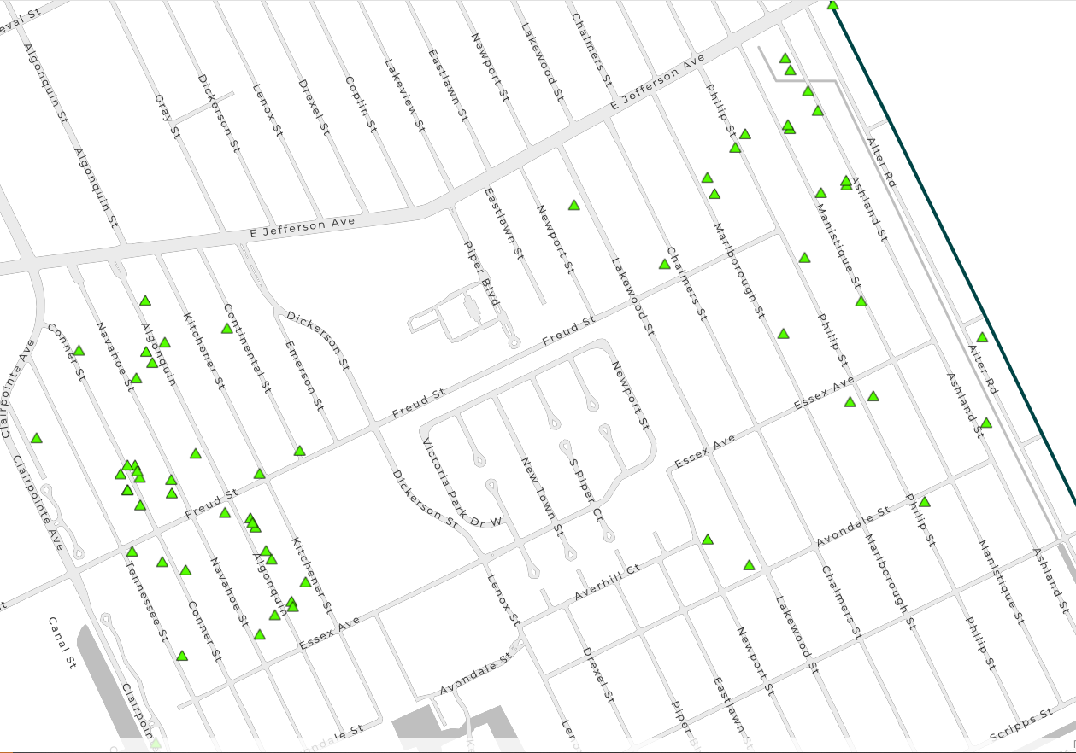
Jefferson Chalmers
DWSD has developed solutions to expand capacity within existing sewers.
System will be sized to accommodate larger storm events – 16,000 linear feet of new pipe (shown in red).
Project eligible for funding and was submitted to FEMA’s Building Resilient Infrastructure and in Communities (BRIC) grant program.
$11.3M grant award announced in August 2023.
Known locations of private sewer lateral defects

Slide 28
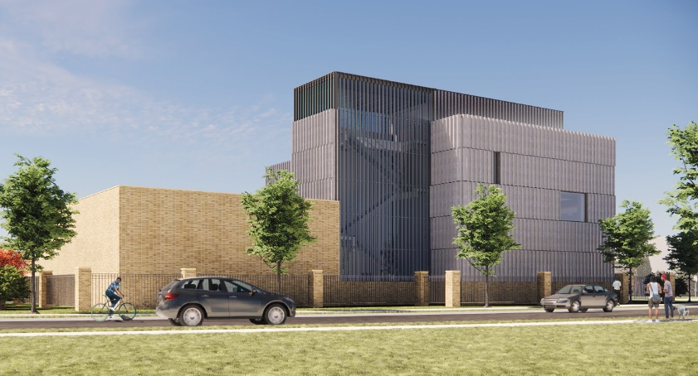
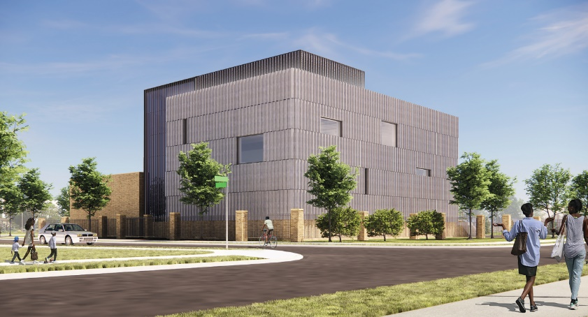
Great Lakes Water Authority (GLWA)
During the next few years, GLWA will invest three-quarters of a billion dollars in Detroit to improve climate resiliency.
The projects are primarily in the westside and lower eastside.
These infrastructure upgrades align with construction that DWSD, MDOT and other agencies have planned.
Conceptual renderings of upgraded Freud Pumping Station

Slide 29
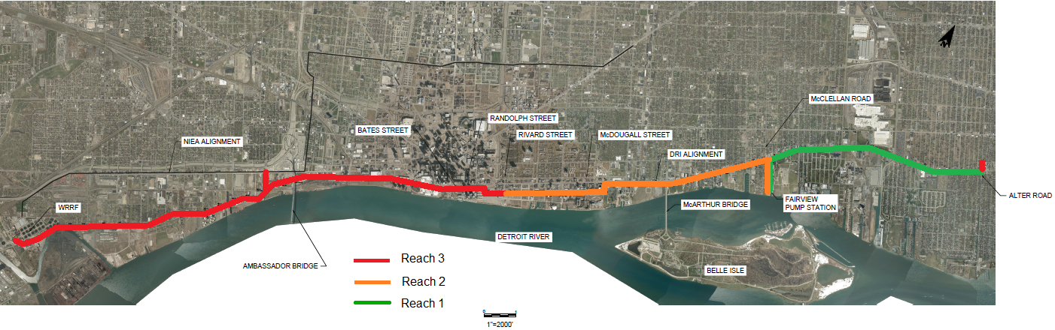
$113M Upgrade to Detroit River Interceptor
The most comprehensive upgrade to the Detroit River Interceptor (DRI) since it was constructed – will optimize capacity and extend the service life.
The DRI conveys one-third of all wastewater flow from the GLWA service area.

Slide 30
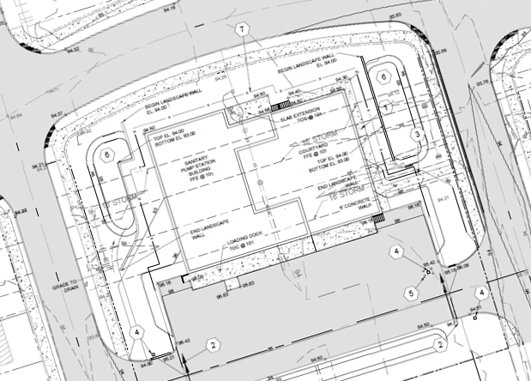
$594M Upgrade to Freud and Conner Pumping Stations
Freud Pumping Station expansion is to improve the overall reliability of the collection system and minimize system surcharging to substantially reduce the risk of future combined sewage flooding/backups in Jefferson Chalmers and the lower eastside.
The Conner Creek Pump Station rehabilitation will be to improve reliability of sanitary and storm pumping.

Slide 31
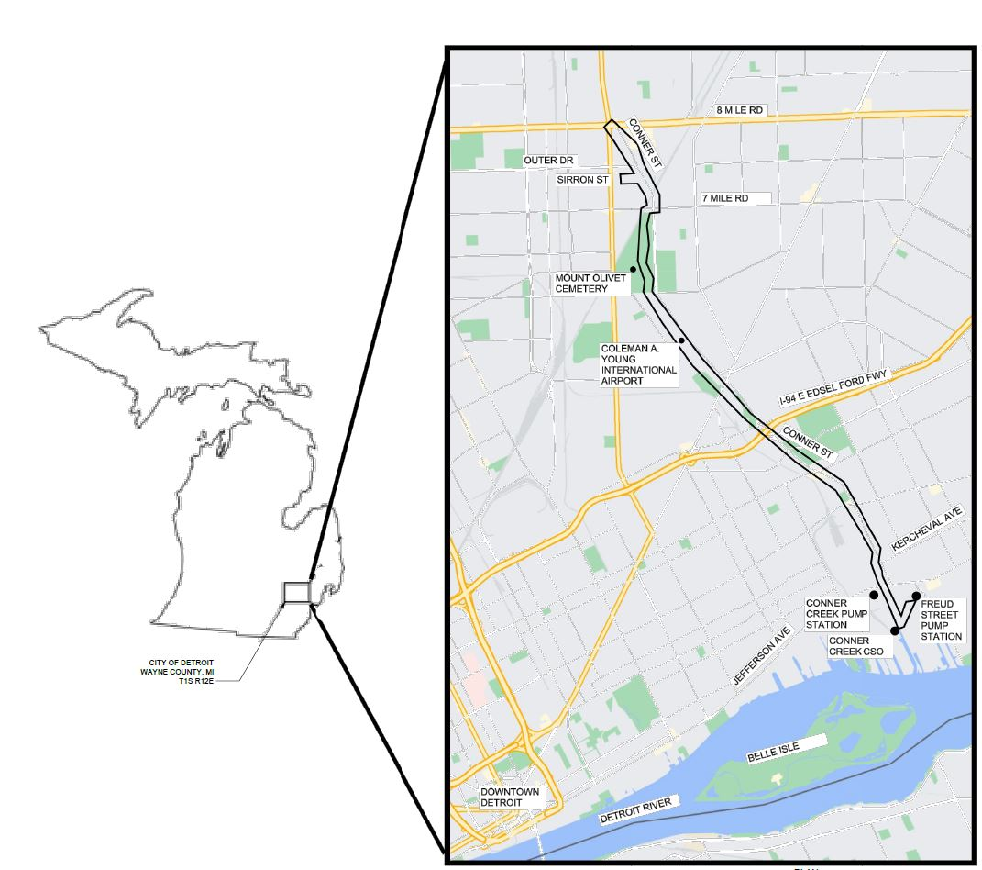
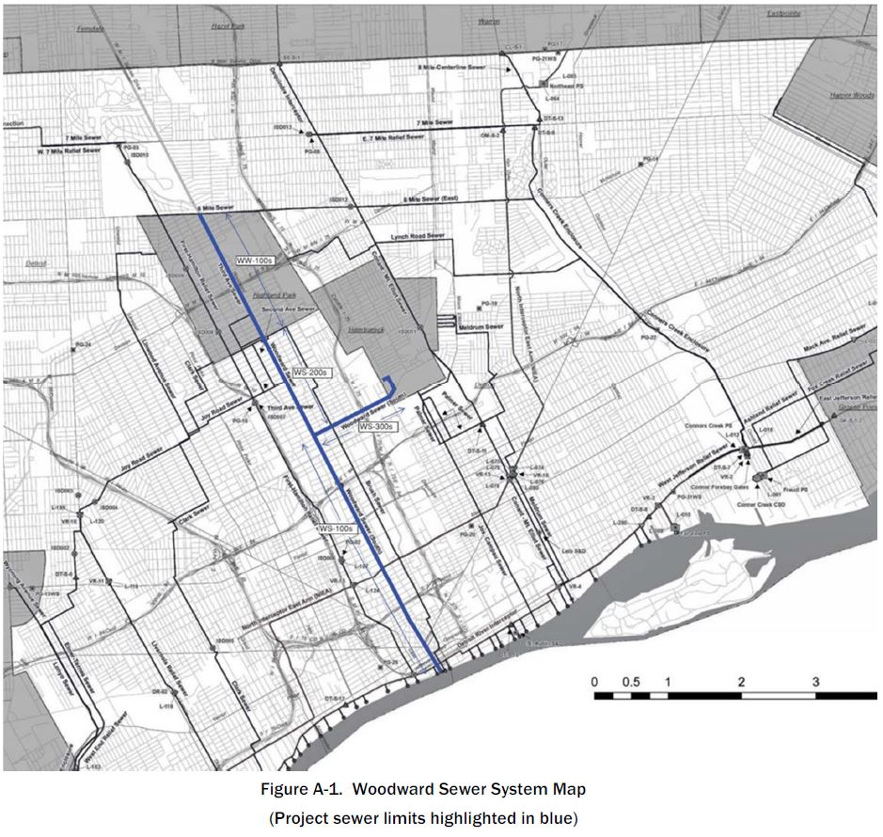
$55M Woodward and Conner Sewer System Rehabilitation
The Woodward Sewer System project is to improve capacity and life cycle by addressing structure defects.
The Conner Sewer System rehabilitation is intended to extend the life and remove 27,000 tons of grit from usage/flooding and address defects to improve capacity.

Slide 32
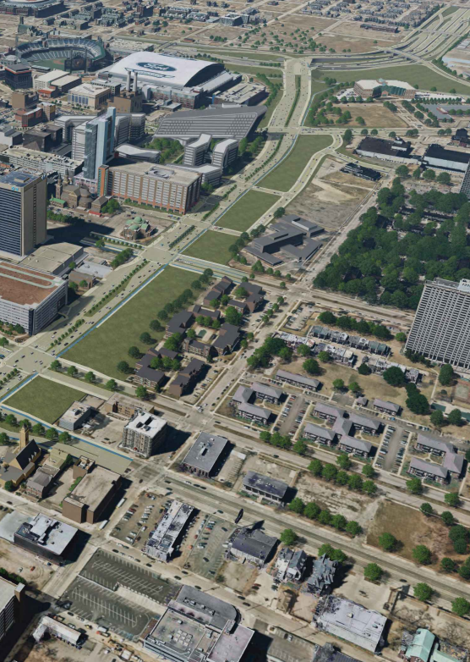
MDOT Collaboration
DWSD appreciates MDOT recognizing the value of including stormwater management in its plans.
The freeway projects will utilize existing outfalls to the Detroit River to remove 100s of acres of drainage area from the combined sewer system.
Projects will manage 100s of millions of gallons annually in accordance with the ordinance.
Improvements include deep storage tunnels, surface detention and green infrastructure.
Conceptual rendering of I-375 Freeway Removal Project

Slide 33
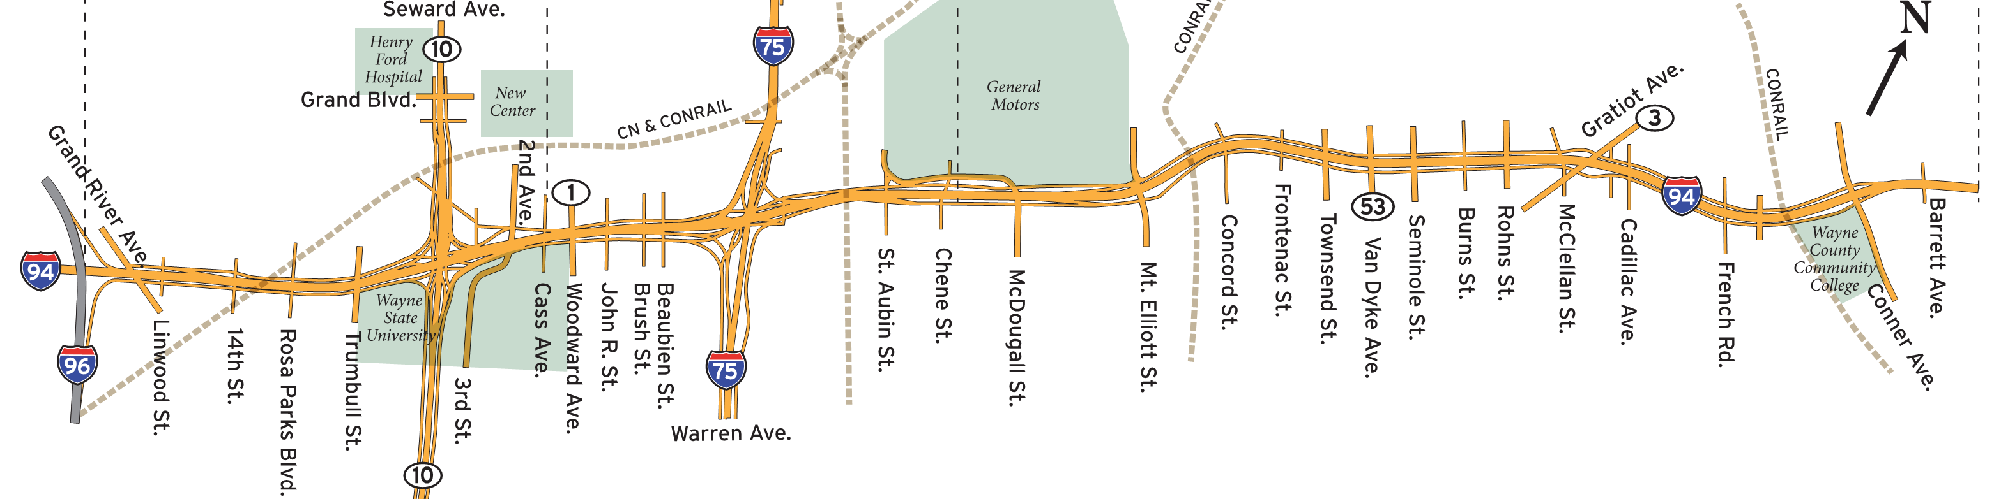

$3.2B I-94 Modernization Project to Remove Millions of Gallons of Stormwater
New MDOT drainage tunnel on I-94 to remove 5 miles of freeway and 10 miles of service drive stormwater runoff from the local sewer system.
I-96 to Burns Avenue
Burns to Barrett Avenue

Slide 34
Grant Funding Secured/Sought
Secured
Michigan State Revolving Fund $10M for individual lead service line replacement (750 locations) – received and to be completed 2023.
EPA $5M WIN Grant for lead service line replacement – received and work begins this summer with new DWSD employee crews.
EGLE APRA $75M for lead service line replacement – neighborhood-by-neighborhood for vulnerable populations and first $25M contracted.
$1.6M in state and federal grants for the Fenkell Stormwater Project to install 24 bioretention gardens – community engagement underway, construction begins 2024.
EGLE $480,000 grant to support East Side Resiliency Planning Project to study and determine a stormwater management project(s) – waiting on second grant approval (see below).
FEMA BRIC $11.3M grant for upsizing sewers in Jefferson Chalmers – approval expected by September.
Allocated, Waiting Approval
HUD Disaster Recovery $40M for flood and sewage backup mitigation following June 25-26, 2021 flooding – waiting for HUD final approval to use dollars for BBPP (potentially increase to $80M).
Applied
EGLE Clean Water State Revolving Fund $80M in grants for three westside stormwater projects – expect approval by September.
FEMA HMGP $3.2M grant for private sewer lateral repair – expect response by Fall 2023.
National Fish & Wildlife Foundation $540,000 grant to support East Side Resiliency Planning Project to study and determine a stormwater management project(s) – expect response by Fall 2023.

Slide 35
Thank You!
detroitmi.gov/DWSD
DWSD-publicaffairs@detroitmi.gov
facebook.com/DWSDDetroit
313-267-8000
@DetroitWaterDep
YouTube.com/DWSDwater

