Slide 1

S License Test Prep
Fall 2022

Slide 2
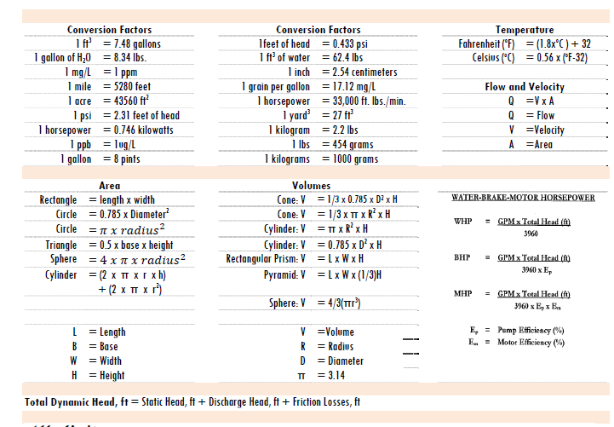
ELGE Formula Sheet 1/6

Slide 3
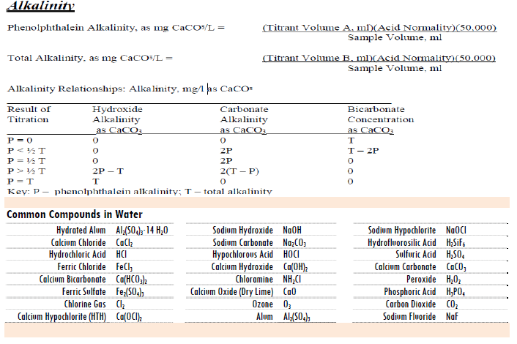
ELGE Formula Sheet 2/6

Slide 4
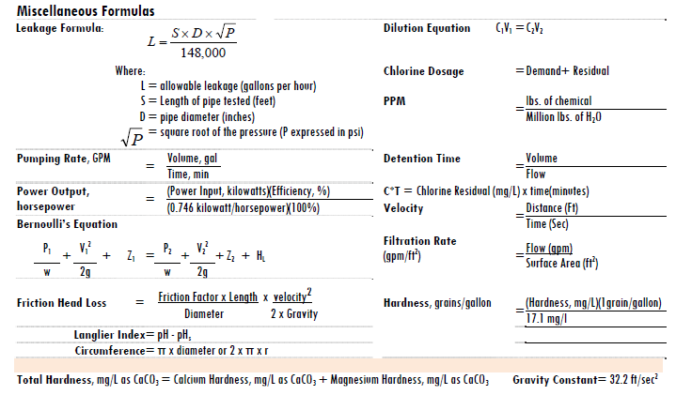
ELGE Formula Sheet 3/6

Slide 5
ELGE Formula Sheet 4/6

Slide 6
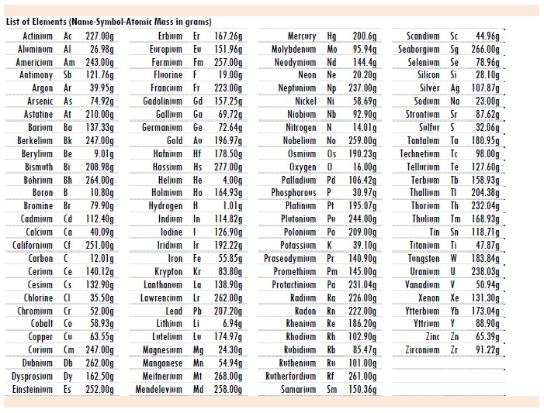
ELGE Formula Sheet 5/6

Slide 7
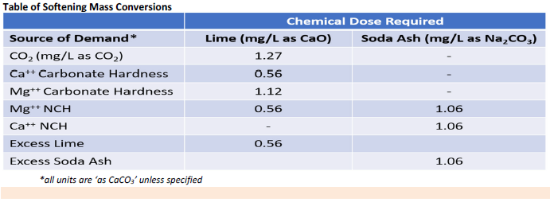
ELGE Formula Sheet 6/6

Slide 8
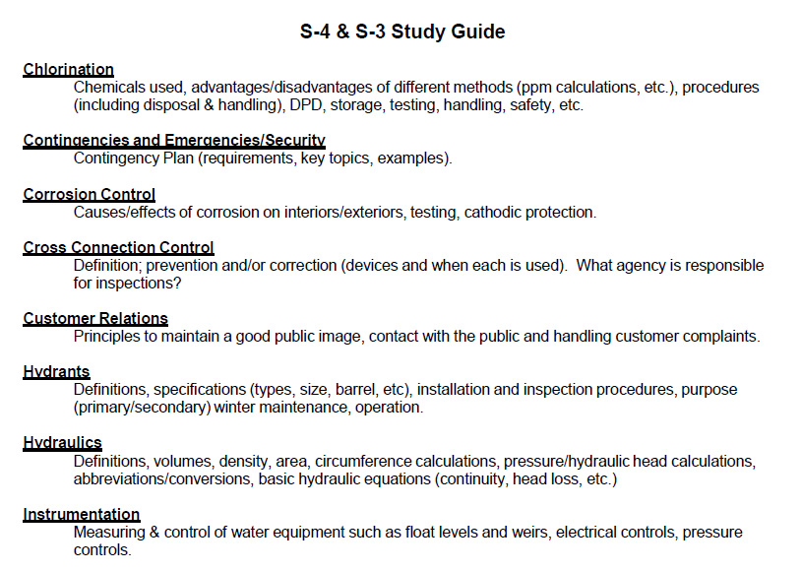
ELGE Study Guide

Slide 9
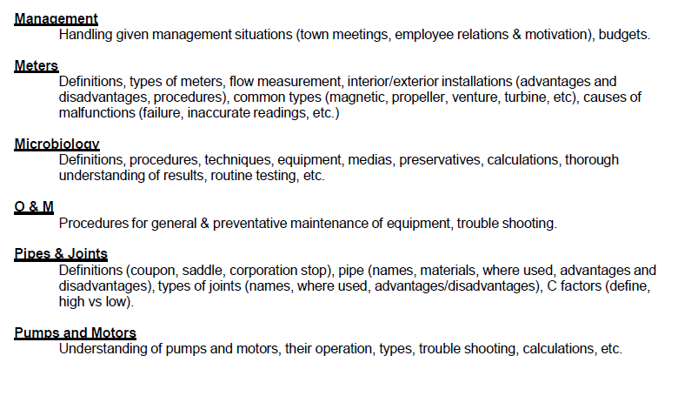
ELGE Study Guide

Slide 10
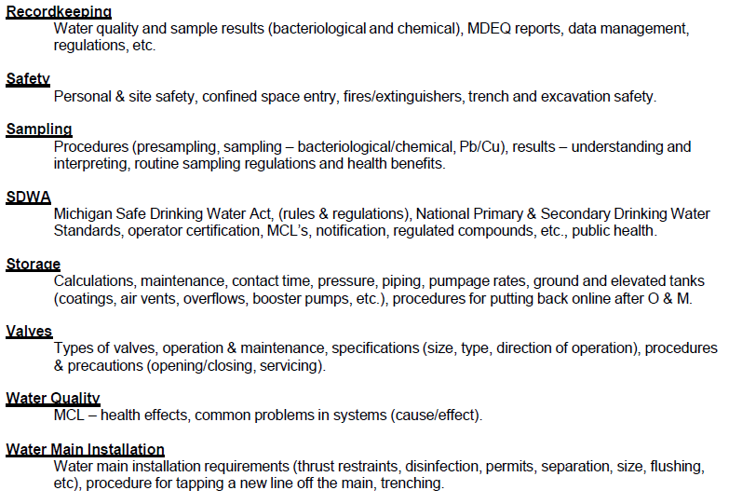
ELGE Study Guide

Slide 11
CHLORINATION

Slide 12
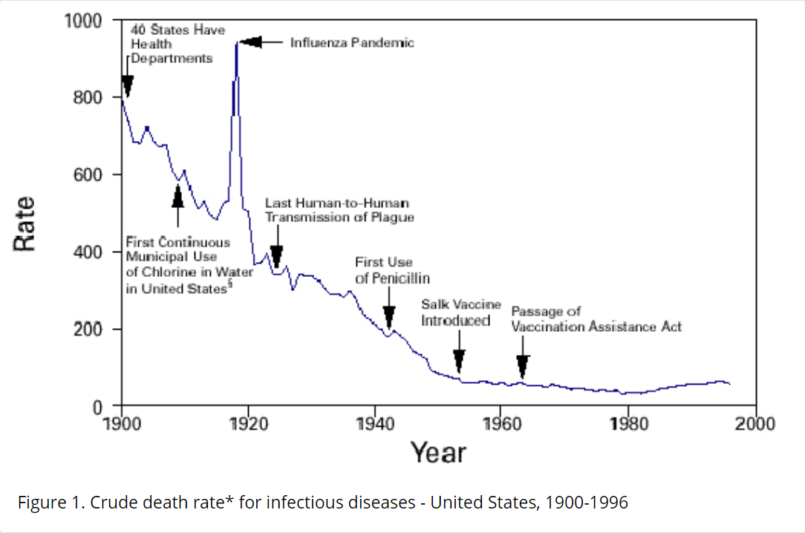
Importance of Chlorination

Slide 13
Chlorination
Gaseous chlorine (100%), liquid sodium hypochlorite (12%), or solid calcium hypochlorite (65%)
Chlorine residual required – go beyond the “breakpoint”
DPD – used to test for chlorine residual, either color compare or digital readout
Dosage = Demand + Residual
Total Chlorine Residual = Combined Chlorine + Free Chlorine
Chlorine combined with organics creates Disinfectant By Products – Trihalomethane (THHM) and Haleocitic Acids which can cause cancer

Slide 14
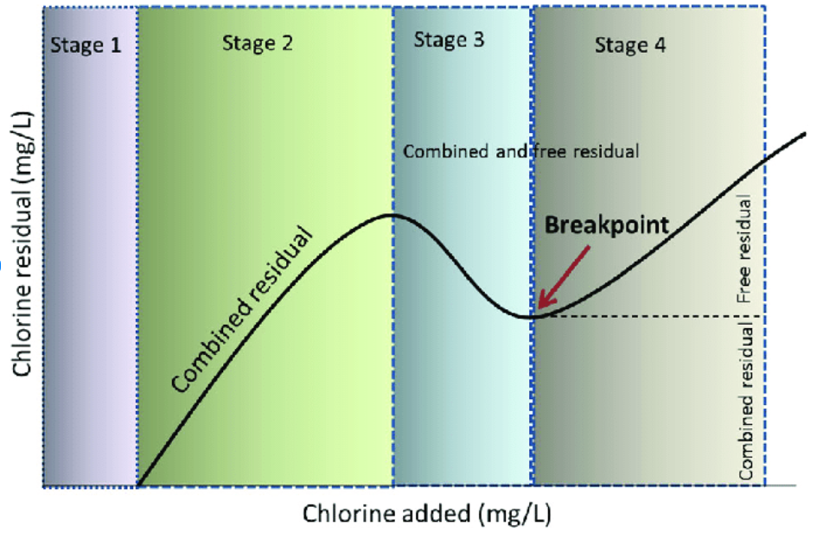
Chlorination - Breakpoint

Slide 15
Chlorination Safety
Always use self contained breathing apparatus (SCBA) when working on chlorine cylinders
Never work on cylinders alone
Never apply heat to a chlorine cylinder
Never apply water to a leaking or burning cylinder or the leak will grow worse
Always use hand truck for 150 pound cylinders, ton cylinders require cranes or mechanical equipment
Always use safety chains when storing or transporting chlorine cylinders

Slide 16
CONTINGENCIES AND EMERGENCIES/SECURITY

Slide 17
Contingencies Emergency Security
Conduct Vulnerability Assessment
Send Vulnerability Assessment to EPA
Develop Emergency Response Plan (ERP)
Certify to EPA the ERP is updated based on Vulnerability Assessment
NEW – Continuity of Operations (COOP)

Slide 18
Contingencies Emergency Security
Common Planning Scenarios
  Absence of trained personnel
  Loss of power to facilities
  Inadequate amount of supplies and materials
  Inadequate communication equipment
  Plausible natural disasters – flood, tornados, heat wave

Slide 19
Contingencies Emergency Security
Common Vulnerability Assessment Steps
  Identify and describe system components
  Assign assumed disaster characteristics
  Estimate disaster effects on system components
  Estimate customer demand following disaster
  Identify key system components that would be primarily responsible for system failure

Slide 20
Contingencies Emergency Security
Emergency Response Plan
  Conduct vulnerability assessment
  Inventory organizational personnel
  Provide for recovery operation (plan)
  Provide training on plan for operators
  Coordinate with local and regional authorities like Health, Police and Fire – Have phone numbers documented
  Establish communication procedures
  Provide protection for people, equipment, and records/maps

Slide 21
CORROSION CONTROL

Slide 22
Corrosion Control
Dissimilar metals - Galvanic Series Chart
Add Orthophosphate to water to coat inside of pipes
Cause of Flint Water crisis not adding Orthophosphate
Polyethylene wrap on ductile iron water mains
Dielectric bushings and fittings (plastic bushings)
Soil needs to be tested for corrosivity
Cathodic protection – sacrificial anodes

Slide 23
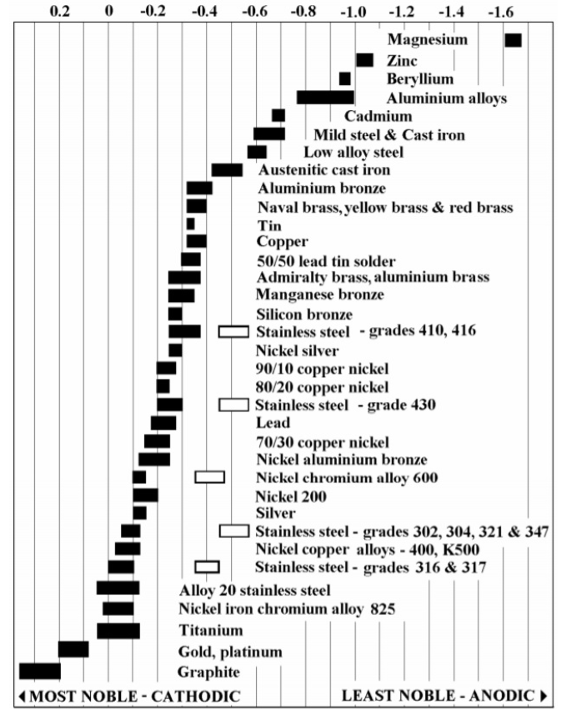
Corrosion Control - Galvanic Series
Elements on the top of the chart will give up electrons to elements lower on the chart

Slide 24
Corrosion Control Water Storage Tanks
Metallic coatings on outside of tank
Non metallic coatings like paint, coal tar enamels, cement mortar, epoxy resins, zinc paints, etc
Chemicals added to water to inhibit corrosion
Electrical control – cathodic protection
Prevent electrochemical reactions
Ensure everything that touches water is NSF 61
Corrosion is a possible source of taste and odor issues

Slide 25
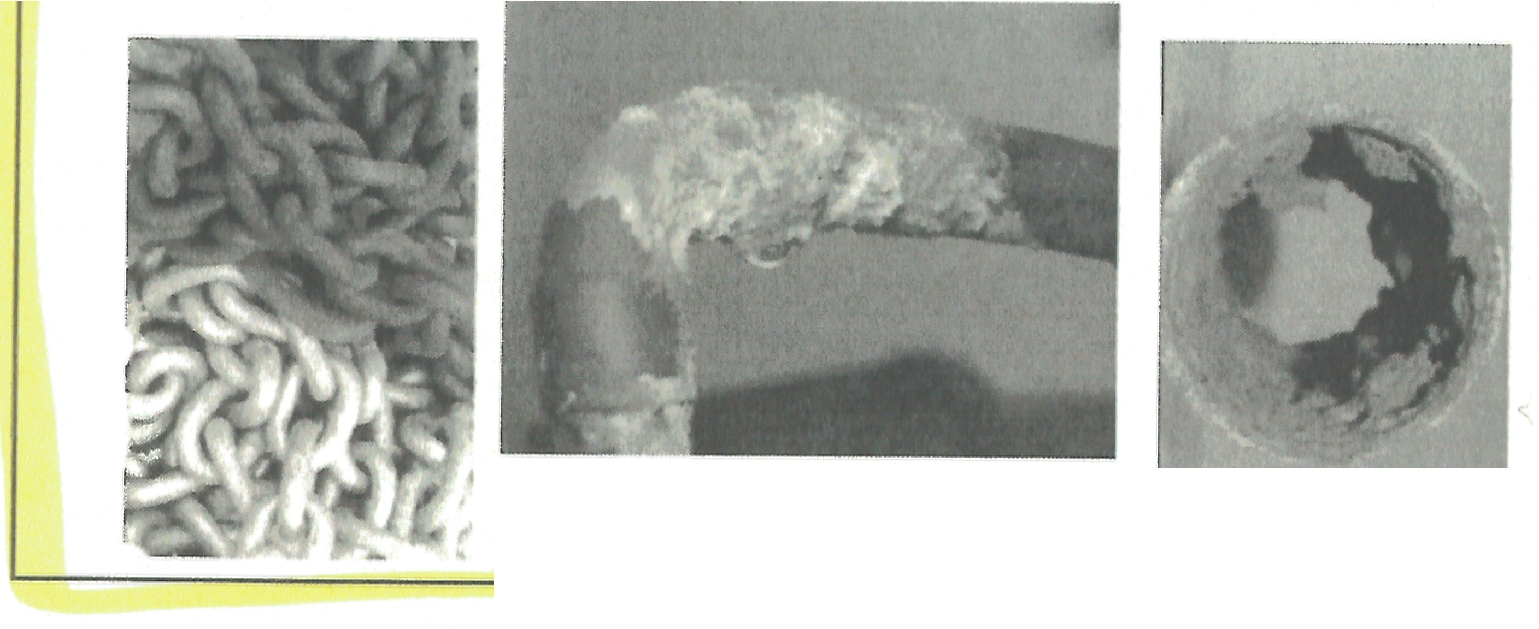
Corrosion
The definition of Corrode is - destroy or damage (metal, stone, or other materials) slowly by chemical action.
Corrosion is defined as - the process of corroding metal, stone, or other materials.
Corrosion is caused by oxidation.

Slide 26
Impact of Water Characteristics on
Lead Corrosion
FACTOR | CORROSION RATE
Increase pH (should be> 7.2)
Increase Chloride
Increase Sulfate
Alkalinity (< 50 mg/Las CaC0₃)
Increase Dissolved Oxygen
Increase HOCI/OCI·
Increase Orthophosphate

Slide 27
CROSS CONNECTION CONTROL

Slide 28
Cross Connection Control
Backflow – largest cause of disease or illness in a water systems
  Back Siphonage – lower pressure on system side due to breaks, leaks, high demand, or fighting fires
  Back Pressure – high pressure on customer side like tall buildings, pumps on customer side
Cross Connections – any unintentional connection between the potable water and non potable water
Hoses in radiators, pools, or any source of water is a cross connection

Slide 29
Cross Connection Basic Program
Enact ordinance giving legal authority to enforce
Train personnel on causes and hazards
Listing and inspection/reinspection of high hazards
Review all applications for new service for cross connection concerns
Obtain listing of all approved backflow prevention devices and certified testers

Slide 30
Cross Connection Basic Program
Acceptable installation of the correct type of device based on the hazard
Routine testing of backflow protection devices
Adequate records of devices installed, inspection, and testing records
Notification of customers when testing required
Maintain adequate pressures throughout distribution system – boil water alert at 20 psi or less

Slide 31
Backflow Prevention Devices
Air gap separation device
Reduced pressure principle (RPP) device
Double check valve
Pressure vacuum breaker
Atmospheric (non pressure) vacuum breaker
Only first three are approved for service connections!

Slide 32
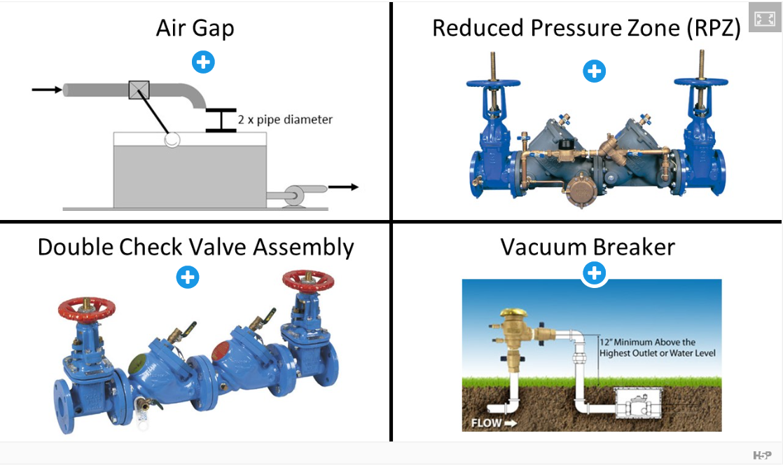
Backflow Prevention Devices
Has an auto relief valve
Only good for moderate hazards

Slide 33
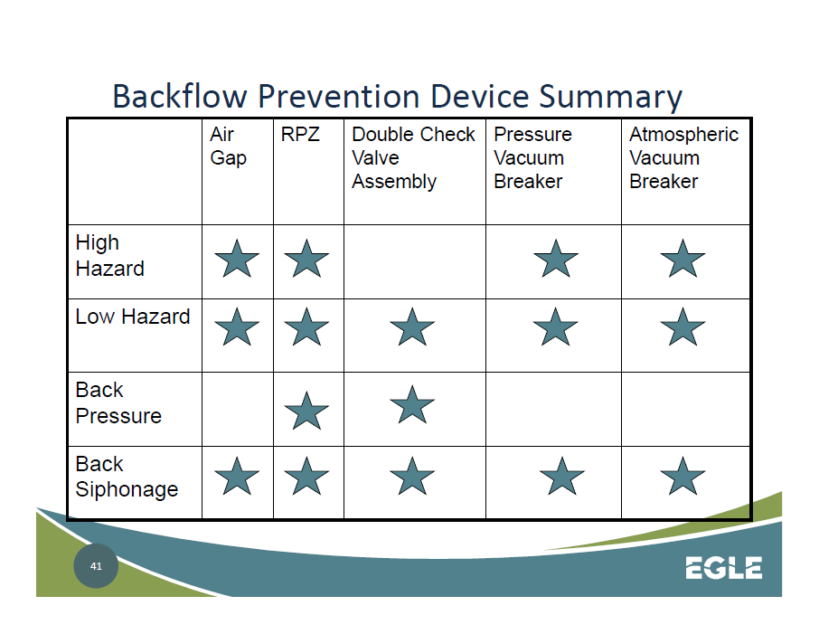
Backflow Prevention

Slide 34
CUSTOMER RELATIONS

Slide 35
Customer Relations
Every employee responsible for customer relations
Appearance of personnel, facilities, and equipment matters
Integrity matters in keeping public trust
Try to diffuse or de-escalate interactions with angry customers
Consumer Confidence Report mandated by law – provides water quality testing results on an annual basis
Accurate billing is essential for public confidence

Slide 36
HYDRANTS

Slide 37
Hydrants
Used to Fight fires, flush pipelines, and provide water to equipment
Four Main Parts
  Inlet connection to public water supply
  Main valve
  Barrel
  Head
Wet and Dry Barrel hydrants
Nozzles usually 2.5 or 4.5 inches in diameter, larger nozzle points to street
Typical spacing 500 feet (Detroit uses 300 feet)
Inspect twice per year – Spring and Fall – ensure no water in Fall in cold climate

Slide 38
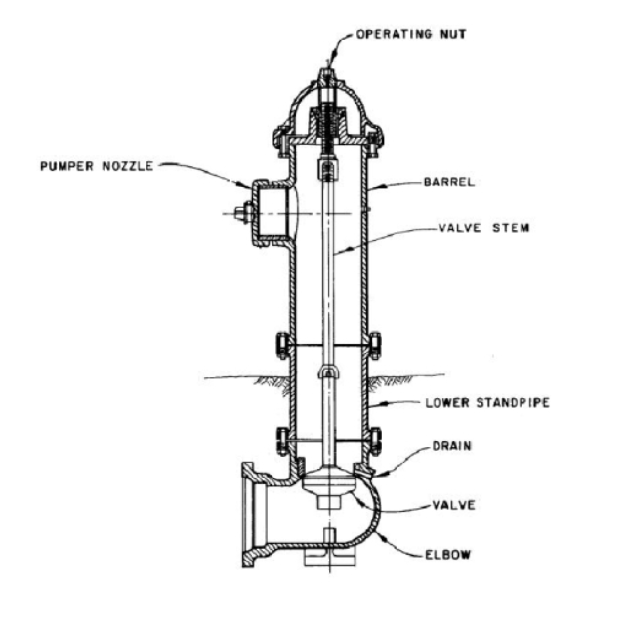
Hydrants

Slide 39
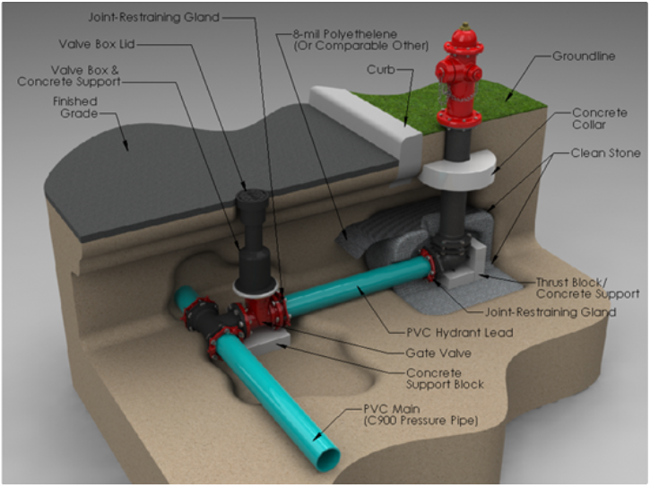
Hydrants

Slide 40
Hydrant Inspections
Inspect for leakage
Open hydrant fully check for ease of operation
Flush the hydrant
Check for thread damage
Replace all caps
Check for exterior obstructions

Slide 41
Hydrant Inspections
Check dry barrel hydrants for proper drainage
Be sure the auxiliary valve in fully open position
If inoperable, tag it out of service
Maintain a good record of the inspection and any necessary repairs
Pump out before winter to prevent freezing

Slide 42
Classifications and Markings of Municipal Fire Hydrants
Classification | Fire Flow | Barrel Color | Top Nozzle Cap Colors | Pressure
Class AA | 1,500 gpm (5680 L/min) Or greater | Chrome Yellow | Light Blue | 20 psi (140 kPa)
Class A | 1,000 – 1,499 gpm (3785 - 5675 L/min) | Chrome Yellow | Green | 20 psi (140 kPa)
Class B | 500 - 999 gpm (1900 - 3780 L/min) | Chrome Yellow | Orange | 20 psi (140 kPa)
Class C | 500 gpm (1900 L/min) Or less | Chrome Yellow | Red | 20 psi (140 kPa)
Based on information given in NFPA 291. Recommended Practice for Are Flow Testing and Marking of Hydrants, 2007.

Slide 43
HYDRAULICS

Slide 44
Water Rules to Live By
Water always takes the path of least resistance.
Water always goes from high energy to low energy.
Water has a principle known as the no-slip rule
Water is incompressible
Water is the universal solvent
Q = Q; Where Q = Flow (gallons per minute)

Slide 45
Hydraulics
1 psi for every 2.31 feet of water column
0.433 psi for every foot of water column
One gallon weights 8.34 lbs
One cubic foot of water weighs 62.4 lbs
C Factor – higher number means smoother pipe inside
Water hammer – sudden change of direction
Fire flow is larger than customer demand

Slide 46
Hydraulics
Summer is typically max demand season
ISO – Insurance Services Office determines fire protection rating for a water system
50 to 75 psi ideal pressure range for distribution system
Ideal water velocity around 5 feet per second
Head loss due to friction on formula sheet

Slide 47
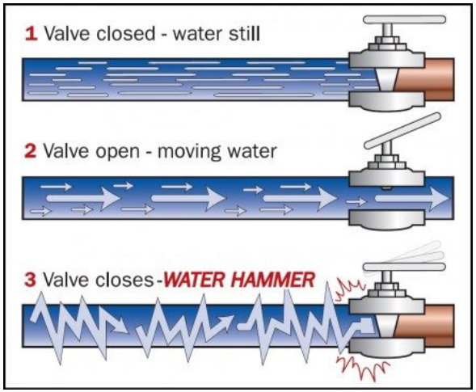
Hydraulics - Water Hammer

Slide 48
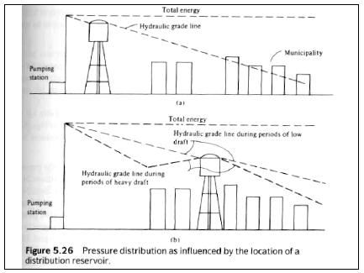
Hydraulic Grade Line

Slide 49
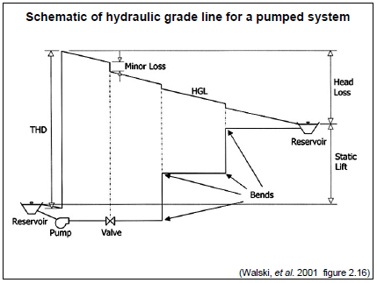
Hydraulic Grade Line

Slide 50
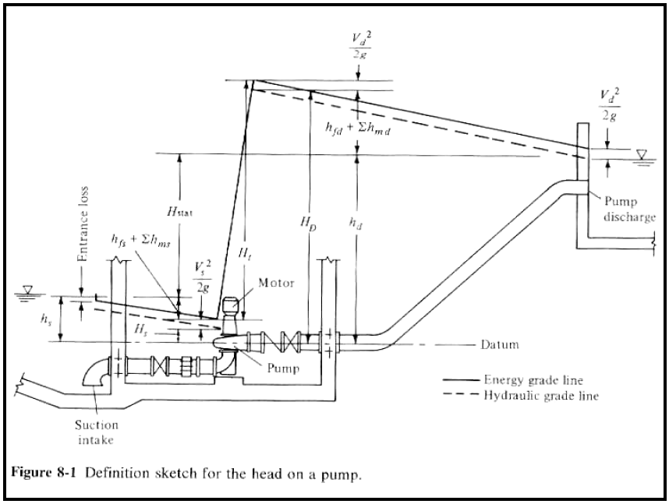
Hydraulic Grade Line

Slide 51
INSTRUMENTATION

Slide 52
Instrumentation
SCADA – Supervisory Control and Data Acquisition
Primary instruments measure flow, pressure, level, and temperature
Secondary instruments respond to and display the information from Primary instruments
Control systems either manually or automatically operate equipment like pumps and valves

Slide 53
MANAGEMENT

Slide 54
Management
Accountability
Authority
Bond
Coverage Ratio
Debt Service
Delegation
Human Machine Interface
MSDS
Operating Ratio
SCADA
OUCH Principle

Slide 55
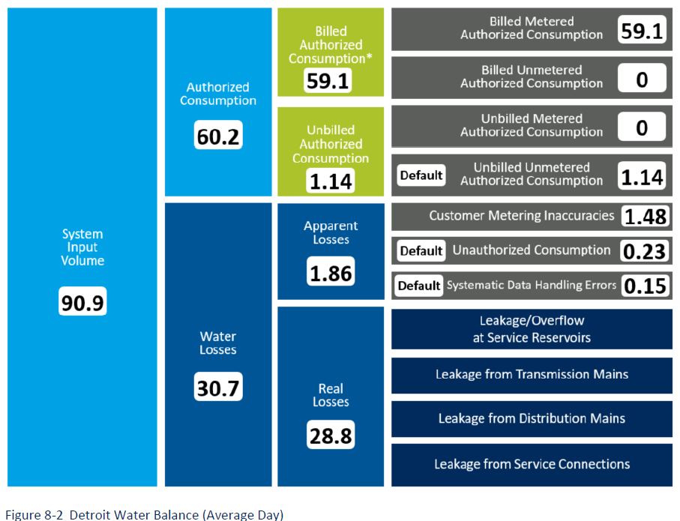
Operational Reporting, Standards and
Metrics – Non Revenue Water 2019
Non revenue water 30.7/90.9 = 33.8% per Black and Veatch Units of Service Phase 2 report
BV estimates 90 gallons per connection per day @ 311,000 connections for Detroit
DWSD goal 20%

Slide 56
WATER METERS

Slide 57
Water Meters
Types of Water Meters
  Positive Displacement – most common
    Nutating Disc
    Piston
  Current/Velocity/Mechanical – larger sizes above 3 inch
  Detector Check – fire lines – doesn’t measure, just informs
  Proportional
  Venturi
  Orifice
  Pitometer
  Magnetic
  Sonic

Slide 58
Water Meters
Meter life typically 10 years
Accurate metering important for revenue and ensuring accurate billing
Select the meter that accurately measures customer demand profile
Malfunctions due to calcification/hardness in water, tampering, or freezing
Y strainer can prevent debris from fouling meter
AMR – automated meter reading
AMI – advanced metering infrastructure

Slide 59
Water Meters
Types of Water Meters
  Positive Displacement – most common
    Nutating Disc
    Piston
  Current/Velocity/Mechanical – larger sizes above 3 inch
  Detector Check – fire lines – doesn’t measure, just informs
  Proportional
  Venturi
  Orifice
  Pitometer
  Magnetic
  Sonic

Slide 60
MICROBIOLOGY

Slide 61
Microbiology
TCR – total coliform rule
RTCR – revised total coliform rule
Coliform – presence of coliform is indication of potential pathway for more harmful Escherichia coli (E.Coli)
E.Coli will make people very sick
RTCR established Maximum Contamination Level Goal (MCLG) for E.Coli

Slide 62
OPERATIONS AND MAINTENANCE

Slide 63

Operator's Responsibilities
Assure Continuous and Safe Supply of Water
Maintain System & Protect the Investment
Understand the System

Slide 64
Operations and Maintenance
Follow Manufacturer’s recommendations for mechanical equipment
Operators have responsibility to care for the system

Slide 65
PIPES AND JOINTS

Slide 66
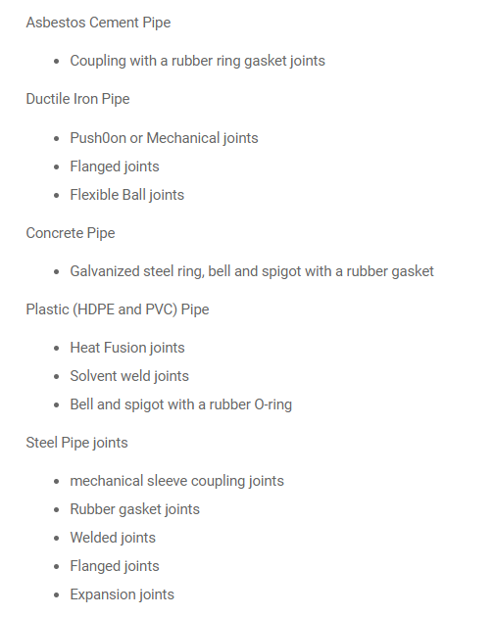
Pipes and Joints

Slide 67
PUMPS AND MOTORS

Slide 68
Pumps and Motors
  Two main types of pumps in water distribution
    Velocity – Centrifugal and Vertical Turbine
    Positive Displacement – chemical feed application

Slide 69
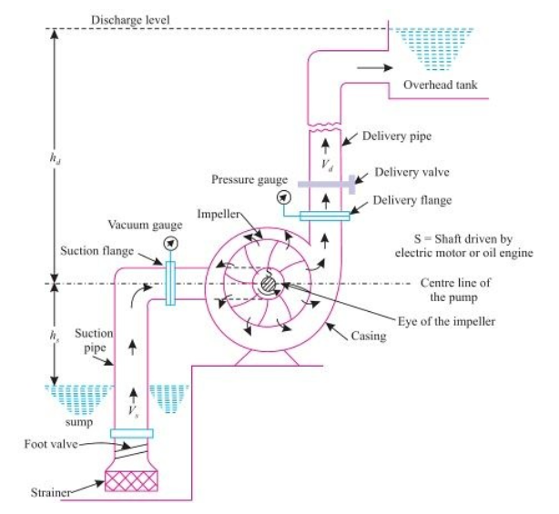
Pumps and Motors

Slide 70
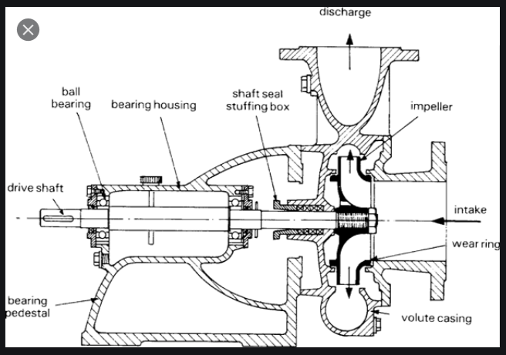
Pumps and Motors – Centrifugal Cutaway

Slide 71
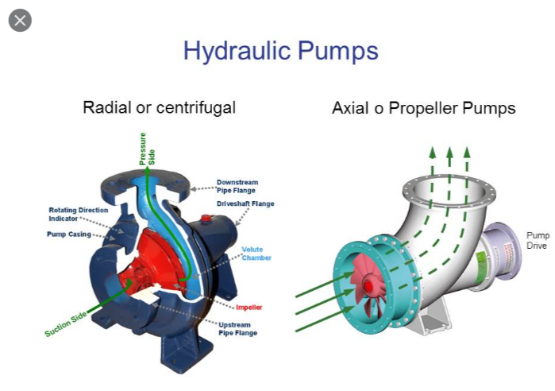
Pumps and Motors – Radial vs Axial

Slide 72
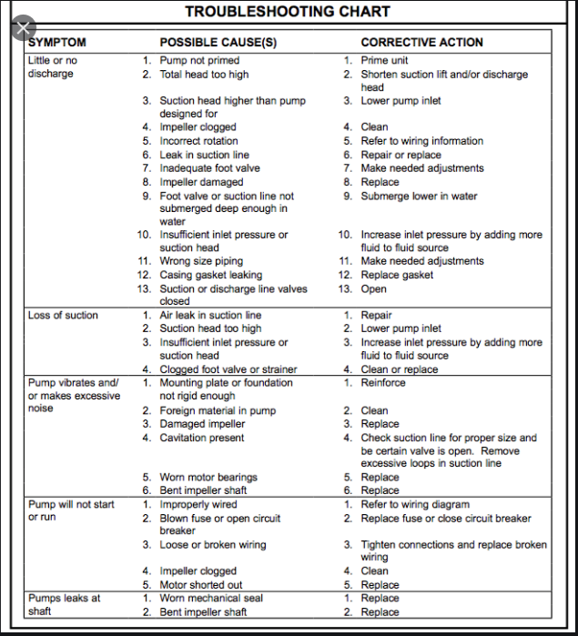
Centrifugal Pump – Troubleshooting

Slide 73
RECORD KEEPING

Slide 74
Record Keeping
Type of Record | Time Period
Bacteriological or turbidity | 5 years
Chemical analysis | 10 years
Actions taken to correct violations | 3 years
Sanitary survey reports | 10 years
Exemptions | 5 years following expiration

Slide 75
SAFETY

Slide 76
Safety
OSHA – Occupational Health and Safety Administration
MSDS – Material Safety Data Sheet
Add acid to water, do not add water to acid
The only person who should remove lockout/tagout is the person who locked it out

Slide 77
Safety – Trenching/Shoring
Competent Person – one who knows rules and regulations on trenching and shoring, and who is authorized to take immediate correction action
Ladder must stick up 3 feet above ground level
Spoil must be at least 2 feet back from edge of hole
Shoring spaced per TABULATED DATA -
Ladder required every 25 feet and clearly visible at all times to those in trench
Shoring required for any excavation over 5 feet, or 4 feet if there’s water in the excavation
Excavations can be “laid back”, but you have to know the soil type to do so A, B, or C
Any protective system for excavation over 20 feet must be designed by Engineer
Competent Person monitors before anyone gets in excavation each day, and as conditions change during the work

Slide 78
Safety – Confined Space
Min oxygen level is 19.5% - do not enter
Hydrogen Sulfide – rotten eggs – can be lethal
Chlorine – 30 ppm irritating, 40 to 60 ppm dangerous, 1000 ppm lethal in few breaths
LEL – lower explosive limit > 10% do not enter
UEL – upper explosive limit

Slide 79
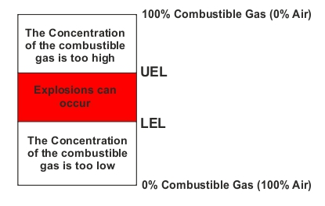
Lower Explosive Limit and Upper Explosive Limit

Slide 80
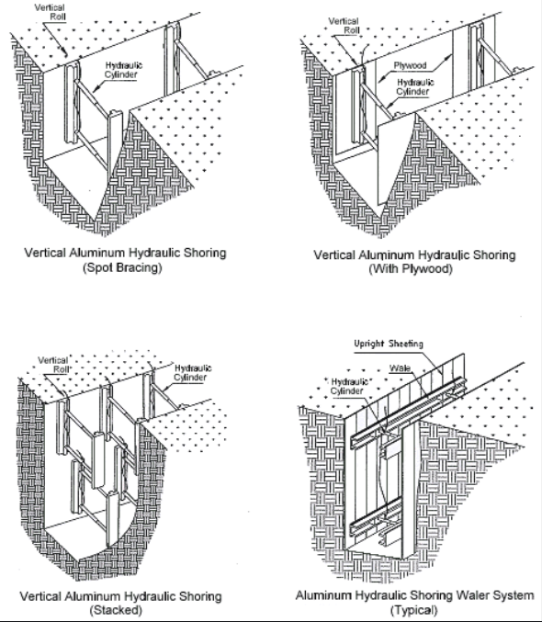
Safety – Trenching/Shoring
The Competent Person must ensure the water in the hole is controlled

Slide 81
Safety – Trenching/Shoring
Hazardous Atmosphere includes:
  Explosive
  Flammable
  Poisonous
  Corrosive
  Irritating
  Oxygen deficient
  Toxic
  Otherwise harmful

Slide 82
Confined Spaces
A confined space is large enough for workers to enter and perform
certain jobs, has limited or restricted means for entry or exit, and is not designed for continuous occupancy.
Permit-required confined space (permit space) has one or more of the following characteristics:
Contains or has a potential to contain a hazardous atmosphere; Contains a material that has the potential for engulfing an entrant;
Has an internal configuration such that an entrant could be trapped or asphyxiated by inwardly converging walls or by a floor which slopes downward and tapers to a smaller cross-section; or
Contains any other recognized serious safety or health hazard.
Confined space examples are:
Tanks, vessels, silos, storage bins, hoppers, vaults, pits, manholes, tunnels, equipment housings, ductwork, pipelines, etc.
Hazards associated with confined spaces:
Engulfment Solid or liquid media | Can become trapped
Hazardous atmosphere H2S, methane, high or low oxygen, process chemicals. | Process specific issues: High pressure, electrical shock, mechanical motion, etc.

Slide 83
Traffic Control
A majority of a water distribution system components tend to be located under or near roadways and streets. As such, appropriate traffic control should be a major concern when it comes to worker safety. Traffic control training can include appropriate vehicle placement and parking, the use of emergency lighting, the use and location of work zone signage and other warning devices, and appropriate employee PPE while in a work zone.
Some of the most important items to remember regarding traffic control is awareness of your surroundings and establishing as safe a work zone as possible for your specific situation. A work zone on an expressway will be recognizably different than a work zone layout in a one-way alley. We could spend an entire training session on traffic safety, but the important thing to remember is a constant awareness of the surroundings.

Slide 84
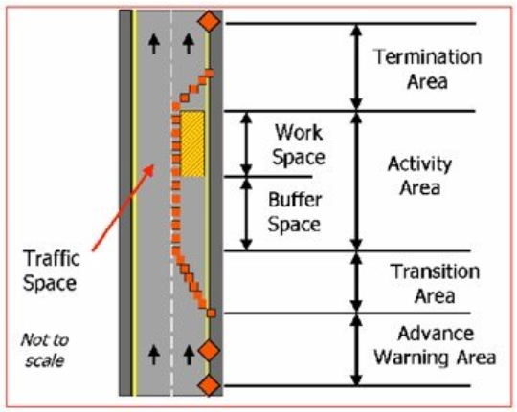
Traffic Control

Slide 85
SAMPLING

Slide 86
Sampling – Required Sample Information
Sampling Information
  Date, place, time of sample
  Name of sample collector
    Identification of sample
    Routine or check sample
Analysis Information
  Date of analysis
  Lab conducting analysis
  Name of person conducting analysis
  Analytical method used
  Analysis results

Slide 87
Sampling – Sample Types
Grab sample – single volume of water from single place at one time
Composite – series of grab samples collected from same place at different times and mixed together
  Time composite – set time in between grabs
  Flow proportional – each grab over time is proportional to the flow at that time

Slide 88
Sampling – Misc
Sample location should be representative of various conditions throughout the system, and entering the system
Samples must be “preserved”
Chlorine samples analyzed immediately
Do Not Sample From
  Any faucet located near bottom of sink
  Any leaking faucet or with threads
  Any faucet connected to home treatment unit
  Any water fountain

Slide 89
Sampling – Lead and Copper
Michigan requires the 1st and 5th liter to be sampled
Highest Tier in system
Current Action Level is 15 parts per billion for Lead
Future Action Level in Michigan is 12 parts per billion on 1/1/2025
Test only kitchen faucet or bathroom faucet
Water must be stagnant for six hours or more

Slide 90
SAFE DRINKING WATER ACT

Slide 91

Why are these in place?
To protect public health!
SDWA sets up multiple barriers:
Source water protection
Treatment
Public information
Distribution system integrity

Slide 92
Safe Drinking Water Act - SDWA
Passed by Congress in 1974
Sets MCL (max contaminant level) for elements that threaten health
Delegates primacy (authority) to states to enforce
Provides grant funding
Monitors the states enforcement success
Provides research into contaminants and treatment effectiveness
Systems serving >10,000 must send annual Consumer Confidence Report (CCR)

Slide 93
Types of Public Water Systems
CLASSIFICATION |  |  | DESCRIPTION | EXAMPLES
Public Water System | Type I Community |  | Provides year-round service to ≥ 15 living units OR to ≥ 25 residents | Municipalities, subdivisions, apartments, condominiums, nursing homes, manufactured housing communities
 | Type II Noncommunity | Nontransient | Serves ≥ 25 of the SAME individuals on an average daily basis for > 6 months per year | Places of employment, schools, day-care centers, bottled water sources
 |  | Transient | Serves ≥ 25 individuals or ≥ 15 service connections on an average daily basis for ≥ 60 days per year | Hotels, restaurants, campgrounds, churches, highway rest stops
 | Type III |  | Public water system that is not a Type I or Type II | Subdivisions, apartments, condominiums, duplexes, with 2-14 living units, facilities serving < 25 individuals or open < 60 days per year
Private Water System |  |  | Serves a single living unit | Single family home

Slide 94
Safe Drinking Water Act - SDWA
Community Water System
  Municipal systems
  Rural water districts
  Mobile home parks
  Serving 15 or more homes

Slide 95
Safe Drinking Water Act - SDWA
Nontransient, Noncommunity Water System
  Schools
  Factories
  Office buildings
  Serving on average at least 25 people who do not live there
  Same population uses the water at least 6 months per year

Slide 96
Safe Drinking Water Act - SDWA
Transient/Non-community water system
  Parks
  Motels
  Restaurants
  Churches
  Own water system and serve at least 25 people
  People only use water there occasionally

Slide 97
SDWA – Regulation of Contaminants
National Primary Drinking Water Standards – sets MCL or required treatment technique for contaminants that have adverse HEALTH effects
National Secondary Drinking Water Standards – sets standards on issues that effect taste, odor, or color, but are not known to have health effects, but negatively influence customers acceptance of water.

Slide 98
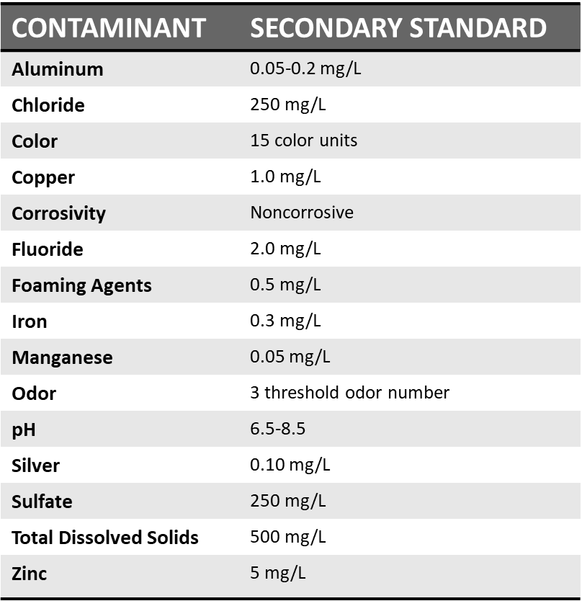
SDWA – National Secondary Standards

Slide 99
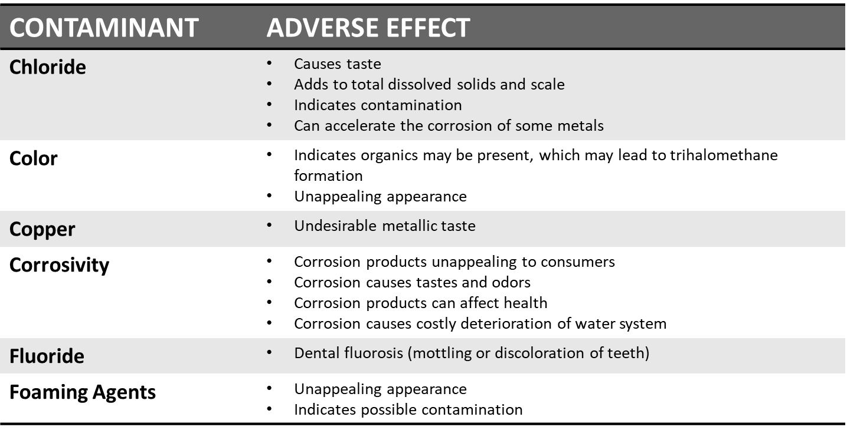
SDWA – Adverse Effects of National
Secondary Standards

Slide 100
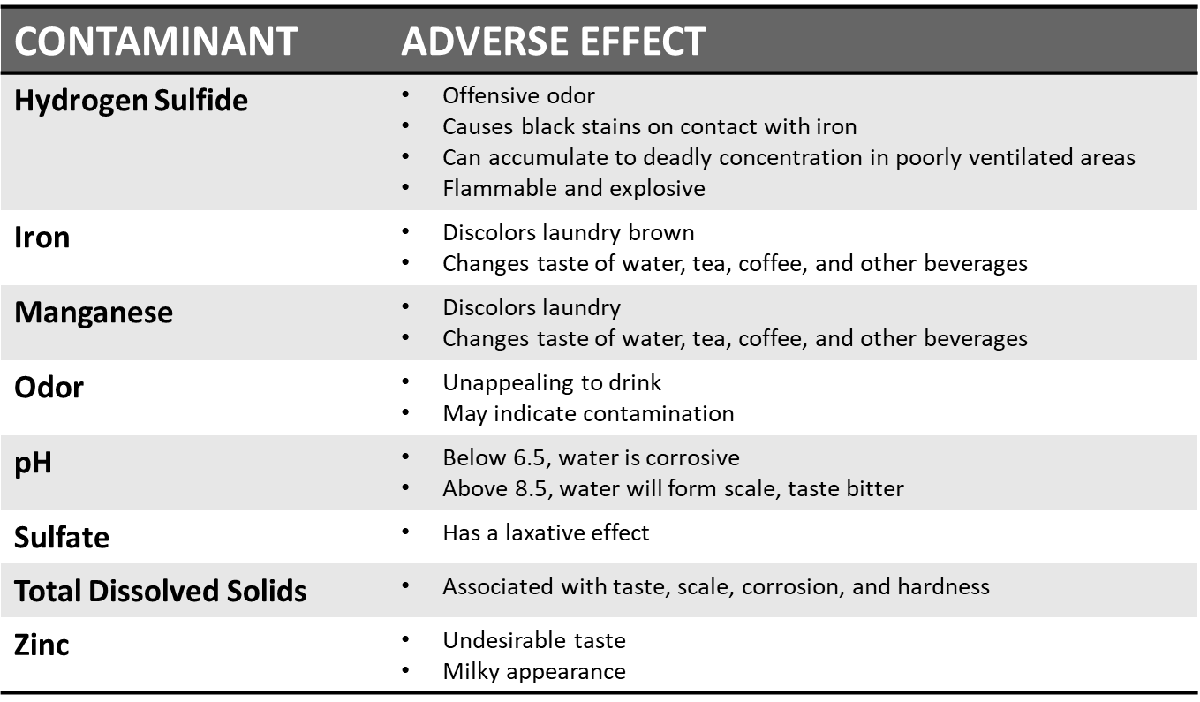
SDWA – Adverse Effects of National
Secondary Standards

Slide 101
SDWA – Regulation of Contaminants
National Primary Drinking Water Standards – sets MCL or required treatment technique for contaminants that have adverse HEALTH effects
National Secondary Drinking Water Standards – sets standards on issues that effect taste, odor, or color, but are not known to have health effects, but negatively influence customers acceptance of water.

Slide 102
SDWA Microbiology Primary Standards
Microbial
Total Coliform | 1 per mL
 | <40 samples/mo – no more than one positive
 | >40 samples/mo – no more than 5% positive
Giardia lamblia | 3-log (99.9%) removal
Legionella | Treatment technique
Enteric viruses | 4-log (99.99%) removal
Heterotrophic bacteria | Treatment technique

Slide 103
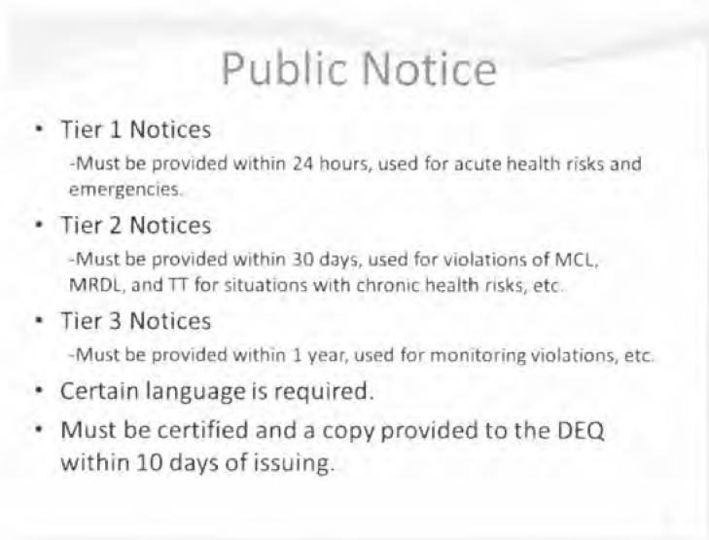
Public Notifications

Slide 104
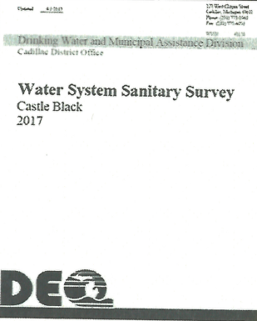
Part 7 of Act 399
EVERY 3 YEARS
Sanitary Surveys 8 Elements:
Source
Treatment
Distribution system
Storage
Pumps
Monitoring
System O&M
Compliance

Slide 105
STORAGE

Slide 106
Storage
Fill reservoirs at night when demand low and energy less expensive
Use storage to handle peaks of the diurnal curve
Know the age of water in reservoirs
Short circuiting of water in reservoirs

Slide 107
Why Do We Need Storage Tanks?
Maintain System Pressure (pump switching)
Reliability (auxiliary power requirement)
Pump Cushion (prevent surge pressure)
Smooth peak flows (lessen demand charge)
Allow off-peak pumping{$$$$$)
Fire storage
Community identity
·

Slide 108
VALVES

Slide 109
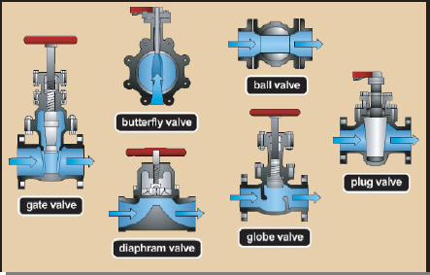
Valves

Slide 110
WATER MAIN INSTALLATION

Slide 111
Water Main Installation
Preparation, Excavation & Laying Pipe
Gasket lube – NSF 60
Pipe bedding - oh so important (long term)
Separation - physical & sanitary concerns
FLUSHING - get rid of "chunks"
Pressure (leakage) testing - do not "rush" this
Disinfection – tablet, continuous feed, slug
FLUSHING - distribute the chlorine
Bacti testing - 2 consecutive, 24 hrs apart, 1200 ft intervals
Final FLUSHING - restore to "normal" residual

Slide 112
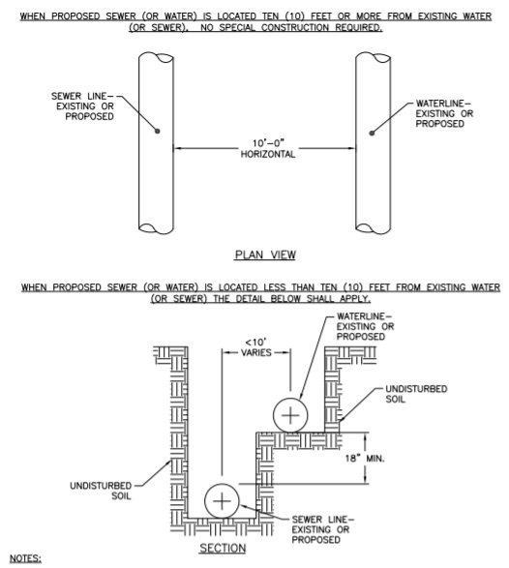
Water and Sewer Separation

Slide 113
Thrust Blocks
Made of concrete or steel rods cast into concrete
Rest against undisturbed earth (now & future)
Standard engineering formulas used to determine size
Block must be centered in-line with thrust force & cradle the fitting, not the joint
Also installed under hydrants and gate valves for support

Slide 114
Flushing
Prior to disinfection, the main must be flushed at a minimum of 3 ft/sec (scouring velocity)
High velocity needed to remove dirt, sand & debris
Flush long enough to remove 2 - 3 times the pipe volume of water

Slide 115
Pressure Testing
After the main and appurtenances have been installed, trench (at least partially) backfilled, the new main must pressure tested
Called Hydrostatic Pressure Testing, or Pressure Test
Done prior to connection to existing mains
New pipes should have virtually no leakage unless something is defective

Slide 116
Prior to Testing
Fill main slowly with water & remove air
Bring up to working pressure & let stand for a period of time to stabilize
Examine any exposed pipe and fittings for leaks

Slide 117
Minimum Test Pressure
For Ductile Iron pipe
    1.25 times the working pressure at highest elevation of pipe
    1.5 times the working pressure at lowest elevation of pipe
For PVC pipe
    At least 1.25 times the working pressure at highest elevation

Slide 118
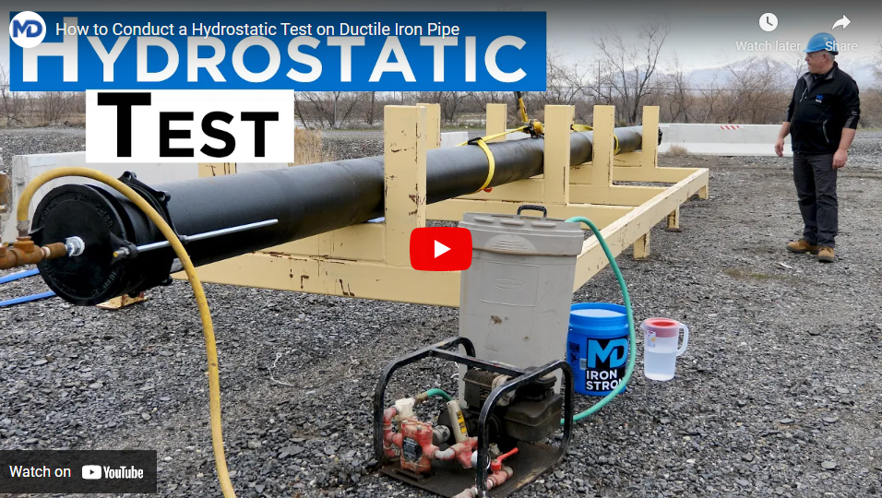
During the Test
Pump up to the minimum test pressure for 2 hours
Test pressure shall stay within + 5 psi at all times
Measure amount of makeup water used to maintain the test pressure for the entire 2 hour period
Pressure Testing

Slide 119
Disinfection of Water Mains
Water suppliers should follow the requirements in AWWA Standard C651, Disinfecting Water Mains
New version published in 2015
Every water supply should have this standard!
Four approved methods of chlorination
Method chosen depends on:
Length & diameter of main
Material & equipment required
Dechlorination may be required
Avoid discharging to surface waters
AWWA Standard C655

Slide 120
Continuous Feed Method
Fill the new main with potable water that has at least a 25 mg/l Cl2 concentration
Hold for 24 hours & measure residual
Valves & hydrants should be operated during hold period
Cl2 residual must be at least 10 mg/I after 24 hours
Flush, then sample for coliform bacteria

Slide 121
Tablet Method
5 gram tablets containing 65% Cl2 taped to top of main to obtain 25 mg/I concentration
Tablets placed at upstream end of:
  first section of pipe
  each branch main (including hydrant leads) 500 foot intervals
Tape must be NSF 61 approved
Slowly fill pipe and wait 24 hours
Detectable Ch residual should be obtained after the 24 hour period
Flush, then sample for coliform bacteria

Slide 122
Slug Method
Slowly moving a slug of water dosed with 100 mg/I Cl2 solution through the main
Slow rate ensures that all parts of main and appurtenances will be exposed to the Cl₂
Cl2 needs to be measured at regular intervals
Slug of Ch should never go below 50 mg/I
  If Cl2 drops below SO mg/l, flow must be stopped and feed point relocated at the head of the slug
Flush, then sample for coliform bacteria

Slide 123
Bacteriological Testing
Primary means to demonstrate sanitary integrity of new main
Analyzed for Total Coliform
  Sample sites every 1,200 ft, plus:
  one from end of the pipe
one from each branch
Consecutive (2) SAFE samples
  24 hours apart

Slide 124
Final Connection to Existing Mains
Mains and appurtenances used to make the final connection to existing mains must be flushed, disinfected and sampled
Connections less one pipe length (< 20 ft)
  May be sprayed or swabbed with Cl2 solution
Connections greater than one pipe length(> 20 ft)
  Set above grade and disinfected and sampled as previously discussed
  After safe samples have been obtained, pipe can be used to connect new main to active distribution system

Slide 125
Ethics
Misrepresentation | Falsification
Sample collection Own education | Knowingly falsifying sampling data or other
Own certification | Lying on your certification application

Slide 126
Types of Public Water Systems
CLASSIFICATION |  |  | DESCRIPTION | EXAMPLES
Public Water System | Type I Community |  | Provides year-round service to ≥ 15 living units OR to ≥ 25 residents | Municipalities, subdivisions, apartments, condominiums, nursing homes, manufactured housing communities
 | Type II Noncommunity | Nontransient | Serves ≥ 25 of the SAME individuals on an average daily basis for > 6 months per year | Places of employment, schools, day-care centers, bottled water sources
 |  | Transient | Serves ≥ 25 individuals or ≥ 15 service connections on an average daily basis for ≥ 60 days per year | Hotels, restaurants, campgrounds, churches, highway rest stops
 | Type III |  | Public water system that is not a Type I or Type II | Subdivisions, apartments, condominiums, duplexes, with 2-14 living units, facilities serving < 25 individuals or open < 60 days per year
Private Water System |  |  | Serves a single living unit | Single family home

Slide 127
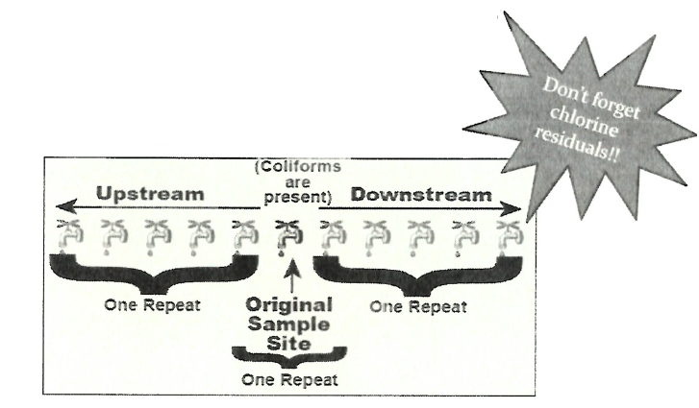
RTCR Repeat Monitoring
For every positive routine compliance sample:
3 repeat samples required (within 24 hours)
  Original location
  Upstream (within 5 service connections)
  Downstream (within 5 service connections)

Slide 128
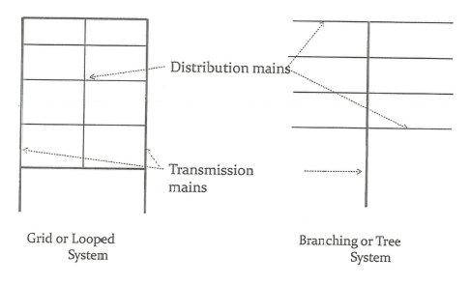
Common System Layouts

Slide 129
Watermain Installation
Preparation, Excavation & Laying Pipe
Gasket lube - oh so important(short term)
Pipe bedding- oh so important (long term)
Separation - physical & sanitary concerns
FLUSHING - get rid of "chunks"
Pressure (leakage) testing - do not "rush" this
Disinfection - many "approved" methods.
FLUSHING - distribute the chlorine
Bacti testing- 2 consecutive, 24 hrs apart, 1200 ft
Final FLUSHING - restore to "normal" residual

Slide 130
Trench Excavation and Preparation
General Preparation
  Call Miss Dig
  Excavate to Plans
  Shore up Trench
  Store Soil Away from Trench
Width of Trench
  Type of Soil
  Depth of Trench
  18" from centerline, or 1 foot on each side of pipe
Ensure Stable Foundation
  Safety, Safety, Safety
Separation - physical & sanitary concern
  18-inch vertical
  10 feet horizontal
  "center pipe joints" at crossings
Rock Excavation
  Excavate extra 6" of rock and backfill with clean sand
De-Water as necessary

Slide 131
Backfilling
Use only clean sand or soil for initial layers
  Free of stones, debris, peat, roots, frozen material, etc.
First layer of backfill
  Install material up to the center of the pipe (springline)
  Keep joints exposed until after pressure testing is complete
  Then compacted around and under the pipe with a hand or pneumatic tamper
Continue adding layers of good quality backfill and compact to secure the pipe
  Final layer should be at least 6" above the top of the main for ≤ 8" pipes
  Thicker layer for larger pipes as recommended by manufacturer
Fill in rest of trench with excavated material and compact!
  Advised to wait until pressure testing is completed

Slide 132
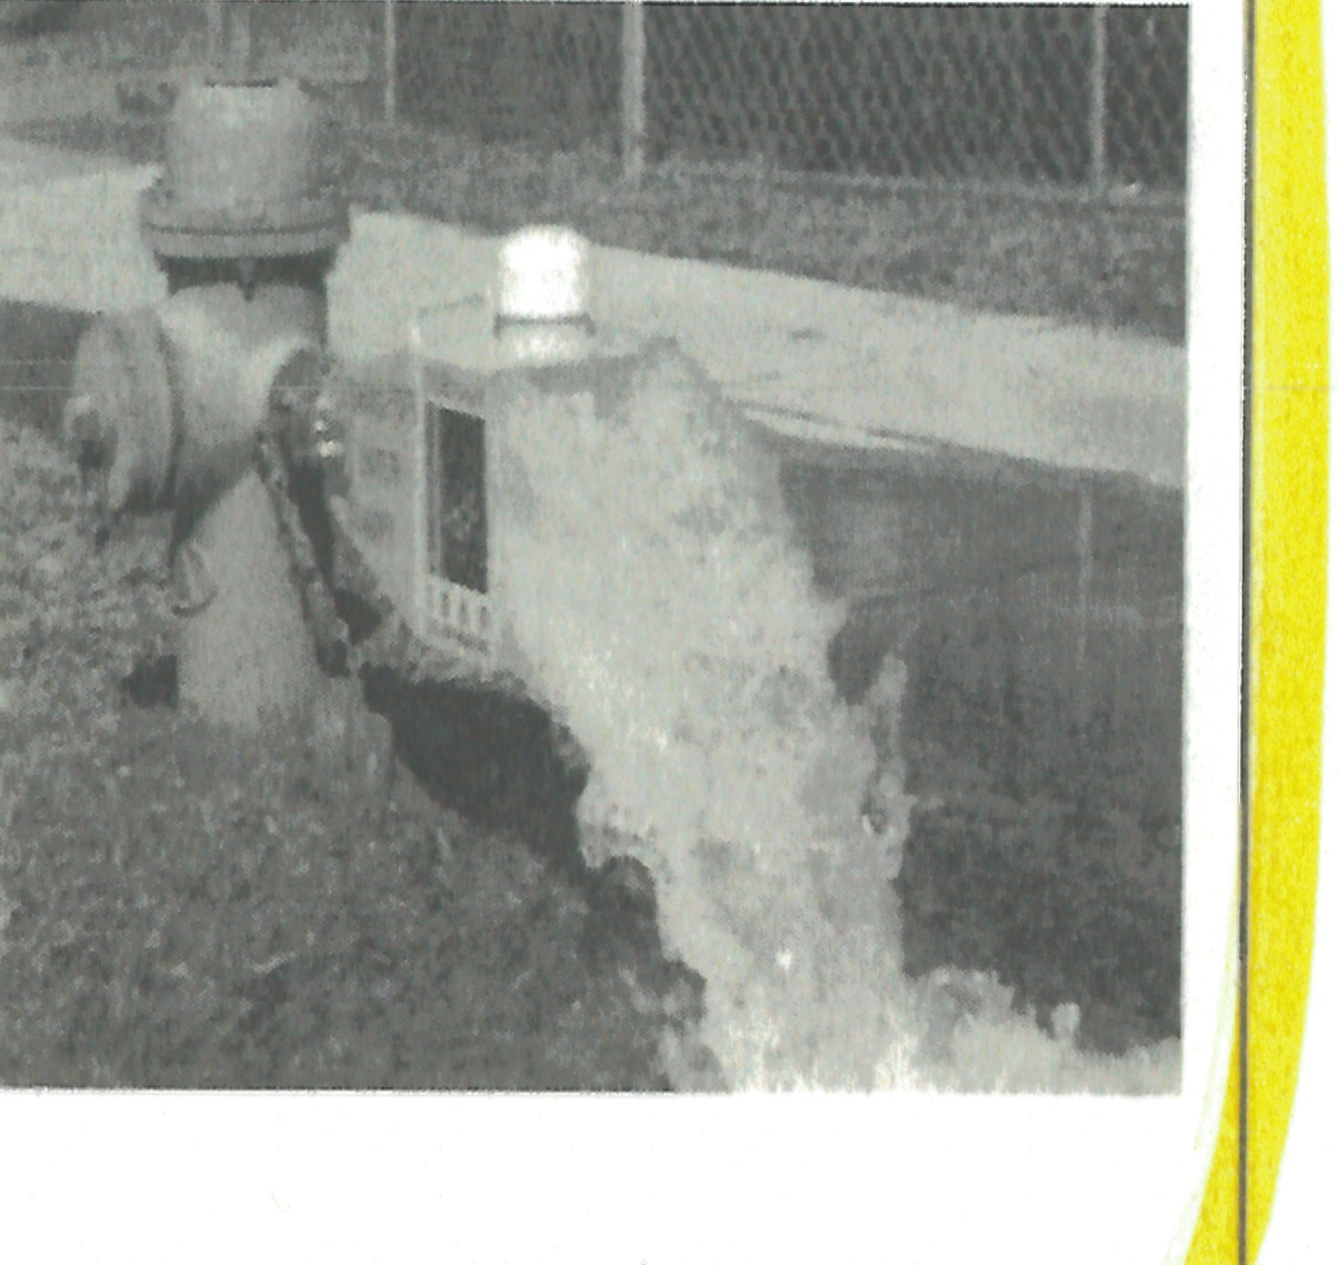
Flushing
Prior to disinfection, the main must be flushed at a minimum of 3 ft/sec (scouring velocity)
High velocity needed to remove dirt, sand & debris
Flush long enough to remove 2 - 3 times the pipe volume of water

Slide 133

Leakage Formula for DI and PVC
L = allowable leakage in gallons per hour (gph)
S = length of pipe in feet (ft)
D = diameter of pipe in inches (in)
P = average test pressure (psi)

Slide 134
Final Connection to Existing Mains
Mains and appurtenances used to make the final connection to existing mains must be flushed, disinfected and sampled
Connections less one pipe length ( ≤ 20 ft)
May be sprayed or swabbed with Cl2 solution
Connections greater than one pipe length ( ≥ 20 ft)
Set above grade and disinfected and sampled as previously discussed
After safe samples have been obtained, pipe can be used to connect new main to active distribution system

Slide 135
LEAD AND COPPER

Slide 136
Acronym Definition Slide
Pb=Lead
Cu = Copper
S0₄ = Sulfate
C1 = Chloride
LCR = Lead and Copper Rule
CCT = Corrosion Control Treatment
OCCT = Optimized Corrosion Control Treatment

Slide 137
Determining the Difference
Color/Appearances
Copper Color
Bright or Dull Gray
Rust
Magnetic Properties
  Copper & Lead - No Magnetic Attraction
  Galvanized - MAY Have Magnetic Attraction
Scratch Test
  Scratch with Screwdriver or File
  May Not be Acceptable with Homeowner
  *Note - A little bit of paint may result in changes in appearances or magnetic properties.

Slide 138
Problem 1-Calculating 90th percentile
SAMPLE # | LEAD CONCENTRATION (mg/L)
1 | 0.001
2 | ND
3 | 0.002
4 | 0.223
5 | 0.070
6 | ND
7 | ND
8 | ND
9 | 0.122
10 | 0.013
What is the 90th percentile. Concentration for lead based on these values?
Are the results in compliance with the action level?

Slide 139
Action Level Exceedance for Lead
When an Action Level is exceeded for Lead, supplies must do the following:
    Return to standard monitoring
    Conduct source water monitoring
    Sample water quality parameters
        pH (taken in the field), water temperature (taken in the field), alkalinity, calcium, conductivity, orthophosphate or silicate (if applicable), chloride, sulfate
    Distribute Public Advisory - within 3 business days
    Distribute Public Education - within 60 days of the end of the monitoring period
    Distribute Consumer Notice of Lead {and Copper) - 30 days from receipt of result
    Corrosion Control Plan {study, install, and demonstrate)
        Failure to perform/complete one element results in a Treatment Technique Violation
    Report the exceedance on the Consumer Confidence Report
    Lead Service Line replacement - at a rate of 7% per year if exceeder already has OCCT.

Slide 140
ETHICS

Slide 141
Ethics Violations - Misrepresentation
Sample collection
  Chlorinating sample
  Microwaving sample
  Different site used than documented
  Dilution of sample
Certification
  Impersonation as a certified operator
  Misrepresentation of education or job description on applications

Slide 142
Ethics Violations - Falsification
Sample collection
  Wrong sampling data
  Recording fake data
Certification
  Falsification of an application
  Falsified operator certificate
  Falsified CEC slip

Slide 143

Thank You
Presentation name and date
1

